Slide 1

Compensation for Incapacity
Accurate and Timely Payment
Of Workers’ Comp Benefits

Slide 2

Payment with Prejudice
Order or award of compensation.
OR
Employer/Insurer accepts the claim.
  MOP Box 20(A)
Creates a compensation payment scheme.
Notes:
Compensation payment scheme means the procedure whereby an employer is required to provide compensation or other benefits under the Act to an employee. Explain that “with prejudice” means there is basically no opportunity to reduce or discontinue benefits without an order from the Board (unless the employee RTW and then they can reduce or discontinue under 205.9.A), and that MOP box 20-B affords the opportunity to proceed with payment of the claim as if it was accepted without forfeiting the opportunity reduce or discontinue benefits without an order from the Board (unless the employee RTW and then they can reduce or discontinue under 205.9.A).

Slide 3
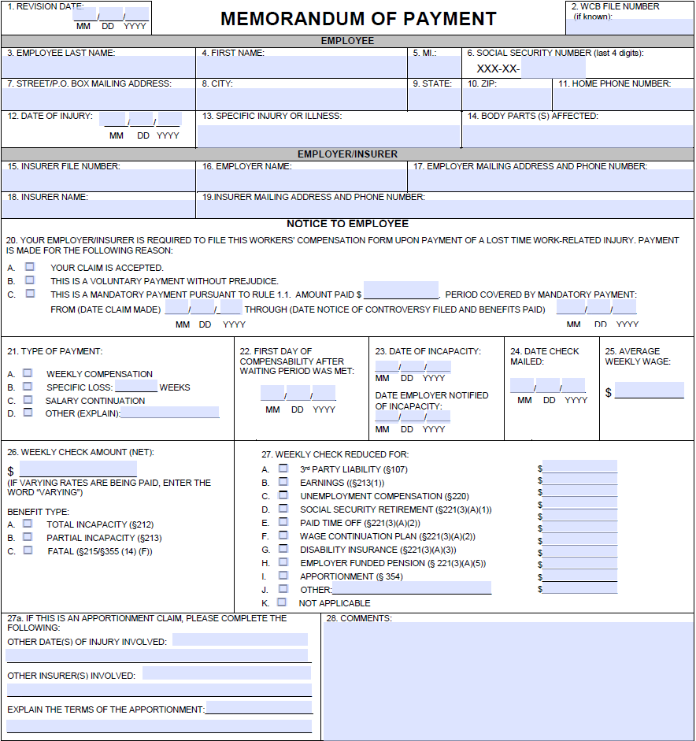
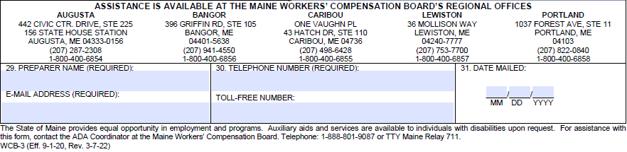

Slide 4
Section 204: Waiting period; when compensation payable
Compensation for incapacity to work is not payable for the first 7 days (exception – Firefighters)
Total incapacity – waiting period met after 7 consecutive days (regardless of wage loss).
In a broken period of incapacity, the waiting period may be determined by wages lost, or by benefits lost.

Slide 5
Waiting period
When compensation payable
AWW Method
  Waiting period is met when the injured employee loses earnings equal to the employee’s pre-injury AWW.
Comp Rate Method
  Waiting period is met when the injured employee’s accrued weekly benefits are equal to the employee’s WCR.
The first day of compensability (MOP box 22) is the first day lost earnings exceed AWW (AWW method), or first day accrued benefits exceed WCR (Comp Rate method).

Slide 6
Waiting period
When compensation payable
In a broken period of incapacity, it is acceptable to use the last day of the pay week in which the waiting period is exceeded as the first day of compensability (MOP box 22).
The waiting period is payable when lost earnings have exceeded 2 x AWW (AWW method), or accrued benefits exceed 2 x WCR (Comp Rate method).

Slide 7
Waiting period; when compensation payable
Example:
  DOI 3/14/16 – RTW limited duty
  Pay period Sunday – Saturday
  Pre-injury AWW $750 / WCR $500.00
  Post-injury actual earnings $450 / WCR $300.00
  Partial rate = ($750.00 - $450.00) x 2/3 = $200.00

Slide 8
Waiting period; when compensation payable (AWW Method)
AWW=$750.00 WCR=$500.00
First day of compensability (MOP Box 22): 4/2/16
Pay Period | AWW | Earnings | Lost Earnings | Cumulative Lost Earnings
3/13-3/19/16 | 750.00 | 450.00 | 300.00 | 300.00
3/20-3/26/16 | 750.00 | 450.00 | 300.00 | 600.00
3/27-4/2/16 | 750.00 | 450.00 | 300.00 | 900.00 | WP MET
4/3-4/9/16 | 750.00 | 450.00 | 300.00 | 1200.00

Slide 9
Waiting period; when compensation payable (WCR Method)
AWW=$750.00 WCR=$500.00
First day of compensability (MOP Box 22): 4/2/16
Pay Period | Partial Weekly Benefit Rate | Cumulative Partial Weekly Benefit Rate
3/13-3/19/16 | 200.00 | 200.00
3/20-3/26/16 | 200.00 | 400.00
3/27-4/2/16 | 200.00 | 600.00 | WP MET
4/3-4/9/16 | 200.00 | 800.00

Slide 10
Waiting period; when compensation payable
In case incapacity continues for more than 14 days, compensation is allowed from the date of incapacity.
Must pay for the waiting period.

Slide 11
Waiting period – when payable
(AWW Method)
AWW $750.00 - 2 x AWW $1500.00
Pay Period | AWW | Earnings | Lost Earnings | Cumulative Lost Earnings
3/13-3/19/16 | 750.00 | 450.00 | 300.00 | 300.00
3/20-3/26/16 | 750.00 | 450.00 | 300.00 | 600.00
3/27-4/2/16 | 750.00 | 450.00 | 300.00 | 900.00 | WP MET
4/3-4/9/16 | 750.00 | 450.00 | 300.00 | 1200.00
4/10-4/16/16 | 750.00 | 450.00 | 300.00 | 1500.00
4/17-4/23/16 | 750.00 | 450.00 | 300.00 | 1800.00 | 14 DAYS
4/24-4/30/16 | 750.00 | 450.00 | 300.00 | 2100.00 | 200.00

Slide 12
Waiting period – when payable
(WCR Method)
WCR $500.00 - 2 x WCR $1000.00
Pay Period | Partial Benefit Rate | Cumulative Partial Benefits
3/13 - 3/19/16 | 200.00 | 200.00
3/20 - 3/26/16 | 200.00 | 400.00
3/27 – 4/2/16 | 200.00 | 600.00 | WP MET
4/3 - 4/9/16 | 200.00 | 800.00
4/10 - 4/16/16 | 200.00 | 1000.00
4/17 - 4/23/16 | 200.00 | 1200.00 | 14 DAYS
4/24 - 4/30/16 | 200.00 | 1400.00

Slide 13
Benefit payment
Section 205 and Rule 1.1
The first payment of compensation is due and payable within 14 days of notice or knowledge of a claim for incapacity or death benefits, on which date all compensation then accrued must be paid.
In the previous example, the first day of compensability after the waiting period is met is 4/2/16 (8th day); first payment due 4/8/16.

Slide 14
Benefit payment
Section 205 and Rule 8.4
Subsequent incapacity payments must be made weekly (every 7 days) and directly to the employee entitled to that compensation at that employee’s last known mailing address, or at any place that employee designates.
Notes:
Discuss provisional payments may be required. Also discuss that weekly means every 7 days, not 6 days and then 8 days unless there is a Holiday.

Slide 15
Discontinuance or reduction of payments
Section 205.9 and Rule 8.11
Section A – employee must return to work with the employer of injury.
Reductions and discontinuances must be based on the employee’s actual earnings unless the employee returns without restrictions or limitations.

Slide 16
Discontinuance or reduction of payments
Section 205.9
Section B – all circumstances other than the employee’s return to work with the employer of injury.
  Payment without prejudice (voluntary payment) – must file WCB-8.
  Payment with prejudice (order or award of compensation or compensation payment scheme) – must petition the Board.

Slide 17
Discontinuance or reduction of payments
Section 205.9 and Rule 8.15
RTW with a different employer and employer/insurer is filing a 21-day certificate of discontinuance/reduction (WCB-8):
  The employer/insurer must include, with the 21-day certificate, form WCB-231A (Employee’s Return to Work Report)
  Within 14 calendar days after the expiration of the 21-day period, or 14 days after receipt of the documentation from the employee (if received after expiration of the 21 day period), file with the Board the documentation received along with an amended 21-day certificate, which shall also include any necessary adjustments based on that documentation.
Notes:
Make it clear that only clerical corrections that do not affect the employee’s rights are accepted (i.e. box 22).

Slide 18
Discontinuance or reduction of payments
Examples
RTW with the employer of injury
  Jane $600 AWW / RTW earning $620
    WCB-4 Discontinuance (with or without restrictions or limitations)
  Julie $600 AWW / RTW no restrictions or limitations earning $560
    WCB-4 Discontinuance (maintain proof of full duty release on file)
  Janice $600 AWW / RTW with restrictions or limitations earning $560
    WCB-4 Modification (to partial)
    If reduced earnings are strictly due to economic conditions (i.e. overtime no longer available), may discontinue with a WCB-8
  Joslyn $600 AWW / RTW without restrictions or limitations according to her treating health care provider, but there are conflicting medical records from another health care provider with respect to the lack of restrictions or limitations, earning $560
    WCB-8 (21 Day) Discontinuance

Slide 19
Discontinuance or reduction of payments
Examples (continued)
RTW with the employer of injury
  Judy $600 AWW / RTW earning $560 because she chooses not to work optional overtime which she worked prior to the injury
    If RTW was with restrictions or limitations, WCB-8 (21 Day) Discontinuance
    If RTW was with no restrictions or limitations, WCB-4 Discontinuance (maintain proof of full duty release on file)
RTW with a different employer
  Joyce $600 AWW / RTW with different employer and with restrictions or limitations earning $560
    WCB-8 Modification (to partial)

Slide 20
Discontinuance or reduction of payments
Examples (continued)
Concurrent employment
Jean $600 AWW with ER of injury; $300 AWW with concurrent ER, RTW earning $620 with ER of injury and $320 with concurrent ER
  If RTW was with restrictions or limitations, WCB-8 (21 Day) Discontinuance (must be at combined AWW with ER of injury to discontinue with WCB-4)
  If RTW was with no restrictions or limitations, WCB-4 Discontinuance (maintain proof of full duty release on file)
Jill $600 AWW with ER of injury; $100 AWW with concurrent ER, RTW earning $720 with ER of injury and $50 with concurrent ER
    WCB-4 Discontinuance (with or without restrictions or limitations)
    Same if there is NO RTW with concurrent employer, as she is earning above combined AWW with ER of injury

Slide 21
How Do We Discontinue?
John has a full duty release, but upon his return to work he is fired.
  -WCB-8 (21-Day) Discontinuance
Jim has a full duty release, but refuses to return to work.
  -WCB-8 (21-Day) Discontinuance
Jason is released to regular duty on Monday 10/1/18, but takes vacation pay for the week and returns on Monday 10/8/18.
  -WCB-4 Discontinuance per new rule 8.11.2.C.
Jerry is unable to work and receiving TTD. He dies 10/1/16, the cause of death is not related to the work-related injury.
  -WCB-4 Discontinuance

Slide 22
Maximum benefit levels
Section 211
Adjusted annually on July 1 – adjust on that day. File a modification.
  Penalty may apply if benefit is not timely adjusted
Date of Injury 1/1/13 – 12/31/19: 100% of the state average weekly wage as determined by the Department of Labor. DOIs 1/1/20 and after: 125% of SAWW.
If new max rate > employee’s own rate, pay employee’s own rate.

Slide 23
Compensation for total incapacity
Section 212
Weekly Compensation Rate (WCR) is two-thirds of the AWW (AWW divided by three times two).
If the employee is totally incapacitated for only part of the pay week, pay benefits based on lost earnings for the pay week.
Maximum benefit rate applies.

Slide 24
Title 39-A, Section 212
Compensation for Total Incapacity
“…while the incapacity for work resulting from the injury is total, the employer shall pay the injured employee a weekly compensation equal to 2/3 of the employee's gross average weekly wages, earnings or salary, but not more than the maximum benefit under section 211. Compensation must be paid for the duration of the incapacity.”

Slide 25
Title 39-A, Section 213
Compensation for Partial Incapacity
“While the incapacity for work is partial… weekly compensation is equal to 2/3 of the difference, due to the injury, between the employee's average gross weekly wages, earnings or salary before the injury and the average gross weekly wages, earnings or salary that the employee is able to earn after the injury, but not more than the maximum benefit under section 211.”

Slide 26
Compensation for partial incapacity
Section 213 and Rule 8.8
Benefit = AWW minus earnings times two-thirds
- or -
Deduct WCR on earnings from WCR based on AWW (2/3 of AWW minus 2/3 of earnings)
Maximum benefit rate applies

Slide 27
Compensation for partial incapacity
Section 213 and Rule 8.8
Things to remember:
  Employers should be notified of their obligation to promptly furnish all post-injury information necessary to facilitate timely indemnity payments (need weekly information even if the pay cycle is different).
  Match benefit calculations to the employer’s pay cycle.
  There is no such thing as a partial week of partial benefits.
Notes:
Reference the Recordkeeping Requirements under the Fair Labor Standards Act (FLSA). To be compliant with FLSA, the employer must maintain total hours and wages for each workweek.

Slide 28
Modifications from Total to
Partial or Partial to Total
When an employee is both partially and
totally incapacitated in the same payroll week, calculate the benefit due for that
week per Section 213 of the Act only.
Partial Benefit due = AWW minus earnings times 2/3
Notes:
Explain that you always calculate TPD benefits for the whole week, not just for the days where TTD was not paid.

Slide 29
Modifications from Total to
Partial or Partial to Total
  Example 1:
  John is injured 3/5/16, no loss of earnings in w/e 3/5/16
  Pay period Sunday – Saturday
  Pre-injury AWW $750 /WCR $500
  OOW 3/5 - 3/16/16, RTW 3/17/16 with restrictions
  Post-injury actual earnings $300

Slide 30
Modifications from Total to
Partial or Partial to Total
March 2016 Sun | Mon | Tue | Wed | Thu | Fri | Sat
 |  | 1 | 2 | 3 | 4 | 5 DOI - No loss of earnings
6 TTD | 7 TTD | 8 TTD | 9 TTD | 10 TTD | 11 TTD | 12 TTD
13 TTD | 14 TTD | 15 TTD | 16 TTD | 17 TPD | 18 TPD | 19 TPD

Slide 31
Modifications from Total to
Partial or Partial to Total
Example (cont.)
  Pre-injury AWW $750 / WCR $500
  Out of work 3/5 - 3/16/16, returns light duty 3/17/16
    No lost earnings in w/e 3/5/16, no benefits due
    No earnings in w/e 3/12/16, total benefits due (2/3 AWW = $500.00)
      Waiting period, do not pay yet
  Pay partial benefits for week ending 3/19/16

Slide 32
Modifications from Total to
Partial or Partial to Total
Example (cont.)
  Pre-injury AWW $750 / WCR = $500
  Post-injury weekly earnings $300 / WCR = $200
  ($750 - $300) = $450 x 2/3 = $300
  Compensation payable for the w/e 3/19 = $300.00
  Note WP was met the prior week

Slide 33
Modifications from Total to
Partial or Partial to Total
Example 2:
Jack is Injured 4/6/16, earns $450 for w/e 4/9/16
  Pay period Sunday - Saturday
  Pre-injury AWW $1050 / WCR $700
  OOW 4/6/16 - 4/14/16, RTW 4/15/16 with restrictions
  Post-injury actual earnings $480/week

Slide 34
Compensation for partial incapacity
Section 213 and Rule 8.8
April 2016 Sun | Mon | Tue | Wed | Thu | Fri | Sat
 |  |  |  |  | 1 | 2
3 | 4 | 5 | 6 DOI TTD | 7 TTD | 8 TTD | 9 TTD
10 TTD | 11 TTD | 12 TTD | 13 TTD | 14 TTD | 15 TPD | 16 TPD
17 TPD | 18 TPD | 19 TPD | 20 TPD | 21 TPD | 22 TPD | 23 TPD

Slide 35
Modifications from Total to
Partial or Partial to Total
Example 2 (cont.)
  Pre-injury AWW $1050 / WCR $700
  Earnings w/e 4/9 $450 / WCR $300
    Partial benefit = ($1050 - $450) x 2/3 = $400
  Earnings w/e 4/16 and ongoing $480 / WCR $320
    Partial benefit = ($1050 - $480) x 2/3 = $380
  WP met 4/12, 1st day of compensability 4/13
  Initial payment due 4/19 – pay $780.00 accrued benefits less $700.00 for waiting period.

Slide 36
Modifications from Total to
Partial or Partial to Total
Example 2 (cont.)
  Be sure to pay for the waiting period in addition to TPD in the week the incapacity continues for more than 14 days (2 x WCR).

Slide 37
Waiting period; when compensation payable
Example 2 Calculations (cont.)
WCR = $700.00, 2 x WCR = $1400.00)
 | Weekly Benefit Rate | Cumulative Partial Weekly Benefit Rate | Benefit Due | Notes
4/3/16 - 4/9/16 | 400.00 | 400.00 | 0 | WP not met
4/10/16 - 4/16/16 | 380.00 | 780.00 | 80.00 | $780 minus $700.00(WP)
4/17/16 - 4/23/16 | 380.00 | 1160.00 | 380.00 | Weekly partial benefit
4/24/16 - 4/30/16 | 380.00 | 1540.00 | 1080.00 | $700.00(WP) + $380 partials
5/1/16 - 5/7/16 | 380.00 | 1920.00 | 380.00 | Weekly partial benefit

Slide 38
Specific Loss Benefits
Section 212.3
Compensation for actual loss of certain body parts
The incapacity is considered to continue from the loss of the body part to the end of the specified period
Compensation from the date of injury until the loss of the limb does not count toward the specified period (Scott v Fraser Papers, Inc. – Maine Supreme Judicial Court, 2013)
Incapacity beyond the specified period is compensable, even if the employee had returned to work, with no offset for those earnings

Slide 39
Specific Loss - example
John injured his hand at work and went out on TTD, and four weeks later had his index finger amputated as a result of that injury. Six weeks following the amputation, he returned to work full duty. The specific loss period would begin at the date of the amputation (not the date of injury) and continue for the specified period (38 weeks), even though he returned to work within the 38 week period. If he was then taken out of work after the 38 week period for that same injury, it would be treated as a new period of incapacity, with no offset for the earnings or benefits he had within that 38 weeks. If the employee did not return to work within the specific loss period, a WCB-4 Modification should be filed to change from specific loss benefits to weekly compensation at the expiration of the 38 weeks.

Slide 40
Recovery of Overpayments
Overpayments of benefits paid to the injured employee in error may only be recovered by requesting a return of the overpayment, in writing, and advising the injured employee that any such return of benefits is voluntary on their part.
Overpayments may NOT be recovered by unilaterally taking a credit or “holiday” against future benefits, nor by requesting a return of the overpayment without indicating it is voluntary.

Slide 41
Earnings Offsets
Sick Pay vs Vacation/PTO
The employee’s compensation for incapacity is subject to an offset for sick pay as a wage continuation plan (Section 221)
Vacation pay is not subject to offset
“Paid time off” that is not distinguishable between sick and vacation/personal time is subject to offset per recent legislation

Slide 42
Coordination of Benefits
Section 221
Old-age insurance benefit payments under the United States Social Security Act
Offset of 50% of social security benefits received
No offset if SS benefits began prior to date of injury, or if spouse’s benefits
No additional offset for SS COLA increases after benefits are coordinated
Offsets do not apply to specific loss benefits
File a WCB-4 Modification of Compensation

Slide 43
Coordination of Benefits
Section 221
Employer – paid disability or wage continuation plan
Also applies to some PTO plans per new legislation
Offset of 100% of the after tax amount of the payments, proportional offset if employee contributed to the plan
No additional offset for increases after benefits are coordinated
Offsets do not apply to specific loss benefits
File a WCB-4 Modification of Compensation

Slide 44

QUESTIONS???

