Slide 1

Adjuster 201 Training
The Dispute Resolution Team

Slide 2
Training Objectives
Average Weekly Wage Refresher
Tracking towards the waiting period
Hypotheticals

Slide 3
Average Weekly Wages (AWW), earnings or salary §102(4)
Apply each method in order. If one does not apply move to the next. If neither A/B/C produce a “fair and reasonable AWW”, use method D.
Method A. Regular workweek and consistent earnings, or salary.
Method B. Irregular workweek or employed less than 200 workdays.
Method C. Seasonal employment.
Method D. “fallback provision, applicable when none of the forgoing methods can be reasonably and fairly applied”

Slide 4
AWW §102(4): Method A
Method A. Regular workweek and consistent earnings, or salary.
Must have worked at least 200 full working days.
Not applicable to employees whose wages during that year have generally varied from week to week. Move to subsection B.
The amount that the Employee was receiving at the time of the injury for the hours and days constituting a regular full working week.

Slide 5

AWW §102(4): Method B
Method B. Use for employees whose wages during that year have generally varied from week to week.
When the employment or occupation did not continue pursuant to paragraph A for 200 full working days.
Do not include earnings from the week-of-injury if they reduce the AWW.
Do not include earnings from the week-of-hire if they reduce the AWW.
For weeks with no earnings, list on the Wage Statement with “0”.
The entire amount of wages or salary earned by the injured employee during the immediately preceding year divided by the total number of weeks, any part of which the employee worked during the same period.

Slide 6
AWW §102(4): Method C
Method C. Includes any employee who is employed directly in agriculture or in the harvesting or initial hauling of forest products, regardless of weeks worked.
All others who work (seasonally) no more than 26 weeks per year.
Include earnings from all employment.
Do not use if employee was not seasonal in the previous calendar year.
Gross earnings for the prior calendar year divided by 52 weeks.

Slide 7
AWW §102(4): Method D
Method D. For situations where Methods A/B/C can not be reasonably and fairly applied. Commonly referred to as the fallback provision.
Consider the previous wages, earnings or salary of the injured employee and of other employees of the same or most similar class working in the same or most similar employment in the same or neighboring locality.
Provide at least 2 comparable wages statements.
If needed, use Employers outside of your business to best represent a fair and reasonable wage.
The ultimate goal is to calculate an AWW that is “fair and reasonable”.

Slide 8
Concurrent Wages: §102(4)(E)
“When the employee is employed regularly in any week concurrently by 2 or more employers, for one of whom the employee works at one time and for another of whom the employee works at another time, the employee’s average weekly wages are computed as if the wages, earnings, or salary received by the employee from all such employers were wages, earnings or salary earned in the employment of the employer for whom the employee was working at the time of the injury.”

Slide 9
When Should Fringes Be Included?
If the claimant’s fringe benefits end during their incapacity period, the fringe value must be considered in the AWW.
Analyze the fringe benefit worksheet when first received from the employer. Some employers do not understand the cost should be broken down into a weekly amount. If something looks off, check with the employer to confirm.
  Do this at the beginning of the claim when the information is easily accessible.
Pension contributions are typically written as a percentage. Multiply the percentage listed on the fringe worksheet by the AWW to determine a weekly value.

Slide 10
Fringe Benefits: §102(4)(H)
“Average weekly wages, earnings or salary” does not include any fringe or other benefits paid by the employer that continue during disability. Any fringe or other benefits paid by the employer that does not continue during the disability must be included for purposes of determining an employee’s average weekly wage to the extent that the inclusion of the fringe or other benefit will not result in a weekly benefit amount that is greater than 2/3 of the state average weekly wage at the time of the injury.
The limitation on including discontinued fringe or other benefits only to the extent that such inclusion does not result in a weekly benefit amount greater than 2/3 of the state average weekly wage at the time of injury does not apply if the injury results in the employee’s death.

Slide 11
Fringe Benefits: §102(4)(H) (Cont.)
For injuries occurring on or after 01/01/2020, any fringe or other benefit paid by the employer that does not continue during the disability must be included for purposes of determining an employee’s average weekly wage to the extent that the inclusion of the fringe or other benefit will not result in a weekly benefit amount that is greater than 2/3 of 125% of the state average weekly wage at the time of injury.
The limitation on including discontinued fringe or other benefits only to the extent that such inclusion does not result in a weekly benefit amount greater than 2/3 of 125% of the state average weekly wage at the time of injury does not apply if the injury results in the employee’s death.

Slide 12
Tracking the
Waiting Period(Example)
Jayne Doe works fulltime for Stars Hollow Grocer in the produce department. Her job duties include unloading daily produce shipments from the truck, restocking produce on the sales floor, and confirming expiration dates. On the date of injury, Jayne was unloading shipments from the truck onto a dolly to bring into the stock room. She lifted a box full of gourds, estimated to weigh around 50 pounds. She had to twist awkwardly to place the box onto her dolly. While performing these tasks, she felt a pop in her lower back, causing instant pain.
The Employee was seen by the 10-day provider and given work restrictions, which can be accommodated by the Employer. However, the Employer’s sedentary light duty assignment is not consistent, causing a potential wage loss.
Janye’s Average Weekly Wage is $720.00, with a compensation rate of $480.00.
Jayne does have Employer paid fringe benefits. Fringes are paid by the Employer during the incapacity period.
The insurance adjuster will need to obtain weekly post-injury earnings to track towards the 7-day waiting period to determine when benefits are owed.

Slide 13
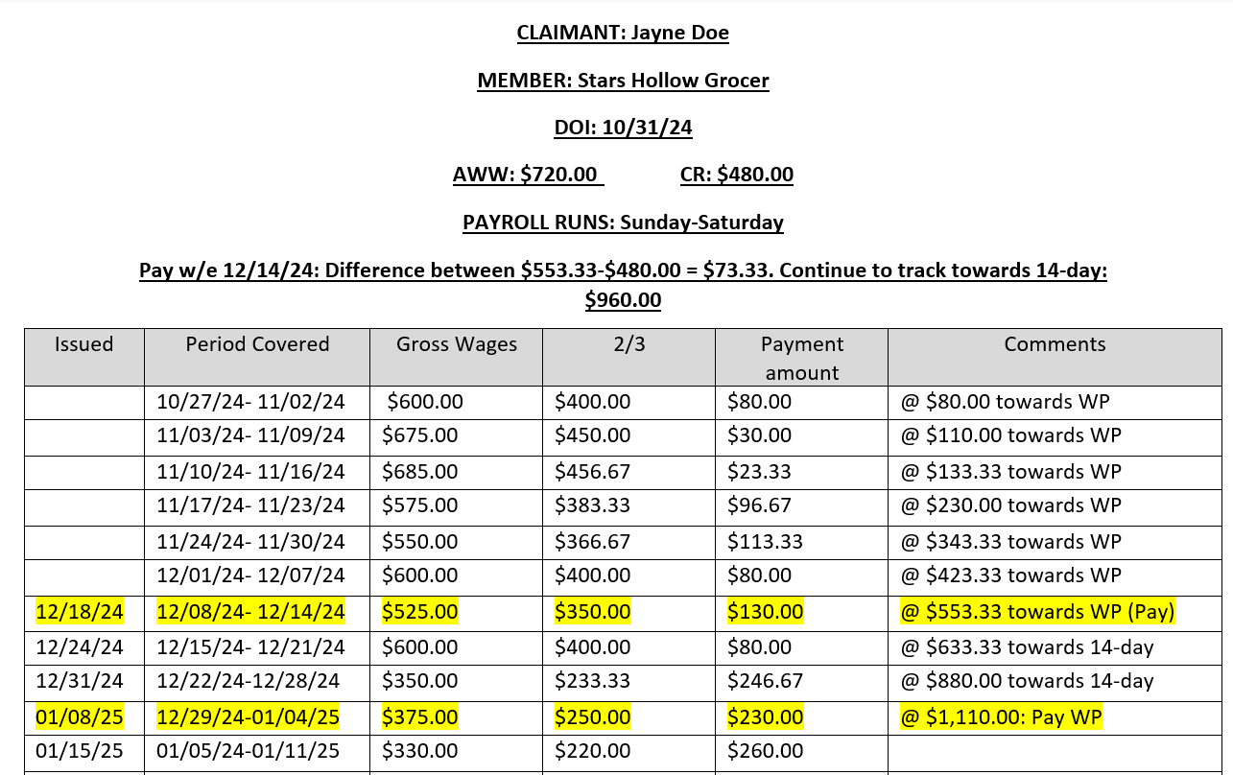
Tracking Towards the Waiting Period(Example)

Slide 14


Hypotheticals

Slide 15
John Doe v. Mega Lo Mart
Change In Occupation Example
Mr. Doe works for the Mega Lo Mart grocery store as a clerk.
He makes $12.43/hour, working 18-30 hours per week.
After 90 days, Mr. Doe receives a promotion to produce manager.
The new rate of pay is $26/hour, and he is now working 40 hours per week.
Mr. Doe was injured after his rate of pay and hours increased for the Employer of injury.

Slide 16


Breakout Room & Poll
Notes:
1. Would the change in occupation affect the Average Weekly Wage? In what way?

Slide 17
John Doe v. Superstore
Retroactive Increase In Pay Example
John Doe works as a forklift driver making $23/hour.
He was injured on 10/01/25.
On 12/01/25, Mr. Doe receives a $3/hour raise. Pursuant to contract negotiations, the raise is retroactive to 06/01/25.
How would the raise affect the Average Weekly Wage?

Slide 18
Breakout Room & Poll
Notes:
1. Should the retroactive pay increase be excluded from the Average Weekly Wage?

Slide 19
Jane Doe v. Emerald City Plaza
Concurrent Seasonal Employment Example
Ms. Doe works full-time for the local hospital.
As a second job, she works summers as a cashier at Emerald City Plaza amusement park.
The summer job lasts around 14-weeks, from mid-June through Labor Day.
Ms. Doe received $3,377.00 for the entire concurrent employment period.
How would the concurrent employment affect the Average Weekly Wage?

Slide 20
Breakout Room & Poll
Notes:
1. What Average Weekly Wage calculation method should be used? A/B/C/D

Slide 21
Jane Doe v. Dunder Mifflin
Change In Employment Status
Example
Jane Doe worked full-time as a data entry specialist for Dunder Mifflin Paper Company.
Ms. Doe worked full-time for the company for five years before going out on maternity leave.
Once she returned from maternity leave, she voluntarily chose to move to a part-time position.
Ms. Doe was injured at work after the change in employment status from full-time to part-time.
How does the voluntary status change affect the employee’s Average Weekly Wage?

Slide 22
Breakout Room & Poll
Notes:
1. Would the Average Weekly Wage only be based on the part-time wages?

Slide 23
Jane Doe v. Haddonfield General Hospital
Fringe Benefit Example
Jane Doe works as a medical technician at Haddonfield General Hospital.
The hospital has a program that reimburses employees for college classes.
Ms. Doe regularly took courses and received $53.35 per week in reimbursement payments.
The college courses were not necessary for the employee’s job.
Ms. Doe was injured after starting the college course work.

Slide 24
Breakout Room & Poll
Notes:
1. Should the tuition reimbursement be considered a fringe benefit?

Slide 25
John Doe v. Wayfinder Airlines
Additional Fringe Benefit Example
John Doe works for Wayfinder Airlines as a ramp agent.
His hours vary widely week to week. His rate of pay is $15.60/hour.
In addition to his hourly rate, he receives some additional benefits:
  A clothing allowance.
  A rewards program.
  Profit sharing
  The ability to fly standby.
Mr. Doe was injured while employed by the airline.

Slide 26
Breakout Room & Poll
Notes:
1. Should the fringe benefit value of the standby flight be based on the cost of a normal flight ticket or the taxes the Employer paid for the seat?

