Slide 1

Medical Fee Schedule

Slide 2
Headlines
Annual update complete
Next periodic update will be undertaken in 2020

Slide 3
Essential Tools
Maine Workers’ Compensation Statute (39-A M.R.S.A.)
Maine Workers’ Compensation Medical Fee Schedule (Board Rules Chapter 5)
CPT Professional Edition
HCPCS Level II Professional Edition
Notes:
Much of the information in the books is copyrighted so we cannot share it.

Slide 4
Statutory and Regulatory References
39-A M.R.S.A. § 206
  Duties and rights of parties as to medical and other services; cost
39-A M.R.S.A. § 208
  Medical Information
39-A M.R.S.A. § 209-A
  Medical Fee Schedule
Notes:
DUTIES AND RIGHTS OF PARTIES AS TO MEDICAL AND OTHER SERVICES; COST
An employee sustaining a personal injury arising out of and in the course of employment or disabled by occupational disease is entitled to reasonable and proper medical, surgical and hospital services, nursing, medicines, and mechanical, surgical aids, as needed, paid for by the employer
MEDICAL FEE SCHEDULE
In order to ensure appropriate limitations on the cost of health care services while maintaining broad access for employees to health care providers in the State, the board shall adopt rules that establish a medical fee schedule setting the fees for medical and ancillary services and products rendered by individual health care practitioners and health care facilities…
This Chapter outlines billing procedures and reimbursement levels for health care providers who treat injured employees. It also describes the dispute resolution process when there is a dispute regarding reimbursement and/or appropriateness of care. Finally, this Chapter sets standards for health care reporting.
Effective 12-11-11.
Payment of bills for medical or health care services.
When there is no ongoing dispute, if bills for medical or health care services are not paid within 30 days after the carrier has received notice of nonpayment by certified mail from the provider of the medical or health care services or, if the bill was paid by the employee, from the employee who paid for the medical or health care services, $50 or the amount of the bill due, whichever is less, must be added and paid to the provider of the medical or health care services or, if the bill was paid by the employee, to the employee who paid for the medical or health care services for each day over 30 days in which the bills for medical or health care services are not paid.
Not more than $1,500 in total may be added pursuant to this subsection.

Slide 5
Statutory and Regulatory References
39-A M.R.S.A. § 209-A
  The Board shall adopt rules that establish a medical fee schedule setting the fees for medical and ancillary services.
Notes:
1.07.7 allows contracts

Slide 6
Board Rules Chapter 5
Outlines billing procedures and reimbursement levels for health care providers who treat injured employees.
Describes the dispute resolution process when there is a dispute regarding reimbursement and/or appropriateness of care.
Sets standards for health care reporting.

Slide 7
Board Rules Chapter 5
Section 1
General Provisions

Slide 8
Section 1.01 application
Applies to all treatment of a claimed work-related injury or disease.
Treatment does not include expenses related to managed care services such as utilization review, case management, and bill review or to examinations performed pursuant to 39-A M.R.S.A. §§ 207 and 312.

Slide 9
Section 1.02 payment calculation
Pursuant to 39-A M.R.S.A. § 209-A, the Board has adopted a medical fee schedule which reflects the payment methodology developed by the federal Centers for Medicare and Medicaid Services.

Slide 10
Section 1.02 payment calculation
The Board has not adopted all components used by the federal Centers for Medicare and Medicaid Services. Therefore, the application of any fee schedule, payment system, claims processing rule, edit or other method of determining the reimbursement level for a service(s) not expressly adopted in this chapter is prohibited.

Slide 11
Sections 1.03 and 1.04
Definitions
  You should be familiar with all the definitions.
Legal Disclaimers
  CPT copyright by AMA; we cannot share the CPT descriptions without paying significant royalties to the AMA.

Slide 12
Section 1.05 authorization
Nothing in the Act or these rules requires the authorization of medical, surgical and hospital services, nursing, medicines, and mechanical, surgical aids provided pursuant to 39-­A M.R.S.A. § 206.
An employer/insurer is not permitted to require pre-authorization of medical, surgical and hospital services, nursing, medicines, and mechanical, surgical aids provided pursuant to 39-­A M.R.S.A. § 206 as a condition of payment.

Slide 13
Section 1.06 billing procedures
Bills must specify:
  -the billing entity’s tax id,
  -the health care provider,
  -the employer,
  -the employee,
  -the date of injury/occurrence,
  -the date of service,
  -the work-related injury or disease treated,
  -the appropriate procedure code(s), and
  -the charges for each procedure code.

Slide 14
Section 1.06 billing procedures
Bills properly submitted on standardized claim forms prescribed by CMS (Forms CMS-1450 and 1500) are sufficient to comply with this requirement.
  Uncoded bills may be returned for coding. An uncoded bill is a bill with one or more required billing elements missing.

Slide 15
Section 1.06 billing procedures
Bills do not need to specify the claim number, revenue code, DRG, NDC and/or anything else that you would like to have but is not on the list of required billing elements.

Slide 16
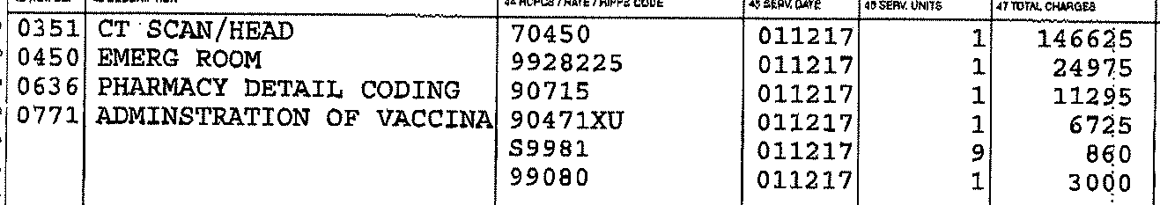
Uncoded bill?
The charges for copies of the medical records and for the completion of the M-1 form do not have revenue codes or descriptions associated with them.
  Should this bill be returned to the provider as an uncoded bill?

Slide 17
Uncoded bill?
This bill is not uncoded as revenue codes/descriptions are not required billing elements per the rules.
  Procedure codes S9981 and 99080 must be paid in accordance with the MFS.

Slide 18
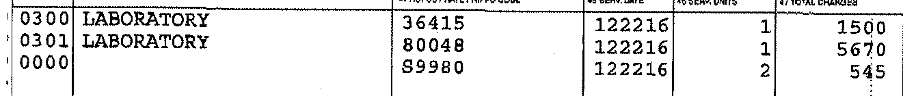
Uncoded bill?
Procedure code S9980 is not a valid code.
  Should this bill be returned to the provider as an uncoded bill?

Slide 19
Uncoded bill?
This bill is not uncoded as it does contain a procedure code (even if that procedure code is invalid).
  Per the rules, the ER/IR must pay the undisputed charges and file a partial denial disputing the charge for code S9980. The reason for the denial would be that the provider is billing with an invalid procedure code. A copy of the denial must be sent to the healthcare provider.

Slide 20
24-A M.R.S.A. § 2385.
3. Reimbursement. The deductible form must provide that the claim must be paid by the applicable insurer, which must then be reimbursed by the employer for any deductible amounts paid by the carrier. The employer is liable for reimbursement up to the limit of the deductible.

Slide 21
Section 1.06 billing procedures
Bills for insured employers must be submitted directly to the insurer of record on the date of injury/illness.
Health care providers shall attempt to verify the name of the insurer that wrote the workers’ compensation policy for the specific employer on the date of injury/illness prior to the submission of a bill to an insurer.

Slide 22
Notice of a claim
Board decision: Lewis Wilson v. Central Maine Towing, Inc. and The Phoenix Insurance Co.
  If a bill for medical services is received and accompanied by an M-1 and/or other medical information that identifies the time, place, cause and nature of the injury, the employer may be deemed to have knowledge of the injury.

Slide 23
Notice of a claim
Bills for covered employers should not be returned to the provider simply because the employer has failed to report the claim.

Slide 24
Section 1.06 billing procedures
  Health care providers may not bill or be paid for any missed appointments.
  A bill must be accompanied by health care records to substantiate the services rendered.

Slide 25
Health care records
  There could be federal privacy laws to consider regarding the re-disclosure of federally protected health information.

Slide 26
Section 1.07 reimbursement
Employee not liable for treatment of work-related injury or illness.
Changes to bills by employers/ insurers are not allowed.

Slide 27
Changes to provider bills
For example, you MAY NOT:
  Change the code submitted
  Pay a lower level of service
  Add a modifier not on the bill
  Etc.
  Etc.

Slide 28
Section 1.07 reimbursement
  The employer/insurer must pay the health care provider’s usual and customary charge or the maximum allowable payment under this chapter, whichever is less, within 30 days of receipt of a properly coded bill.

Slide 29
Definitions
Usual and customary charge
  The charge on the price list for the medical service that is maintained by the provider.
    Leanne Fernald v. Shaw’s Supermarkets, Inc. and William J. Babine v. Bath Iron Works

Slide 30
Definitions
Maximum Allowable Payment (MAP)
  The sum of all fees for medical, surgical and hospital services, nursing, medicines, and mechanical, surgical aids established by the Board pursuant to Chapter 5.

Slide 31
Section 1.07 reimbursement
When there is a dispute whether the provision of medical, surgical and hospital services, nursing, medicines, and mechanical, surgical aids is reasonable and proper, the employer/insurer shall pay the undisputed amounts, if any, and file a notice of controversy within 30 days of receipt.
A copy of the notice of controversy must be sent to the health care provider from whom the bill originated.

Slide 32
No NOC required
Not a covered employer
Bill uncoded per Section 1.06(1)
Bill not accompanied by health care records to substantiate the services rendered per Section 1.06(3)
Not using the prescribed form (e.g. M-1 form, facility charges or ambulatory surgical services not on a UB)
Bill paid per the fee schedule; e.g. OP Facility: Procedure codes with no CPT or with status N
Notes:
NOC required in all other circumstances!

Slide 33
Section 1.07 reimbursement
In cases where the underlying injury has been controverted or denied, a copy of the notice of controversy must be sent to each health care provider that submits or has submitted a request for payment within 30 days of receipt.
A health care provider, employee or other interested party is entitled to file a petition for payment of medical and related services for determination of any dispute regarding the provision of medical services.

Slide 34
Section 1.07 reimbursement
When there is a dispute whether a request for future medical, surgical and hospital services, nursing, medicines, and mechanical, surgical aids is reasonable and proper under § 206 of the Act, the employer/insurer must file a notice of controversy within 30 days of receipt of the request.

Slide 35
Requests for authorization
If you receive a request for authorization and the request is denied, you must file the denial electronically and send a copy of the NOC to the requestor.
Best practice is to advise the requestor that authorization is not required nor a guarantee of payment and the bill for services will be evaluated once it is received.
Notes:
If you go down the road of pre-authorizations, you have to abide by the rule otherwise, you just wait for the bill.

Slide 36
Section 1.07 reimbursement
Payment of a bill not an admission as to reasonableness of subsequent bills.
Nothing precludes payment agreements to promote quality of care and/or reduction of health care costs.
MFS applies to out of state providers treating injured employees under Section 206, i.e. Maine jurisdiction/claim.

Slide 37
Section 1.07 reimbursement
There are many modifiers that affect reimbursement.
  Like the definitions, you need to be familiar with all the modifiers that affect reimbursement.

Slide 38
Section 1.08 fees for reports/copies
Providers may bill for completing initial M-1 Form (prescribed form). The charge is to be identified by billing CPT® Code 99080.
Max fee for initial M-1 is $30.00.

Slide 39
Section 1.08 fees for reports/copies
Providers may charge for copies of HC records required to accompany their bills.
The charge is to be identified on the bill by billing CPT® Code S9981.
The maximum fee for copies is $5 for the first page and 45¢ for each additional page.

Slide 40
Section 1.08 fees for reports/copies
Providers may charge for paper or electronic copies of health care records or other written information requested.
Health care providers shall not require pre-payment unless the requesting party has an unpaid balance for previously requested information from the health care provider.
Health care providers shall not charge a fee for postage/shipping, sales tax, or a fee for researching a request that results in no records.

Slide 41
Section 1.09 fees for testimony
Providers may charge for preparing and attending depositions and hearings.

Slide 42
Section 1.10 expenses
Employer/Insurer must pay employee’s travel-related treatment expenses.
Travel-related expenses must be paid within 30 days of request.
Employer/Insurer must reimburse the employee’s out-of-pocket costs within 30 days.

Slide 43
Section 1.11 medical information
Authorization not required for information related to a claimed work-related injury or illness (unless required by law).

Slide 44
Section 1.11 medical information
Health care providers must, at the written request of the employer/insurer representative, furnish copies of health care records or other written information pertaining to a claimed workers’ compensation injury or disease.
Copies must be furnished within 10 business days from receipt of the written request. An itemized invoice must accompany the copies sent to the requestor.

Slide 45
Section 1.11 medical information
If the employer/insurer or employee representative contends that medical information pre-existing and subsequent to the workplace injury for which claim is being made is relevant to issues in the workers’ compensation case, it shall use Form WCB-220.

Slide 46
Section 1.11 medical information
In the event that the employer/insurer or employee representative contends that testing, treatment or counseling records related to psychological matters, HIV/AIDS, substance abuse, or sexually transmitted disease matters are relevant to issues in the workers’ compensation case, it may obtain such specific information as agreed upon by the represented parties. If the represented parties agree, the parties shall use Form WCB-220A, WCB-220B, or WCB-220C as appropriate.

Slide 47
Section 1.11 medical information
Within 14 calendar days the employee or the employee’s authorized representative shall sign the release and return it to the requesting party.

Slide 48
Section 1.11 medical information
All parties, including health care providers, shall only use Form WCB-220, WCB-220A, WCB-220B, or WCB-220C.
The use of forms other than the ones set forth in Appendix V and/or requiring additional forms is prohibited.

Slide 49
Section 1.11 medical information
Health care providers must furnish copies of the health care records within 30 calendar days from receipt of a properly completed Form WCB-220, WCB-220A, WCB-220B, or WCB-220C.

Slide 50
Section 1.11 medical information
If an employee who is being paid pursuant to a compensation payment scheme revokes a medical release using Form WCB-220R, the employer/insurer may file a Motion to Compel with the Administrative Law Judge assigned to the case.

Slide 51
Section 1.11 medical information
Nothing in the Act or these rules requires any personal or telephonic contact between any health care provider and a representative of the employer/insurer.

Slide 52
Section 1.11 medical information
Health care providers must complete the M-1 form set forth in Appendix I in accordance with 39-A M.R.S.A. § 208.
The use of any other form is prohibited and may subject the health care provider to penalty under 39-A M.R.S.A. § 360.

Slide 53
Quick Reference
Type of Service
Claim Form
Professional services
Inpatient facility fees
Outpatient facility fees
Other
Typically HCFA-1500
Must be on UB-04
Must be on UB-04
Varies

Slide 54
Claim forms
  The CMS-1500 form is the standard paper claim form used by physicians and suppliers.
  The CMS-1500 (aka HCFA-1500) form is NOT required. As long as a bill contains all the required billing elements, it is a valid bill.

Slide 55
Claim forms
The CMS-1450 (aka UB-04) form is the standard paper claim form used by institutional providers.
  This form is required for inpatient and outpatient hospital services and surgical procedures at an ambulatory surgical center.

Slide 56
Claim forms
  Some institutional providers may bill professional services on the UB-04.
    There is no requirement for professional services to be billed separately from facility services.

Slide 57
Quick Reference
Type of Service
Coding/Billing Systems
Professional services
Inpatient facility fees
Outpatient facility fees
Other
HCPCS for service/supplies
ICD for diagnosis
Revenue codes
ICD diagnosis and procedure codes
Revenue codes
HCPCS for service/supplies
ICD for diagnosis
Varies for service/supplies
ICD for diagnosis

Slide 58
Claim form elements
Revenue Code – Codes that identify the type of service.
  Used by institutional providers on the UB-04.
  Revenue codes are not a required billing element per Section 1.06.
  Revenue codes in the 96x, 97x and 98x series are professional fees.

Slide 59
Claim form elements
Healthcare Common Procedure Coding System (HCPCS) – a system that identifies medical procedures, pharmaceuticals, supplies, ambulance services, etc.
  HCPCS include CPT codes maintained by the AMA.

Slide 60
Claim form elements
International Classification of Diseases (ICD) – this is the official system of assigning codes to diagnoses (and procedures for inpatient hospital care).
  The Board did not mandate a specific version of ICD.

Slide 61
Quick Reference
Type of Service
Payment System
Professional services
Inpatient facility fees
Outpatient facility fees
Other
RBRVS
MS-DRGs, Percent of Charges (Specialty Hospitals)
APCs, Percent of Charges (Other Institutional Providers)
Varies

Slide 62
Definitions
Resource-Based Relative Value Scale (RBRVS) – measurement of the relative resource cost of providing individual physician services.
Medicare Severity Diagnosis Related Groups (MS-DRGs) – patients with similar characteristics and costs are assigned to these groups.
Ambulatory Payment Classifications (APCs) – outpatient services grouped by similar resources, costs and clinical characteristics.

Slide 63
Quick Reference
Type of Service
Reimbursement
Professional services
Inpatient facility fees
(ACH, CAH)
Outpatient facility fees (ACH, CAH, ASC)
Other
Section 2/Appendix II
(MAP v. charge on each line)
Section 3/Appendix III
(MAP v. total charges)
Section 4/Appendix IV
(MAP v. total charges)
No MAP
(defaults to 75% U&C charges)

Slide 64
Keys to accurate payment
Date of Discharge/Service - determines which MFS
Type of Service – determines which Appendix
    Professional services (Appendix II includes anesthesia, DMEPOS)
    Inpatient facility fees (Appendix III)
    Outpatient facility fees (Appendix IV)
Provider Type – determines which Column for facility fees
    ACH, CAH, ASC or other

Slide 65
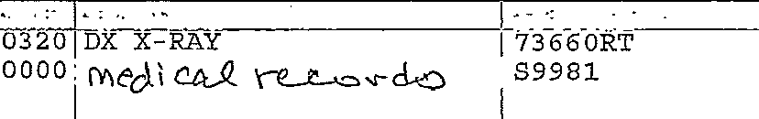
Type of service?

Slide 66
Keys to accurate payment
Professional fees – You compare the maximum per the fee schedule to the charge for each line.
Facility fees – You compare the maximum per the fee schedule to the total billed charges.

Slide 67
Top Reasons Bills are Paid Incorrectly
Procedures with modifiers not paid correctly
Outpatient facility bills paid by applying the “lessor-of” logic at the line level versus the bill level
Implants, medical records charges, and/or the charge to complete the M-1 form are not paid
Professional fee schedule applied to facility fees; i.e. using Appendix II rather than IV

Slide 68
Top Reasons Bills are Paid Incorrectly
Medicare logic applied versus the Maine WC fee schedule rules
Network discounts applied inappropriately
Facility or professional charges not paid for providers that split bill

Slide 69
Board Rules Chapter 5
Section 2
Professional Services

Slide 70
Section 2.01 payment calculation
Defines how professional fees are calculated. Conversion factor of $60.00 for all professional services.
Professional fees are published in Appendix II.

Slide 71
Section 2.02 E&M guidelines
New patient visit allowed when:
  An existing patient is being evaluated for a new injury/illness to determine work relatedness/causality
  An existing patient is being seen for a new episode of care for an existing injury/illness.

Slide 72
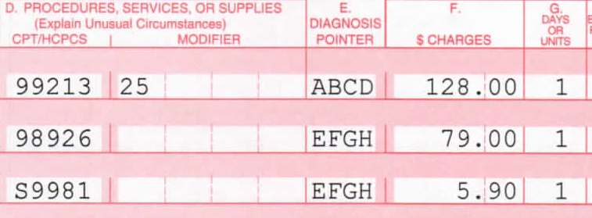
E&M example
Appendix II:
CPT | FEE
99213 | $126.60
98926 | $77.40

Slide 73
E&M example
S9981 is not in Appendix II. Per Section 1.08(3): The maximum fee for copies is $5 for the first page and 45¢ for each additional page, up to a maximum of $250.00.

Slide 74
E&M example
Amount Due = $126.60 + $77.40 + $5.00 = $209.00 (all MAPs less than charges).
  Units for S9981 should have been 3 (total number of pages) but provider didn’t bill correctly.

Slide 75
E&M example #2
Appendix II:
CPT | FEE
99203 | $181.80

Slide 76
E&M example #2
99080 not in Appendix II. Per Section 1.08(2): The maximum fee for preparing a narrative report or the initial M-1 shall be: Each 10 minutes: $30.00.

Slide 77
E&M example #2
Amount Due = $170.00 (charge less than MAP) + $30.00 (charge equals MAP) = $200.00.

Slide 78
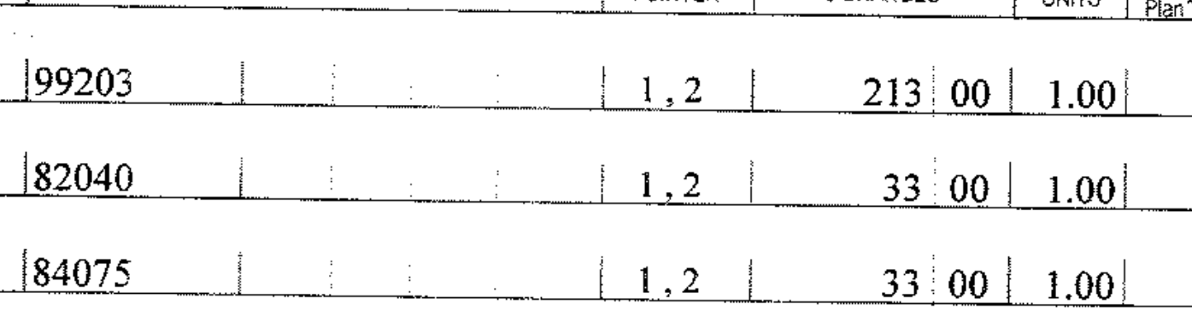
E&M example #3
Appendix II:
CPT | FEE
99203 | $181.80

Slide 79
E&M example #3
Amount Due:
  82040 and 84075 are valid codes that are not in Appendix II so they default to their usual and customary charge.
  $181.80 (MAP less than U&C charge)+ $33.00 + $33.00 = $247.80.

Slide 80
E&M examples
What if the employee was seen last month for a different injury; is a new patient visit code allowed?
  Per new MFS Section 2.02, a new patient visit code is allowed for the evaluation of a new injury.

Slide 81
E&M examples
What if the documentation only supports a level 2 new patient visit?
  Services may not be downcoded. Per MFS Section 1.07(2)(A), the undisputed charges must be paid and a denial filed with the Board. A copy of the partial denial/NOC Form must be sent to the health care provider.

Slide 82
Section 2.03 anesthesia guidelines
Reimbursement determined by the addition of the base unit in Appendix II, time units and modifying units (if any) and multiplying this total value by a conversion factor of $60.00 per unit.

Slide 83
Section 2.03 anesthesia guidelines
Health care providers must bill the number of minutes of anesthesia time.
  One time unit is allowed for each 15 minute time interval, or fraction thereof (7.5 minutes or more). If anesthesia time extends beyond three hours, 1.0 unit for each 10 minutes or significant fraction thereof (5 minutes or more) is allowed after the first three hours.

Slide 84
Anesthesia example
Board Rules and Regulations, Chapter 5:
  Base Unit = 5 per Appendix II
  Time Units = 1 per Section 2.03, Subsection 1.B.
Amount Due:
  5 Base Unit + 1 Time Unit = 6 Total Units
  6 Total Units X $60.00 = $360.00
  Modifier QX – pay at 50% = $180.00 (MAP less than U&C charge).
Notes:
QX Surgical Anesthesia: CRNA was medically directed by a physician (2, 3, or 4 concurrent procedures): pay 50% of the maximum allowable payment under this chapter.

Slide 85
Anesthesia example
By rule providers are to bill the number of minutes in box 24 G. This provider did not bill correctly and therefore was only paid for 20 minutes of anesthesia time rather than the full 3 hours and 41 minutes.

Slide 86
Section 2.04 surgical guidelines
When two or more surgical procedures are performed at the same session by the same individual, the highest weighted surgical code is paid at 100% of the fee listed in Appendix II and additional surgical procedures are paid at 50% of the fee listed in Appendix II. Add-on codes are not subject to discounting.

Slide 87
Surgical example
Appendix II:
CPT | WEIGHT | FEE
26525 | 18.99 | $1,139.40
26546 | 28.94 | $1,736.40
20694 | 12.25 | $735.00

Slide 88
Surgical example
Multiple surgical procedures : pay 100% of the maximum allowable payment under this chapter for the highest weighted surgical procedure; additional surgical procedures are paid at 50% of the fee.
Amount Due = $2,673.60 ($1,736.40+(.5($1,139.40+$735)).

Slide 89
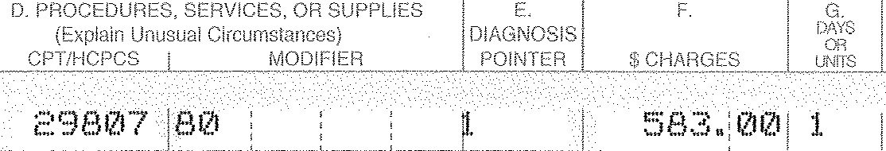
Surgical example #2
Appendix II:
CPT | FEE
29807 | $1,792.20

Slide 90
Surgical example #2
Modifier 80 Assistant Surgeon: pay 25% of the maximum allowable payment under this chapter.
Amount Due = .25 X $1,792.20 = $448.05 (MAP less than U&C charge).

Slide 91
Surgical example #3
50
Appendix II:
CPT | FEE
29807 | $1,792.20

Slide 92
Surgical example #3
50
Modifier 50 Bilateral Procedure: pay 150% of the maximum allowable payment under this chapter for both procedures combined.
Amount Due = $583.00 (U&C charge less than MAP (1.5 X $448.05 or $672.08).

Slide 93
Surgical examples
What if Medicare considers the surgery “incidental” or doesn’t allow an assistant surgeon for a particular procedure?
  Per MFS Section 1.02, “the application of any claims processing rule not expressly adopted in this chapter is prohibited.”
    If the ER/IR contends that the surgery and/or assistant was not reasonable/proper, it has to file a denial with the Board and send a copy of the NOC Form to the provider.

Slide 94
Section 2.05 DMEPOS
The employer/insurer must pay for all DMEPOS that are ordered and approved by the treating health care provider.
Fees for DMEPOS are as outlined in Appendix II. Invoices need not be requested by the employer/insurer.

Slide 95
DMEPOS example
Appendix II:
Amount Due = $375.09 (U&C charge less than MAP).
CPT | MOD | MOD2 | FEE
L4360 |  |  | $452.30

Slide 96
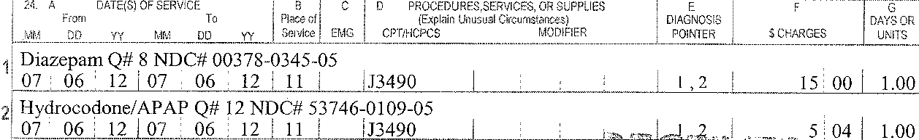
DMEPOS example #2
Amount Due:
  J3490 is a valid code that is not in Appendix II so it defaults to the usual and customary charge for each drug.
  $15.00 + $5.04 = $20.04.

Slide 97
DMEPOS examples
What if the HCPCS code is not in Appendix II and you ask for and receive an invoice that shows the provider paid significantly less than what was charged for the item?
  Unless you have a written payment agreement to pay less, the provider’s usual and customary charge is due. If the ER/IR contends that the charges are not reasonable/proper, it has to file a denial with the Board and send a copy of the NOC Form to the provider.

Slide 98
Radiology example
Appendix II:
CPT | MOD | FEE
74178 | 26 | $170.40
73700 | 26 | $85.20

Slide 99
Radiology example
Code 74020 is a deleted code.
  Per MFS Section 1.07(2)(A), the undisputed charges must be paid and a denial filed with the Board. A copy of the partial denial/NOC Form must be sent to the health care provider.

Slide 100
Radiology example
Amount Due = $170.40 + $85.20 = $255.60 (MAPs less than U&C charges). Contemporaneously, the ER/IR must file the denial and send a copy of the NOC to the provider.

Slide 101
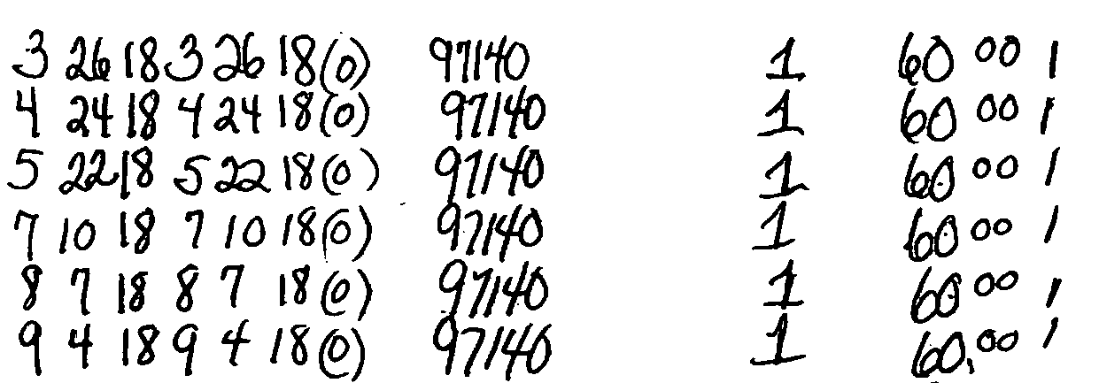
Massage therapy example
Is a handwritten bill ok? Do the charges need to be on a HCFA-1500?
  There is no prescribed billing form for professional services. A handwritten bill is fine as long as it contains all the required billing elements.

Slide 102
Massage therapy example
Code 97140 is defined by the AMA in 15 minute increments.
  Per MFS Section 1.07(2), the ER/IR cannot change a provider’s bill. As billed, this provider will be significantly underpaid if these charges are for 1 hr massages.

Slide 103
Massage therapy example
Amount Due = $48.00 per massage for total of $288.00 (MAPs less than U&C charges). If billed correctly, amount due $360 (billed charges).

Slide 104
Board Rules Chapter 5
Section 3
Inpatient Facility Fees

Slide 105
Inpatient facility fees
IP facility fees must be billed on a HCFA-1450, aka the UB-04.
  This does not preclude professional fees on the UB also.

Slide 106
Section 3.05 payment calculation
Board must utilize MS-DRGs for inpatient facility fees.
Payments are calculated by multiplying the base rate times the MS-DRG weight.

Slide 107
Section 3.05 payment calculation
Inpatient facility fees are published in Appendix III.

Slide 108
Inpatient facility fees
Section 3.06.
  Outlier payments – charges above threshold ($75,000 + fee) paid at 75%.
Section 3.07.
  Implantables – amount paid plus $500 for implantables costing over $10,000.

Slide 109
Inpatient facility fees
Section 3.08.
  Defines services included.
Section 3.09.
  Outlines payments for facility transfers.

Slide 110
Inpatient facility fees
Section 3.10. Inpatient services by institutional health care providers other than acute care or critical access hospitals paid at 75% of charges.

Slide 111
Inpatient facility fees
Section 3.11.
  Professional services paid pursuant to Appendix II.

Slide 112
MS-DRGs
ACH IP bills will generally have the MS-DRG included in Box 71 of the UB.
CAH IP bills will generally NOT have the MS-DRG included in Box 71 of the UB since these hospitals are not paid under the PPS/MS-DRG system by Medicare.

Slide 113
MS-DRGs
An inpatient bill that does not include the DRG does NOT qualify as an uncoded bill. The DRG is not a required billing element.

Slide 114
MS-DRGs
Web-based MS-DRG Groupers are available for purchase.
You simply enter the ICD diagnosis and procedure codes along with the age, gender and discharge status of the patient and the grouper then provides the MS-DRG for you to look up in Appendix III.

Slide 115
MS-DRGs
The appropriate grouper is based on the CMS fiscal year +17.
  For example, for fiscal year 2020 (dates of discharge 10/1/19 - 9/30/20), use version 37 – i.e. 20+17.

Slide 116
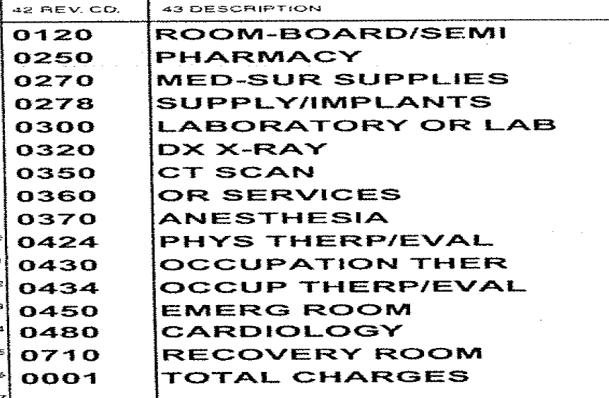
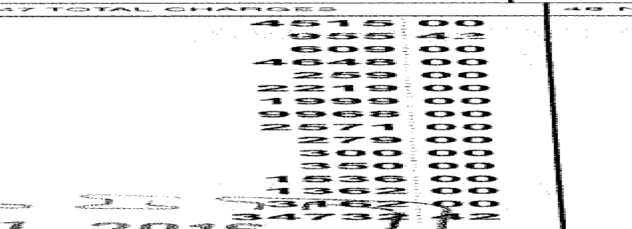
ACH Inpatient facility example

Slide 117

ACH Inpatient facility example
Appendix III:
MS-DRG | ACH Fee
494 | $20,145.81

Slide 118
ACH inpatient facility example
Outlier
    No outlier payment due (total charges of $34,732.42 less than outlier threshold of $95,145.81).
      Outlier threshold is amount in Appendix III of $20,145.81 plus $75,000.

Slide 119
ACH Inpatient facility example
Implantables
    No implantable payments due (total charges for implants is only $4,648.00 so cost is clearly less than $10,000.00).
      In order to be separately reimbursable, implants must cost over $10,000. Remember that the definition of implantable includes “any related equipment necessary to operate, program, and recharge the implantable” so make sure to look at cost in the aggregate.

Slide 120
ACH Inpatient facility example
What if the total charges were 134,732.42?
$134,732.42 total billed charges
    - 20,145.81 fee per Appendix III
    - 75,000.00 per Chapter 5, Section 3.06
    $ 39,586.61
    X .75
  $29,689.96 outlier payment

Slide 121
ACH Inpatient facility example
Amount due based on $34,732.13 total charges:
$20,145.81 fee per Appendix III
Amount due based on $134,732.42 total charges:
$20,145.81 fee per Appendix III
$29,689.96 outlier payment
    $49,835.77

Slide 122
ACH Inpatient facility example
What if the DRG was not on the bill?
ER/IR would need to utilize a grouper to determine the correct MS-DRG for payment.
What if the charges for the implants were well over $10,000 but no invoices were submitted?
There is no need to request invoices. The rule is clear that the provider MAY seek additional reimbursement.
What if you didn’t think the PT Evaluation was reasonable and proper?
The PT Evaluation does not affect reimbursement. The MS-DRG system is based on averages.

Slide 123
Board Rules Chapter 5
Section 4
Outpatient Facility Fees

Slide 124
Outpatient facility fees
OP facility fees must be on a HCFA-1450, aka the UB-04. All outpatient hospital facility services must be reported on a single bill.
  This does not preclude professional fees on the UB also.

Slide 125
Section 4.05 payment calculation
Board must utilize APCs for outpatient facility fees.
Payments are calculated by multiplying the base rate times the APC weight.

Slide 126
Section 4.05 payment calculation
Outpatient facility fees are published in Appendix IV.

Slide 127
Section 4.05 payment calculation
Subsection 1.
  Procedure codes with no CPT or with status N, no separate payment. Do not file a NOC on these codes.

Slide 128
Section 4.05 payment calculation
Subsection 2.
  If the fee listed in Appendix IV is $0.00 for a code with a status other than N, payment is at 75% of charge.

Slide 129
Section 4.05 payment calculation
Subsection 3.
  When there are 2 or more status T’s, the highest weighted is paid at 100%, all others at 50%.
  Add-on codes not discounted.

Slide 130
Section 4.05 payment calculation
Subsection 4.
  When one or more procedure codes with a status indicator of N are billed without other outpatient services, payment must be 75% of the provider’s usual and customary charges.
Notes:
i.e. non-patient referred specimens or the facility collects the specimen and furnishes only the outpatient labs on a given date of service, etc.

Slide 131
Outpatient facility fees
Section 4.06.
  Outliers (per procedure code) - charges above threshold ($2,500 + fee) paid at 75%.
Section 4.07.
  Implantables – amount paid plus 20% for implants over $250.00.

Slide 132
Outpatient facility fee outliers
If a bill has more than one surgical procedure with a status indicator of J, S or T and one or more of those procedures has less than a $1.01 charge, charges for all status J, S and T lines are summed and the charges are then divided across the J, S and T lines in proportion to their APC payment rate. The new charge amount is used in place of the submitted charge amount in the outlier calculation.

Slide 133
Outpatient facility fees
Section 4.08.
  Observation status is outpatient.
Section 4.09.
  Transfers.

Slide 134
Outpatient facility fees
Section 4.10.
  Other institutional provider payments at 75% of charges.
Section 4.11.
  Professional services paid pursuant to Appendix II (revenue codes in the 96x, 97x and 98x series are professional fees).

Slide 135
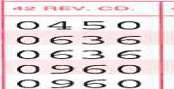
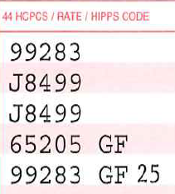
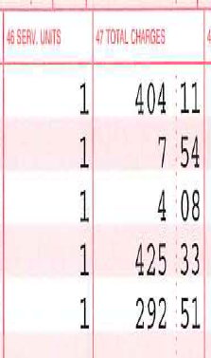
CAH Outpatient facility example
What do you notice about this outpatient facility bill? Is there a duplicate charge?

Slide 136
CAH Outpatient facility example
  This bill has both facility and professional fees.
  Reminder: Revenue codes in the 96x, 97x and 98x series are professional fees.

Slide 137
CAH Outpatient facility example
Do the E/M facility fee level and E/M professional fee level have to match?
  No. The charges do not have to match. For example, the provider service may have been complex but consumed very few facility resources.

Slide 138
CAH Outpatient facility example
Appendix IV:
Code | Status | CAH Fee
99283 | J2 | $480.99
J8499 | E1 | $0.00

Slide 139
CAH Outpatient facility example
Per MFS Section 4.05(2): If the ACH Fee, CAH Fee or ASC Fee listed in Appendix IV is $0.00 for a procedure code with a status indicator other than N, then payment must be calculated at 75% of the health care provider’s usual and customary charge.

Slide 140
CAH Outpatient facility example
Facility fees are evaluated on a total charge basis: $480.99+$8.72 (.75(7.54+4.08)) = $489.71 (more than $415.73 total facility charges).

Slide 141
CAH Outpatient facility example
Appendix II:
Code | Mod | Fee
65205 |  | $63.60
99283 |  | $110.40

Slide 142
CAH Outpatient facility example
Professional fees are evaluated on a line by line basis: $63.60 (less than $425.33) + $110.40 (less than $292.51) = $174.00.

Slide 143
CAH Outpatient facility example
Amount Due:
$415.73 facility fees (total facility charges)
+174.00 professional fees
$589.73

Slide 144
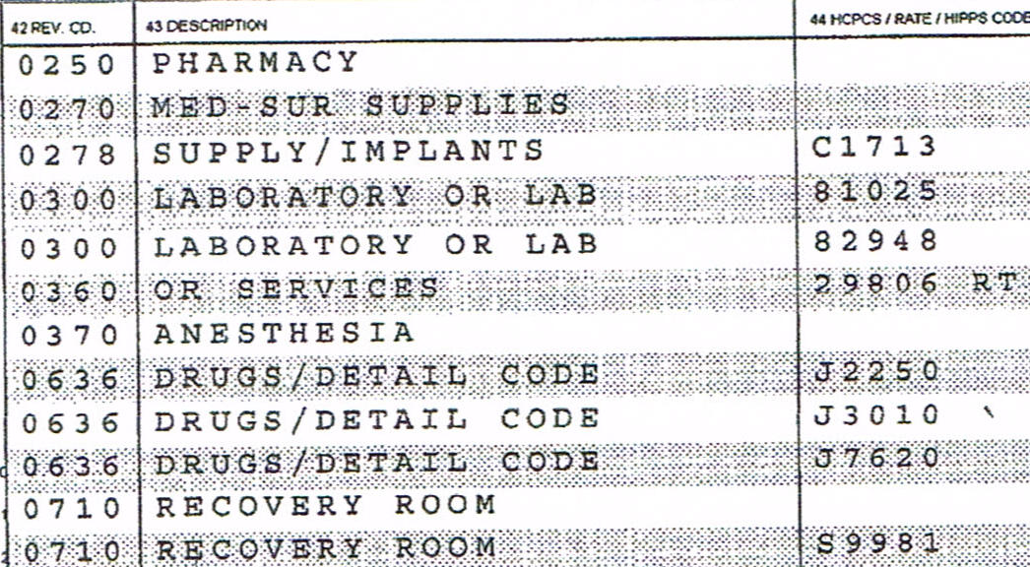
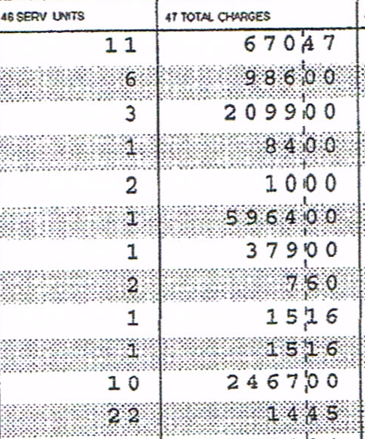
ACH Outpatient Facility Example
Total Charges = $12,711.84
Total Charges Less Medical Records Expense = $12,697.39
Total Charges Less Implants ($2,099) and Medical Records Expense ($14.45) = $10,598.39

Slide 145
ACH Outpatient Facility Example
Appendix IV:
Code | Status | ACH Fee
C1713 | N | $0.00
81025, 82948 | Q4 | $0.00
29806 | J1 | $11,109.76
Code | Status | ACH Fee
J2250 | N | $0.00
J3010 | N | $0.00
J7620 | M | $0.00

Slide 146
ACH Outpatient Facility Example
Outlier
    The only procedure code eligible for an outlier is procedure code 29806 (only charge with a MAP)
    No outlier payment due (charges of $5,964.00 less than outlier threshold of $13,609.76).
      Outlier threshold is amount in Appendix IV of $11,109.76 plus $2,500.

Slide 147
ACH Outpatient Facility Example
    Implantables
  $ 1,410.00 cost of 3 units C1713 ($470/each)
  x 1.2 per Chapter 5, Section 4.07
  = $1,692.00

Slide 148
ACH Outpatient Facility Example
MAP:
  $11,109.76 29806 fee per Appendix IV
  81.87 charges paid at 75% of charge
  $11,191.63 MAP more than total charges of $10,598.39
  Amount due:
  $10,598.39 total charges
  1,692.00 implantables
  14.45 medical records
  $ 12,304.84

Slide 149
ACH Outpatient Facility Example
What if the charges for procedure code 29806 were 15,964.00?
  $ 15,964.00 charge for procedure 29806
    - 11,109.76 fee per Appendix IV
    - 2,500.00 per Chapter 5, Section 4.06
    2,354.24
    x .75
    = $1,765.68 outlier payment

Slide 150
ACH Outpatient Facility Example
Amount due with outlier:
  $11,109.76 total charges were increased by $10,000 making the MAP less than total charges
  1,765.68 outlier
  1,692.00 implantables
  14.45 medical records
  $ 14,581.89

Slide 151
ACH Outpatient Facility Example
What if the provider did not submit cost invoices for the implants?
Amount due:
  $11,109.76 29806 fee per Appendix IV
  81.87 charges paid at 75% of charge
  $11,191.63 MAP less than total charges of $12,697.39
  14.45 medical records
  $11,206.08

Slide 152
ACH Outpatient Facility Example
Appendix IV:
Code | Status | ACH Fee
C1713 | N | $0.00
81025, 82948 | Q4 | $0.00
29806 | J1 | $10,758.89
Code | Status | ACH Fee
J2250 | N | $0.00
J3010 | N | $0.00
J7620 | M | $0.00

Slide 153
ACH Outpatient facility example
Why isn’t the amount due for the surgical procedure capped at the amount of the operating room charges?
  Charges on the 360 revenue code line represent the charges for the operating room only and the operating room charges are only one component of the procedure. The charges for the procedure are actually spread over several lines, i.e. pharmacy, supplies, anesthesia, recovery room.
    The APC payment is for the whole procedure, not just the operating room costs.

Slide 154
Audit considerations
Penalties on an individual claims: §§ 205.4, 324.2, 360.1
  Notice of non-payment via certified mail
  Orders and Decisions
  Form Filing, e.g. Not filing the required NOC

Slide 155
39-A M.R.S.A. § 205(4)
When there is no ongoing dispute, if bills for medical or health care services are not paid within 30 days after the carrier has received notice of nonpayment by certified mail from the provider … or, if the bill was paid by the employee, from the employee …, $50 or the amount of the bill due, whichever is less, must be added and paid to the provider of the medical or health care services or, if the bill was paid by the employee, to the employee …for each day over 30 days in which the bills for medical or health care services are not paid.
    Not more than $1,500 in total may be added.

Slide 156
§ 324 Order or decision
The employer or insurance carrier shall make payments within 10 days after the receipt of notice of an approved agreement or within 10 days after any order or decision of the board.
  The board may assess against the employer or insurance carrier a fine of up to $200 for each day of noncompliance.

Slide 157
39-A M.R.S.A. § 222 and BOI Rules Chapter 530
Notice of offset/lien is in effect. Note: MaineCare and VA have automatic liens in effect for 100% of their “expenses”.
  Satisfy the amount of the lien.
  If additional amounts are due (because the maximum allowable payment under the workers’ compensation medical fee schedule is greater than the health plan reimbursement), these amounts must be paid directly to the health care providers in accordance with Chapter 5 of the Board’s Rules and Regulations.

Slide 158
39-A M.R.S.A. § 222 and BOI Rules Chapter 530
No notice of offset/lien is in effect.
  Pay the health care providers directly in accordance with Chapter 5 of the Board’s Rules and Regulations.

Slide 159
§360. PENALTIES
The board may assess a civil penalty not to exceed $100 for each violation on any person:
  A. Who fails to file or complete any report or form required
  B. Who fails to file or complete such a report or form within the specified time limits
  Would apply to the NOC form.

Slide 160
Audit considerations
Pattern of questionable claims-handling techniques:
  Form filing
  Timeliness of payments
  Accuracy of payments
  Other significant issues

Slide 161
Audit considerations
Repeated unreasonably contested claims:
  No articulable basis for contesting the claim
  The claim is contested upon a basis that is contrary to law or rule

Slide 162
Audit considerations
Other significant issues
  Utilization review
  WCB-11
  Recovery of overpayments
  Record retention
  Unclaimed property

Slide 163
Utilization review
Utilization review must be performed pursuant to a system established by the board.
  The Board currently has no approved treatment guidelines.
  The Board has not adopted any national guidelines such as ODG or ACOEM.

Slide 164
WCB-11 Statement of Compensation
Managed care services such as utilization review, case management and bill review or to examinations performed pursuant to 39­-A M.R.S.A. §§ 207 and 312 may not be included under Medical Treatment on the WCB-11. Section 1.01(1).

Slide 165
Recovery of overpayments
Workers’ Compensation Board Decision No.96-0:Donald C. Pritchard, Jr. v. S.D. Warren Company and Sedgwick James of Northern New England
  The present Act provides this employer with no mechanism to recover what the employer regards as an overpayment of compensation.
Notes:
And a new appellate division case.

Slide 166
Record retention
24‑A M.R.S.A. §§ 2384-C(9) and 3410(1)(B)
  Bureau of Insurance Rule Ch. 250, Section II(I)
  Bureau of Insurance Rule Ch. 250, Section III(I)(2)
39‑A M.R.S.A. §§ 205(2) and 355(14)(B)

Slide 167
Unclaimed property
Hold the check for the required dormancy period (3 years), fulfill due diligence in attempting to locate the payee, and keep documentation of those efforts.
  If the payment remains unclaimed after the required dormancy period, payment must be turned over to the State Treasurer.

Slide 168
Contact information
Medical Fee Schedule:
  Kimberlee.McCarson@maine.gov
Audit:
  Gordon.Davis@maine.gov

