Slide 1
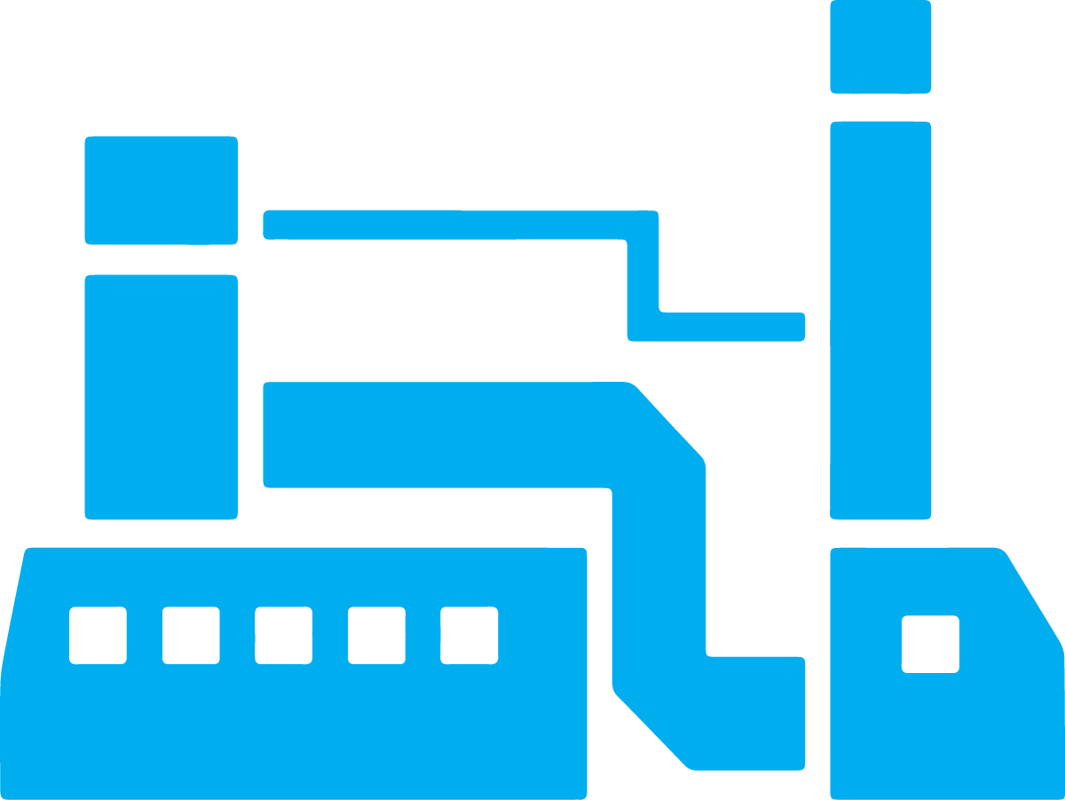


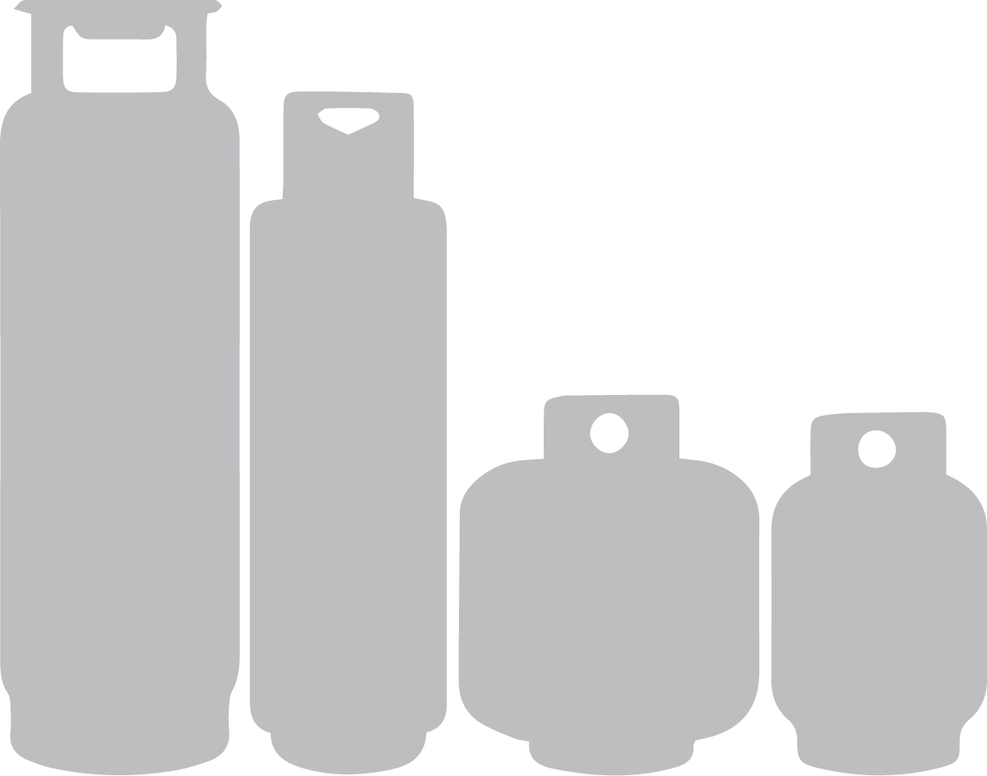





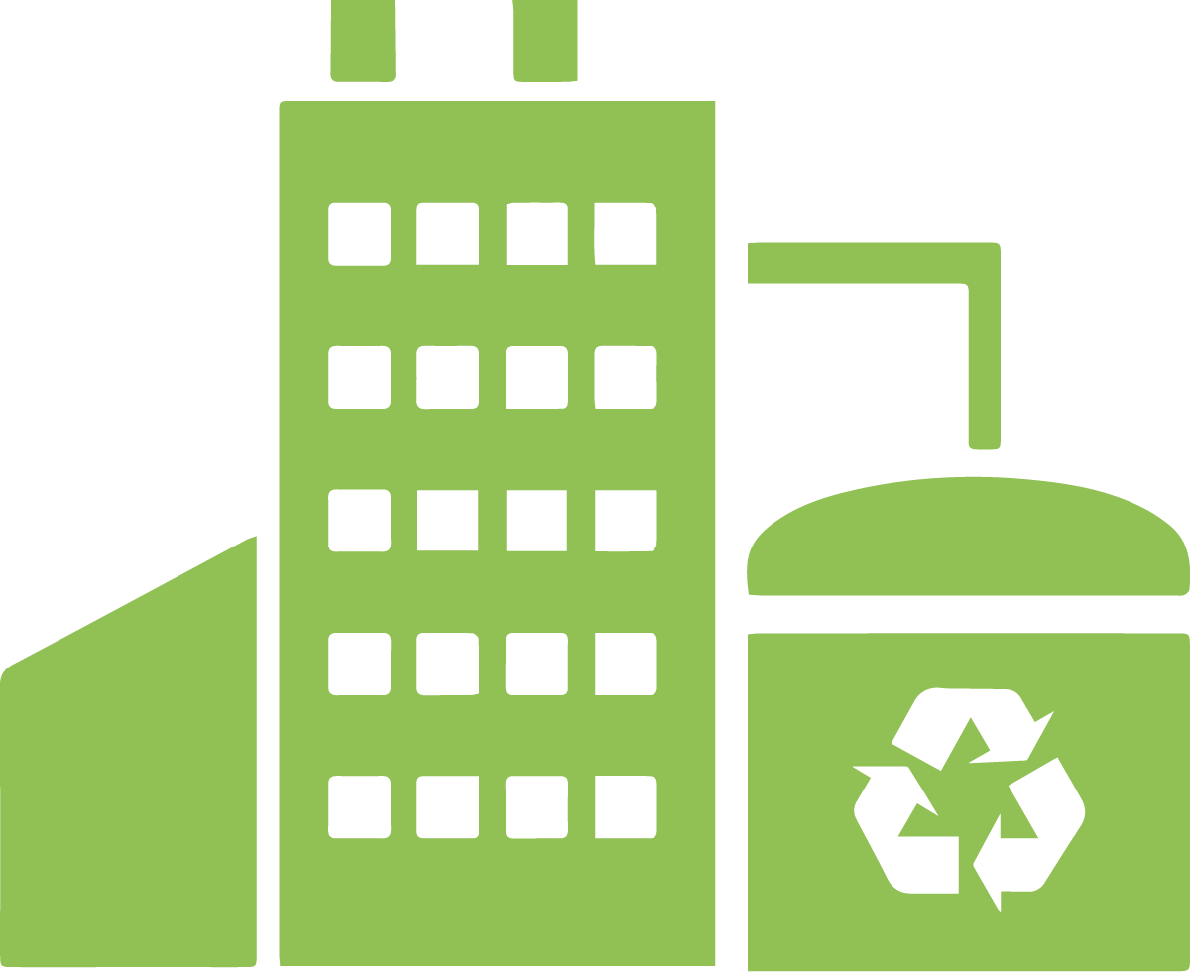
Traditional EPR Model
Producers provide direction to meet responsibilities and funding
TRANSFER
STATION
DISPOSAL &
RECYCLING
FACILITY
PRO
Arrangements to receive pressurized cylinder from residents without charge (state-wide and to meet targets)
MUNICIPAL
DROFF-OFF
HHW EVENTS
PILOT AT
RETAIL
STATE
PARKS
CAMPGROUND
Arrangements to pick-up and properly manage pressurized cylinders from collection points
Notes:
Slide reflects the Connecticut draft program plan but it is also the general approach of what is required for other materials in Maine like paint, electronics, or batteries.
Producers organize typically through a PRO. They provide direction to that PRO to meet their requirements. That PRO arranges for collect, hauling and processing of the materials collected and producers provide funding to the PRO based on the materials collected.

Slide 2
Maine (if alternative collection system)
Alternative Collection Program
Pressurized cylinder producers establish an alternative collection system that collects their products. Allows for greater control of system to ensure it is more effective and efficient
PRO
Arrangements to receive pressurized cylinder from residents without charge (state-wide and to meet targets)
TRANSFER
STATION
DISPOSAL &
RECYCLING
FACILITY
MUNICIPAL
DROFF-OFF
HHW EVENTS
PILOT AT
RETAIL
STATE
PARKS
CAMPGROUND
Arrangements to pick-up and properly manage pressurized cylinders from collection points
Must also pay into a packaging stewardship fund for any materials not collected (even if common system does not offer any additional sites)
This requirement places a higher burden on producers that operate an alternative collection system even if that system is more robust and more effective and efficient than the common collection system
Stewardship Packaging Fund
Notes:
Under the Maine model, pressurized cylinder manufacturers could establish their own PRO and create a separate PRO that would be consistent with the draft program plan in Connecticut collecting from municipal drop-offs, transfer stations, HHW events, disposal and recycling facilities, campgrounds, state parks and potentially retail. This approach provides many advantages, it provides producers with much more direct responsibility and control – allowing them to align with other jurisdictions, create potentially greater economies of scale between states and allow them to more directly control decisions so they lead to more effective and efficient results for their materials – not all general packaging which is not collected, hauled or processed in a similar manner.
However the concern is they under this model they have a requirement placed on them that is not included for other producers like paint or producers that choose to remain in the common collection system. They are required to pay for any materials not captured in the alternative system. So even if the alternative system is more robust and more effective and efficient than the common collection system they are still required to pay more.

Slide 3
Maine (if in the common collection system)
Pressurized cylinders have diminished influence over PROs decisions as focus is on achieving efficiencies and effectiveness for general packaging. Only responsible for what is collected.
Arrangements to receive pressurized cylinder from residents without charge (state-wide and to meet targets)
PRO
TRANSFER
STATION
DISPOSAL &
RECYCLING
FACILITY
MUNICIPAL
DROFF-OFF
HHW EVENTS
Arrangements to pick-up and properly manage pressurized cylinders from collection points

