Slide 1
CMP Property within IF&W Area of Interest
SCR- December 7, 2018

Slide 2
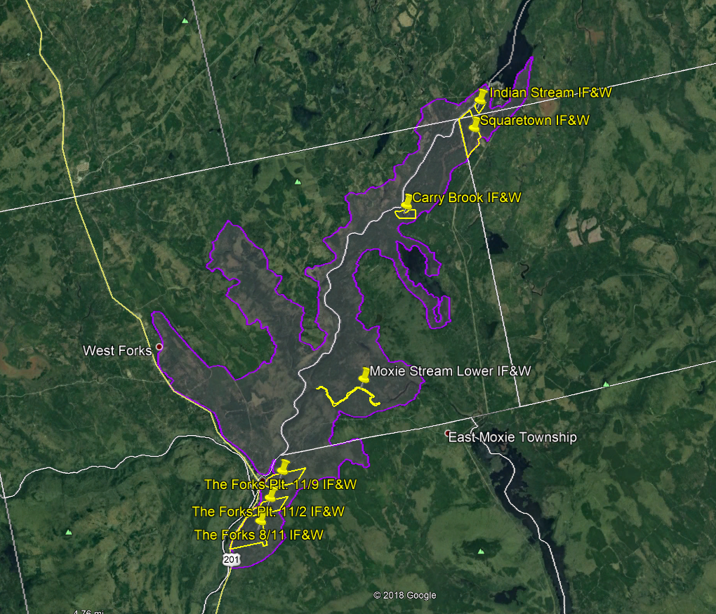
Overview Map
N
No Scale

Slide 3
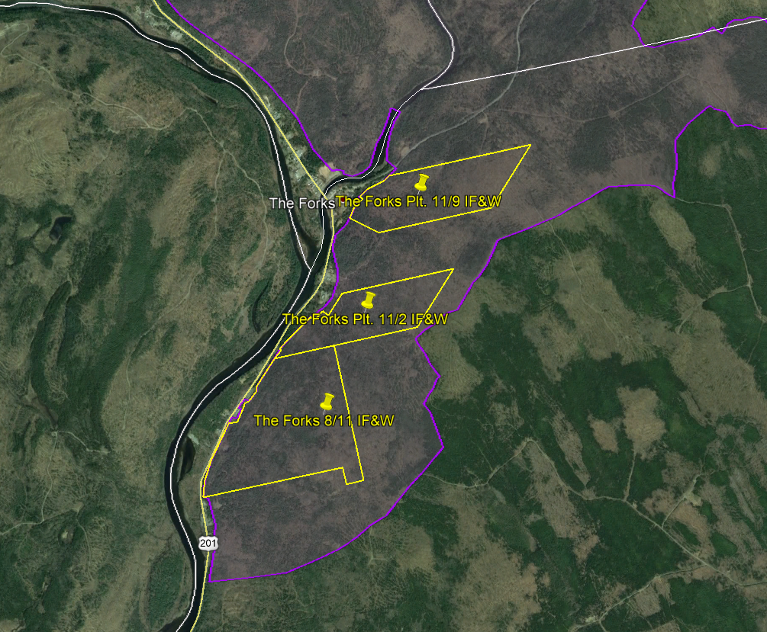
South Section Map
N
No Scale

Slide 4
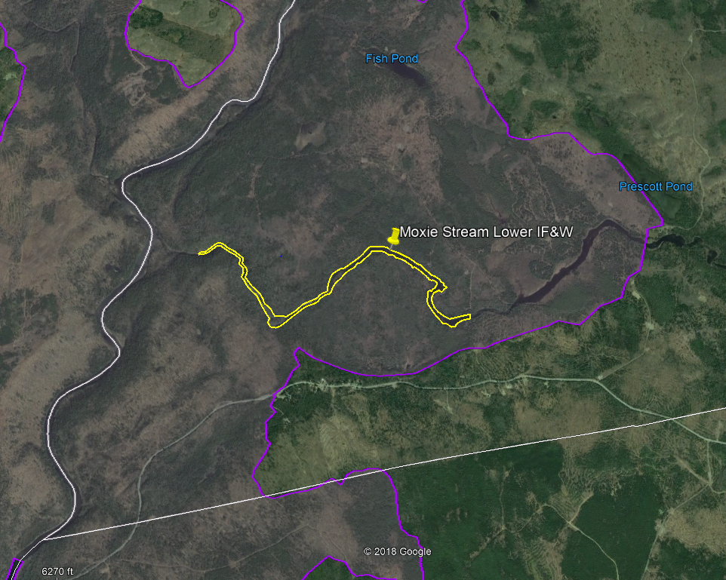
Central Section Map
N
No Scale

Slide 5
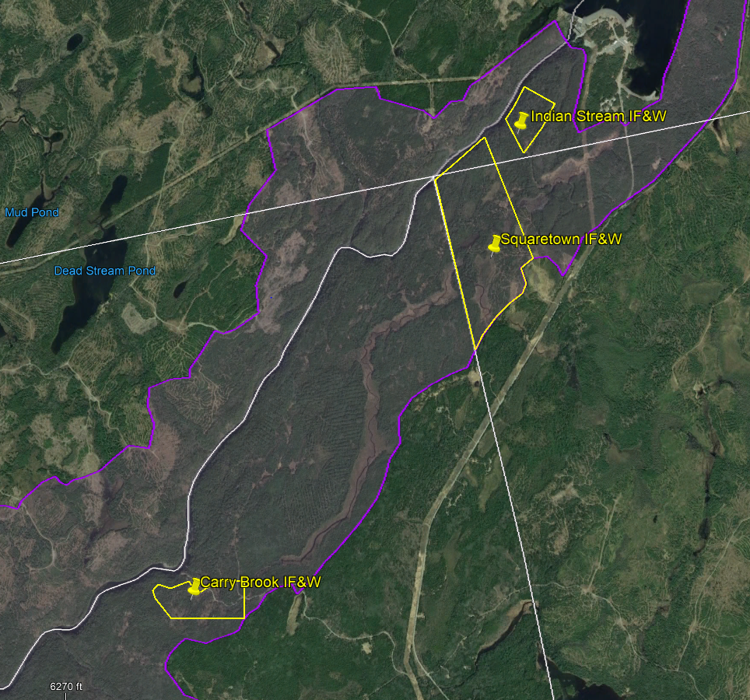
North Section Map
N
No Scale

Slide 6
