Slide 1

Life In the Pits
Mark Stebbins and Erich Kluck
Bureau of Land Resources
Land Division-Mining Unit
MAINE DEPARTMENT OF ENVIRONMENTAL PROTECTION
Protecting Maine’s Air, Land and Water

Slide 2
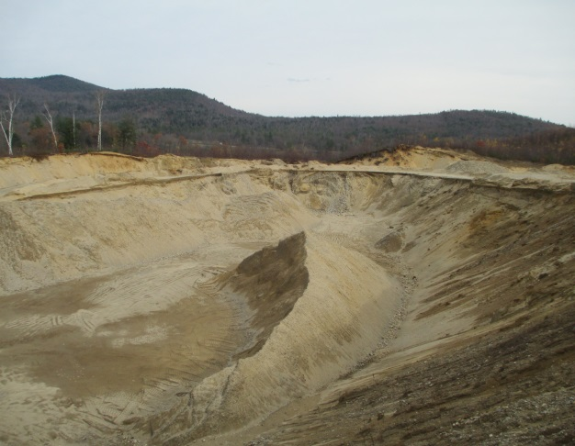
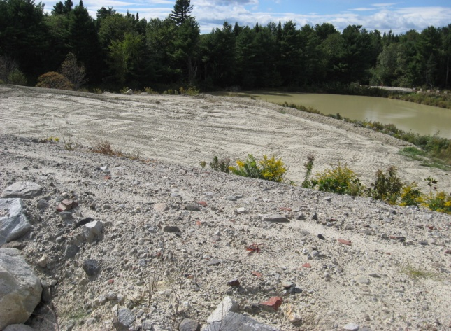
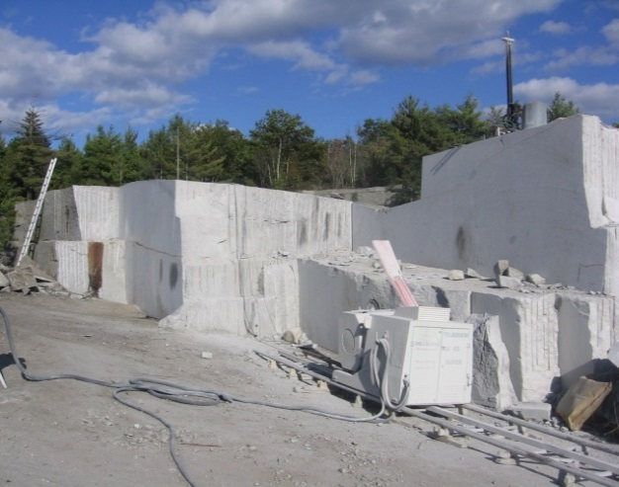
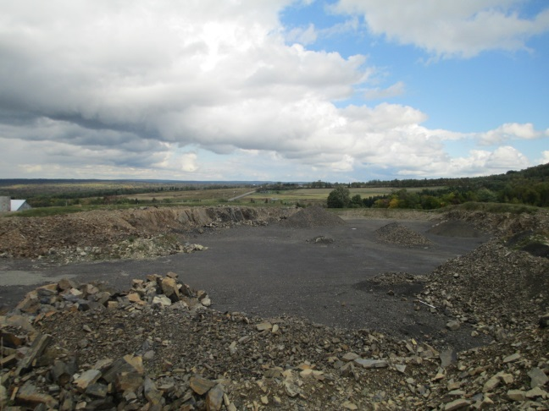
Mining In Maine
866 registered sites:
  731 gravel pits
  124 quarries
  11 clay/topsoil
    10,945 acres NOITC
Active site law pits -99 remaining
  4,923 acres Site Law
MAINE DEPARTMENT OF ENVIRONMENTAL PROTECTION www.maine.gov/dep

Slide 3

Performance-Based Regulation
Establishes a notification process (similar to Permit-By-Rule)
Program only applies to organized towns
Regular inspections to ensure compliance
Law provides Stop-Work authority
MAINE DEPARTMENT OF ENVIRONMENTAL PROTECTION www.maine.gov/dep

Slide 4
DEP Jurisdiction
Performance Standards apply to:
  Sand, gravel, topsoil and clay excavations > 5 acres
  Rock quarries > 1 acre
Erosion control requirements for topsoil and clay excavations up to 5 acres
Other laws may apply to excavations of any size
  Stormwater, Erosion & Sediment Control, NRPA
MAINE DEPARTMENT OF ENVIRONMENTAL PROTECTION www.maine.gov/dep
Notes:
Topsoil & clay <5 ac – Must be phased so that open area does not exceed 2 acres at any one time, E&S control measures in place, reclaim with vegetation

Slide 5
Notices of Intent to Comply
1993-2015
MAINE DEPARTMENT OF ENVIRONMENTAL PROTECTION www.maine.gov/dep

Slide 6
Municipal Law Requirements
If the pit is <5ac- not regulated by DEP.
No local ordinance-following provisions apply: (see Title 30-A, Section 3105)
  10-foot setback to property lines
  slopes graded to 2H to 1V
  25-foot setback to graveyards (see Title 13, Section 1371-A)
MAINE DEPARTMENT OF ENVIRONMENTAL PROTECTION www.maine.gov/dep

Slide 7
DEP Mining Unit
Ensure compliance with Performance Standards for Excavation/Quarries
Focus on “general” environmental issues at the site:
  -- Size (open pit area)
  -- Solid waste -- Noise
  -- Groundwater protection -- Dust
  -- Buffers (roads, property lines) -- Closure/reclamation
  -- Erosion control -- Fuel storage and handling
MAINE DEPARTMENT OF ENVIRONMENTAL PROTECTION www.maine.gov/dep

Slide 8
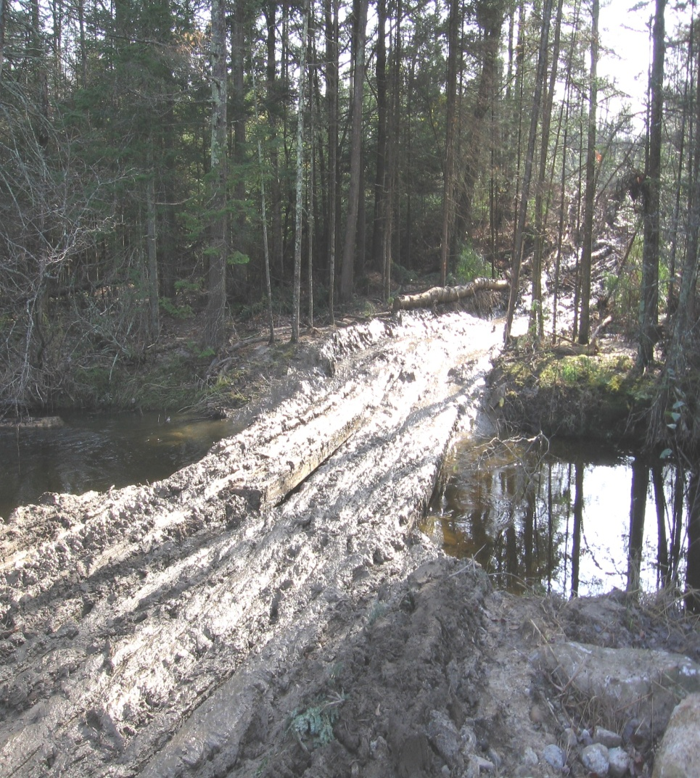
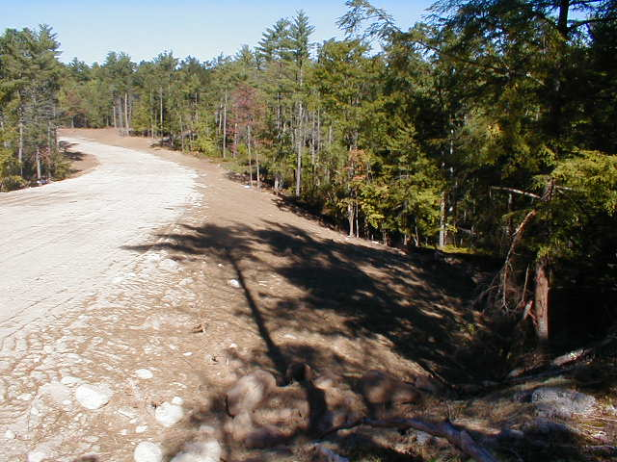
Road Building
Then…
…and now
MAINE DEPARTMENT OF ENVIRONMENTAL PROTECTION www.maine.gov/dep

Slide 9
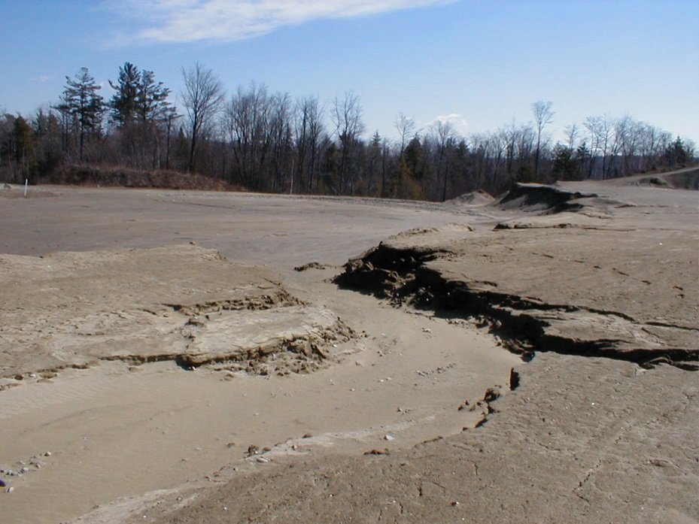
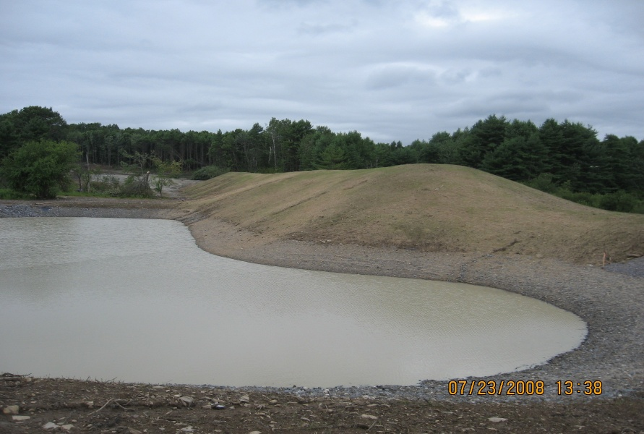
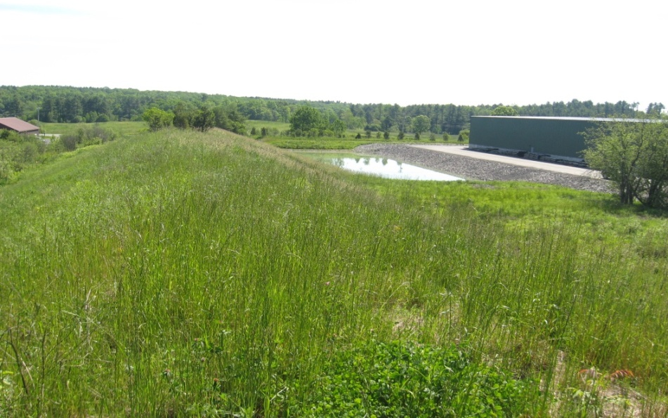
Sediment Ponds
Then…
…and now
MAINE DEPARTMENT OF ENVIRONMENTAL PROTECTION www.maine.gov/dep

Slide 10
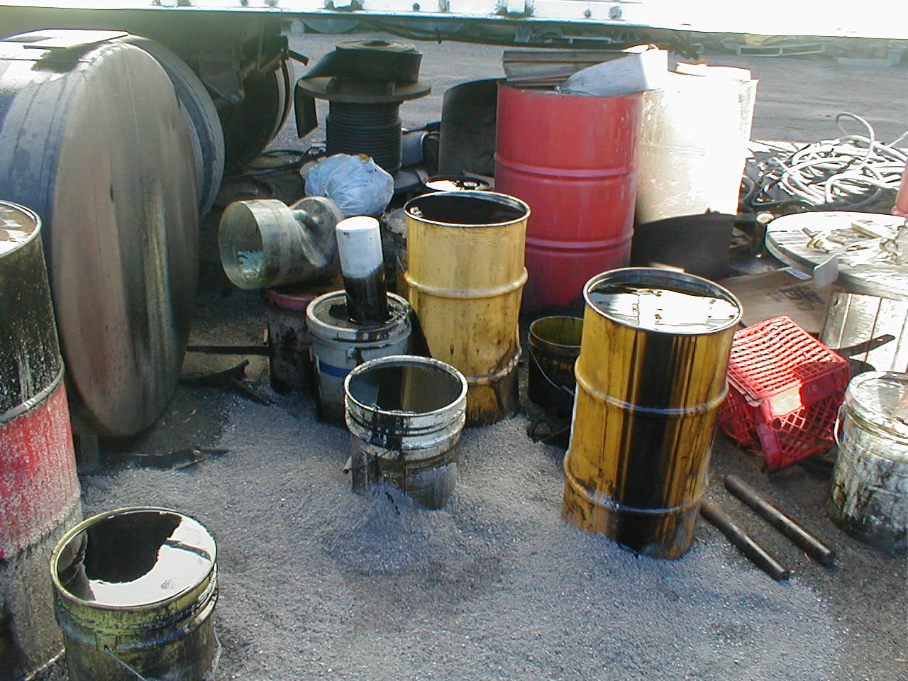
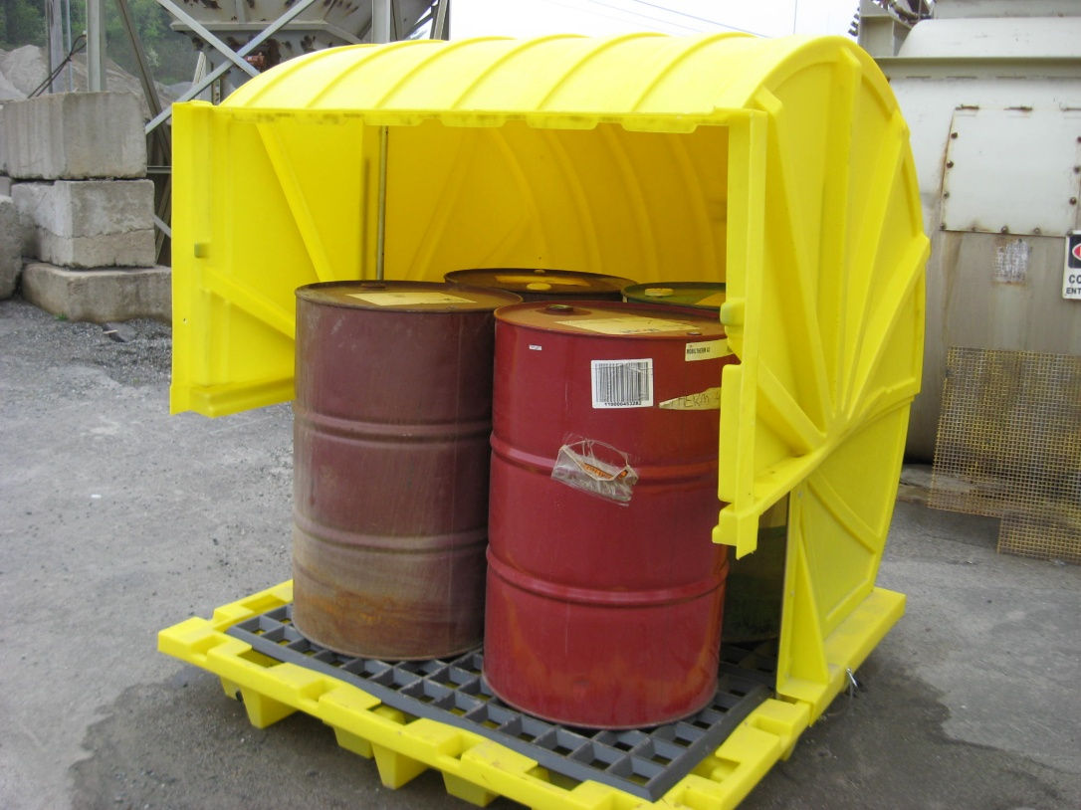
Handling Petroleum Products
Then…
…and now
MAINE DEPARTMENT OF ENVIRONMENTAL PROTECTION www.maine.gov/dep

Slide 11
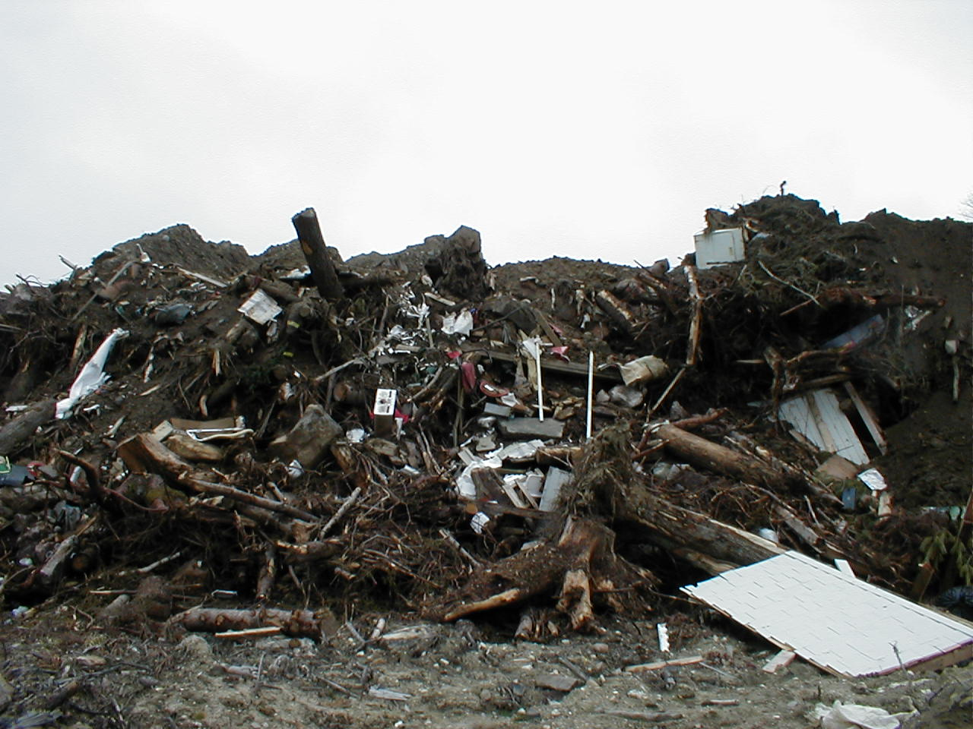
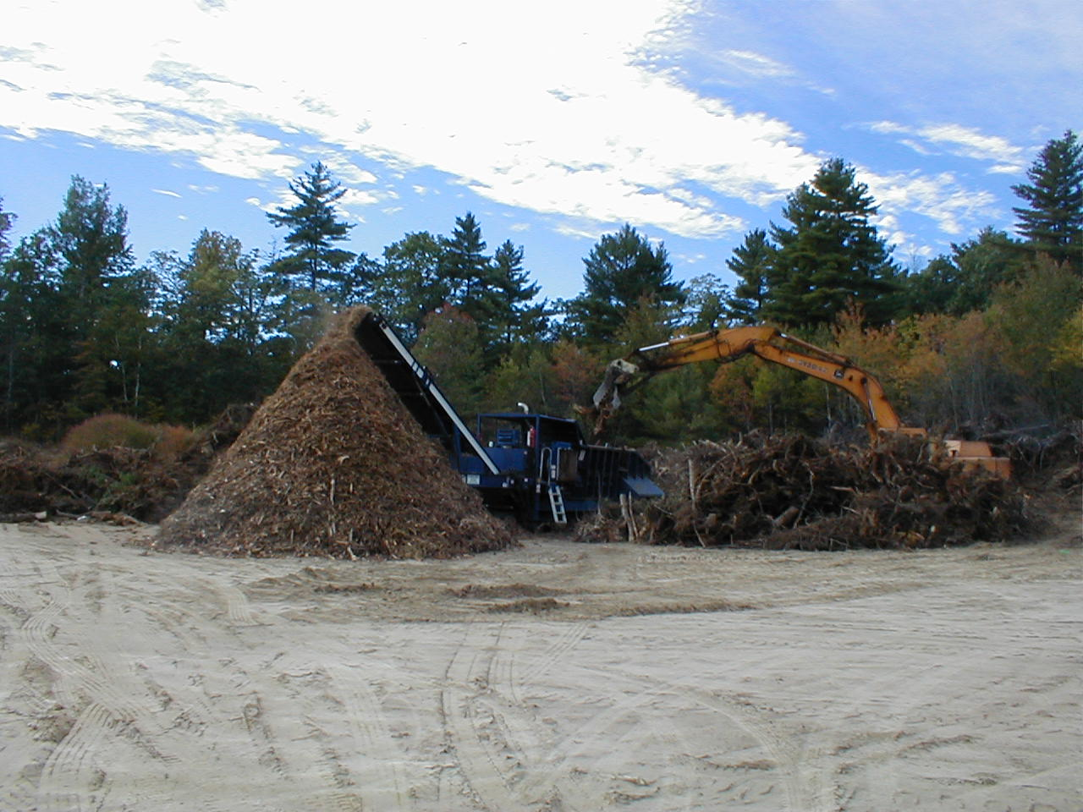
Solid Waste
Then…
…and now
MAINE DEPARTMENT OF ENVIRONMENTAL PROTECTION www.maine.gov/dep

Slide 12
Variances
MAINE DEPARTMENT OF ENVIRONMENTAL PROTECTION www.maine.gov/dep
Notes:
Variance process was added in 1997.
Permitted 1577 acres of ponds-Extending the life of mines
Larger Working Pit Size-$4.2 million in financial assurance

Slide 13
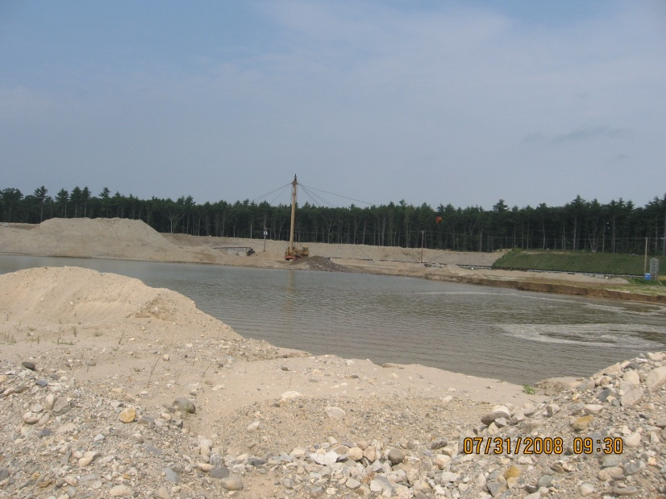
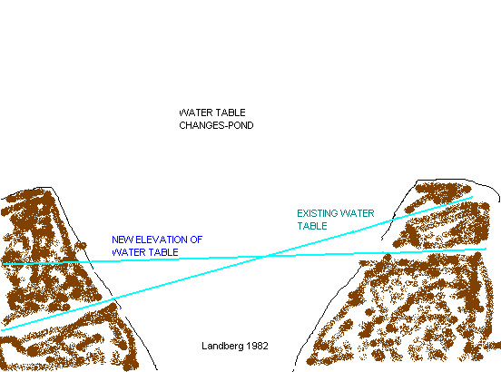
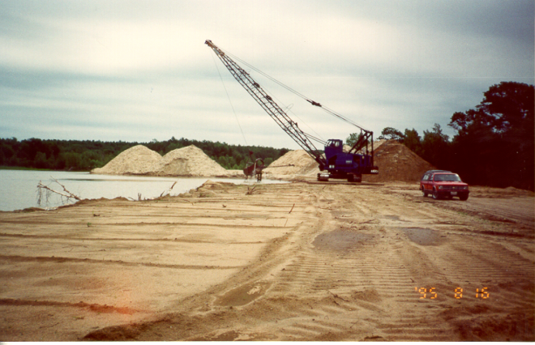
Variances – Extending the Life of the Mine
Almost half of all variances (74 total) are for excavation below the water table.
1,480 acres of ponded area have been approved.
MAINE DEPARTMENT OF ENVIRONMENTAL PROTECTION www.maine.gov/dep

Slide 14
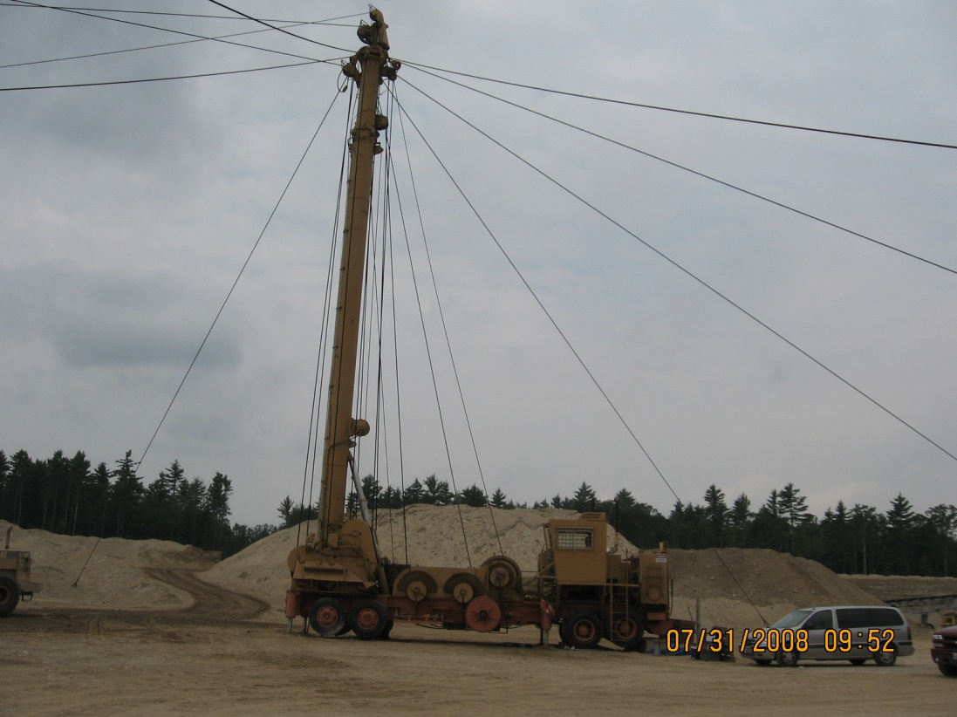
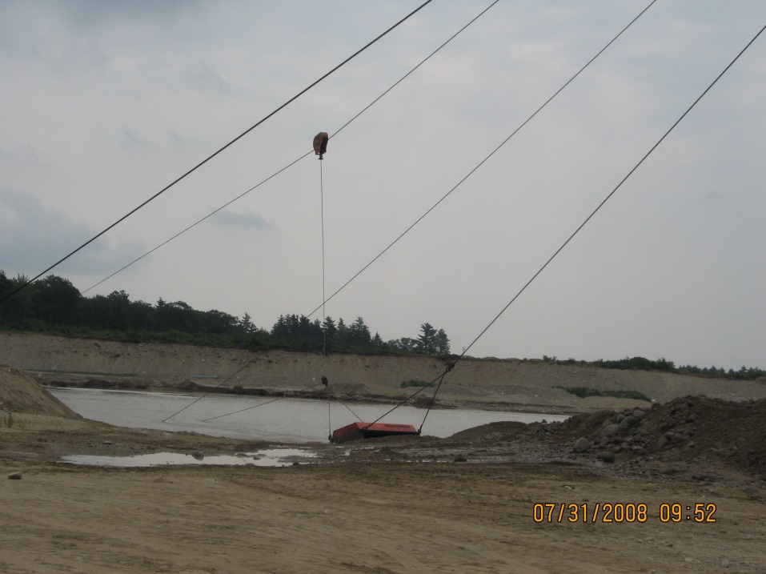
Excavation to Groundwater
MAINE DEPARTMENT OF ENVIRONMENTAL PROTECTION www.maine.gov/dep

Slide 15
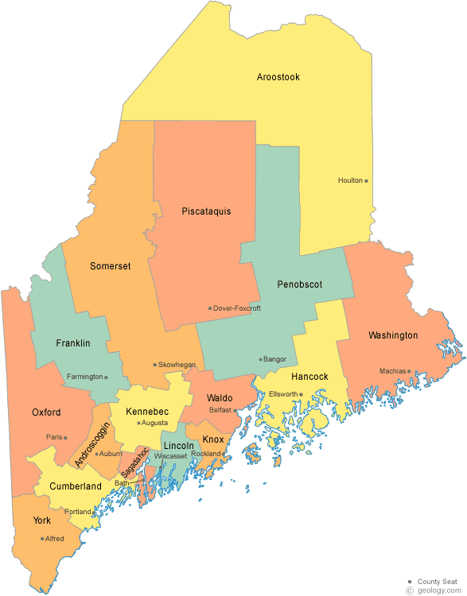
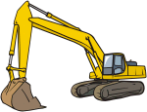
# of Licensed Pits By County
County | # Pits
Androscoggin | 65
Aroostook | 73
Cumberland | 75
Franklin | 33
Hancock | 62
Kennebec | 71
Knox | 44
Lincoln | 21
Oxford | 51
Penobscot | 71
Piscataquis | 12
Sagadahoc | 11
Somerset | 43
Waldo | 56
Washington | 38
York | 144
MAINE DEPARTMENT OF ENVIRONMENTAL PROTECTION www.maine.gov/dep
Notes:
25 % of licensed pits are located in Cumberland & York County

Slide 16
Locations of Licensed Mine Sites
MAINE DEPARTMENT OF ENVIRONMENTAL PROTECTION www.maine.gov/dep

Slide 17
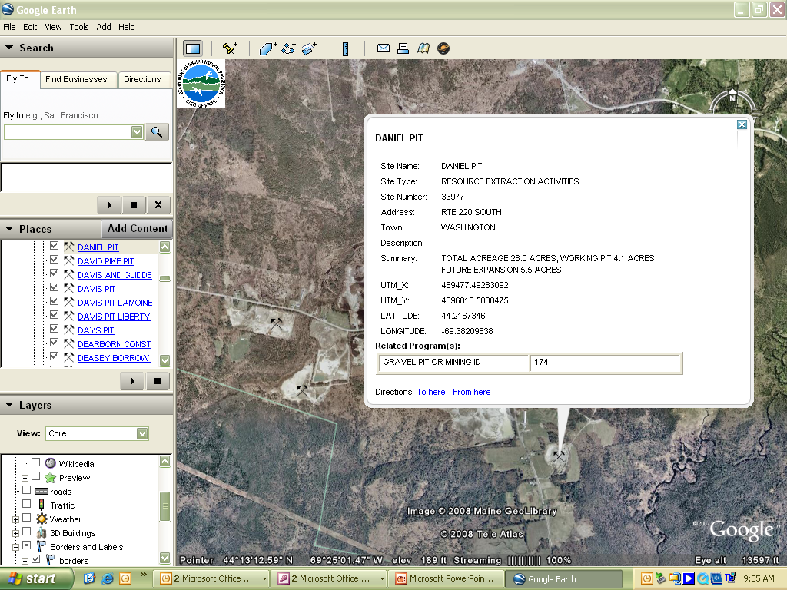
PIT Locations of Google Earth
MAINE DEPARTMENT OF ENVIRONMENTAL PROTECTION www.maine.gov/dep

Slide 18
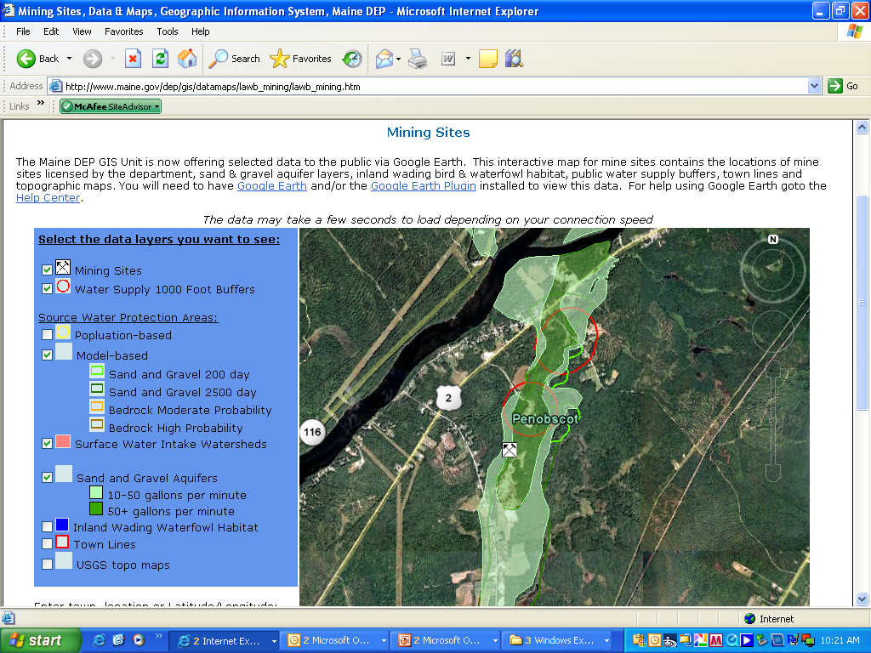
GOOGLE EARTH-MINING SITES
Web –based mapping system
MAINE DEPARTMENT OF ENVIRONMENTAL PROTECTION www.maine.gov/dep
Notes:
The interactive map also contains the significant sand & gravel layer along with public water supplies. The law contains restrictions for fuel storage on high yield (over 50 gpm) and the locations of any public water supply.

Slide 19
Licensed Pits by Town
GPID | PIT NAME | COMPANY/NAME | LOCATION | PIT STATUS | TYPE
721 | ABBOT PIT | MIKE THERIAULT CONSTRUCTION, LLC | ABBOT | Active | G
723 | SPACK PIT | FORREST SPACK SR | ABBOT | Active | G
735 | DAVIS PIT | MICHAEL DAVIS | ABBOT | Active | G
266 | RED GATE PIT | JON R. OLSON | ACTON | Active | G
267 | OLD ACTON AIRFIELD PIT | OLD ACTON AIRFIELD | ACTON | Active | G
268 | LARKIN PIT | William Angelini, LLC | ACTON | Active | G
550 | HOPPER ROAD PIT | ACTON, LLC | ACTON | Active | G
634 | TURCOTTE PIT | The C.A.T. Revocable Trust of 1999 | ACTON | Active | G
695 | HANSEN POND PIT | R.PEPIN & SONS, INC. | ACTON | Active | G
848 | MIDWAY PIT | DAVID PANDELENA | ACTON | Active | G
326 | MORRIS PIT | ELMER MORRIS | ADDISON | Active | G
371 | PERRY PIT | LEON PERRY | ADDISON | Active | G
573 | CARVER PIT | CARVER CONSTRUCTION , INC. | ADDISON | Active | G
78 | RICHARDS 078 | MERTON RICHARDS | ALBION | Pit Closed/Reclaimed | G
244 | RICHARDS PIT | MERTON RICHARDS, INC. | ALBION | Active | G
664 | QUAKER HILL PIT | MERTON RICHARDS | ALBION | Active | G
736 | MARTIN PIT | STEVE MARTIN | ALBION | Active | TS
219 | DAVIS PIT | SSR, LLC | ALEXANDER | Active | G
193 | HUNTER PIT | THORNTON CONSTRUCTION, INC | ALTON | Active | G
227 | ALTON PIT | BENNOCH ROAD ASSOCIATES | ALTON | Active | G
441 | ALTON PIT | PMD, INC. | ALTON | Active | G
443 | ALTON WASH PLANT | OWEN J. FOLSOM, INC | ALTON | Active | G
510 | ALTON PIT | LOU SILVER INC. | ALTON | Active | G
547 | ALTON QUARRY 547 | OWEN J. FOLSOM, INC. | ALTON | Active | Q
626 | ENGSTROM PIT | ABS CONSTRUCTION | ALTON | Active | G
788 | THOMPSON PIT | OWEN J. FOLSOM, INC | ALTON | Active | G
840 | DH PIT | D&h CONSTRUCTION, INC. | ALTON | Active | G
758 | SWASEY PIT | SWASEY EXCAVATION,INC | ANDOVER | Active | G
760 | SWASEY QUARRY | SWASEY EXCAVATION | ANDOVER | Active | Q
208 | MERLE LLOYD & SONS | MERLE LLOYD & SONS | ANSON | Active | G
452 | MATTINGLY QUARRY | MATTINGLY PRODUCTS COMPANY, INC. | ANSON | Active | Q
779 | MATTINGLY | MATTINGLY PRODUCTS COMpany | ANSON | Active | G
http://www.maine.gov/dep/land/mining/index.html
MAINE DEPARTMENT OF ENVIRONMENTAL PROTECTION www.maine.gov/dep
Notes:
The DEP website contains a list of Towns sorted alphabetically with the names of the operator and pit name. This list is updated one or twice a year.

Slide 20
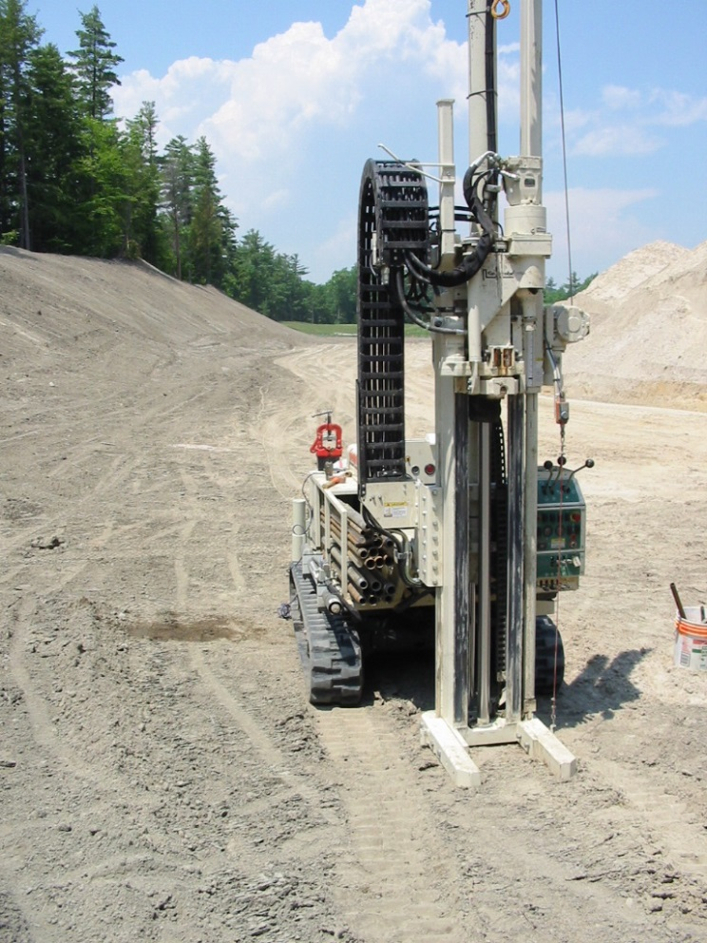
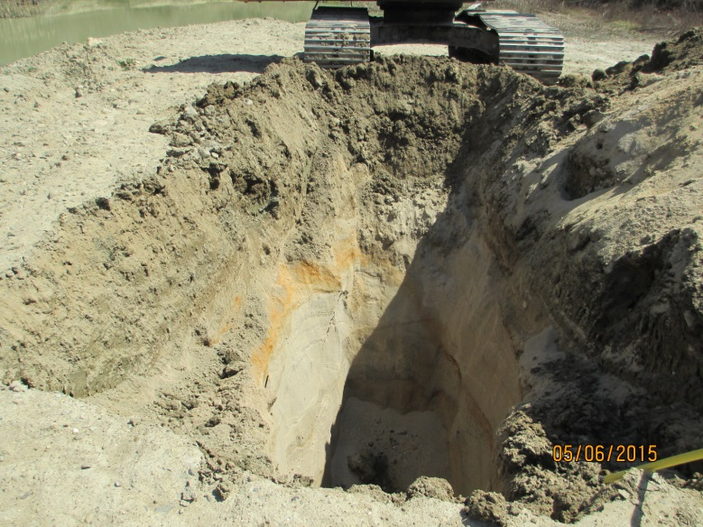
Defining the Resource
Use Topographic Maps
Use Sand & Gravel Aquifer Maps
Surficial Maps or Bedrock Maps
  Test Borings and Test Pits
  Gradation test (Size)
  Confirm the reserves
MAINE DEPARTMENT OF ENVIRONMENTAL PROTECTION www.maine.gov/dep
Notes:
Need more test borings for a gravel pit than a quarry due to the continuity of the deposit. Way more variability in gravel than rock.

Slide 21
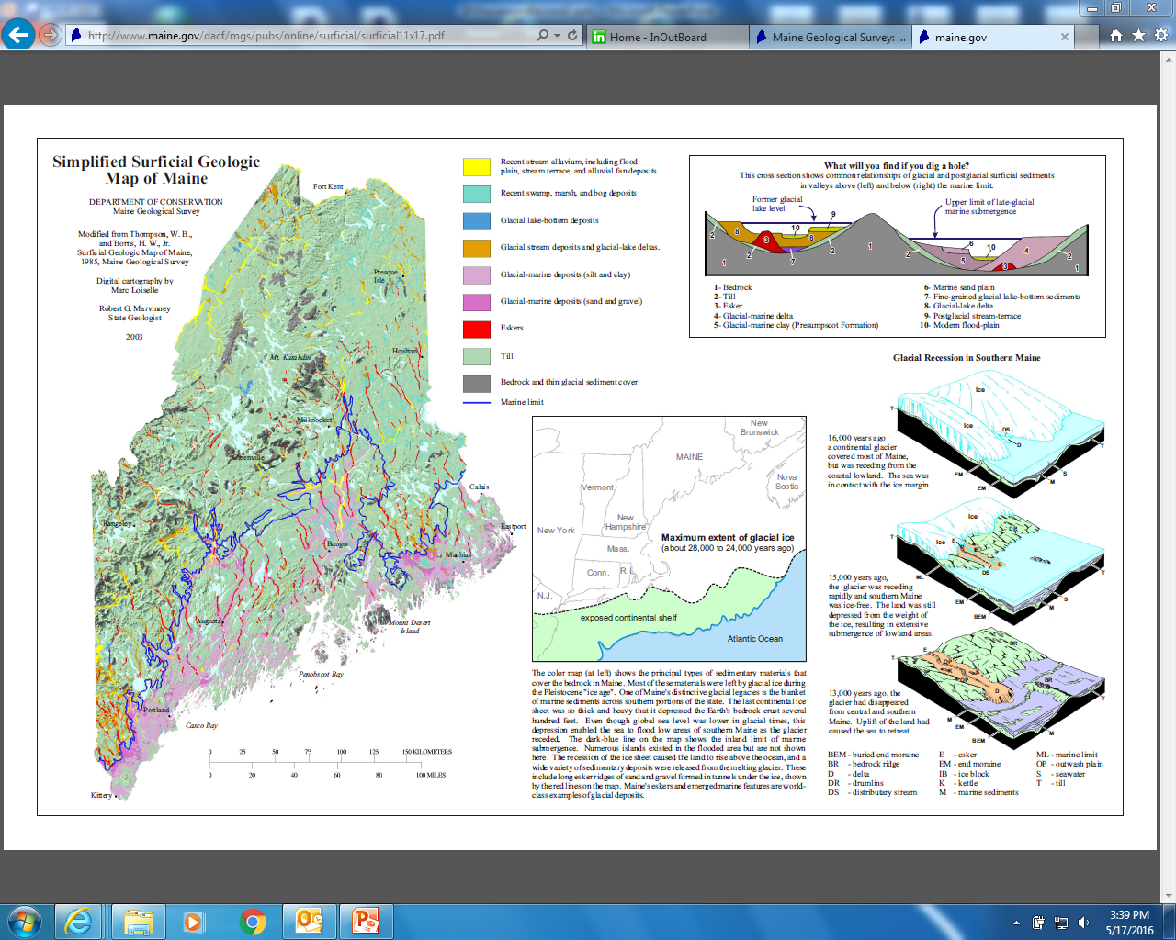
Defining the Resource
MAINE DEPARTMENT OF ENVIRONMENTAL PROTECTION www.maine.gov/dep

Slide 22
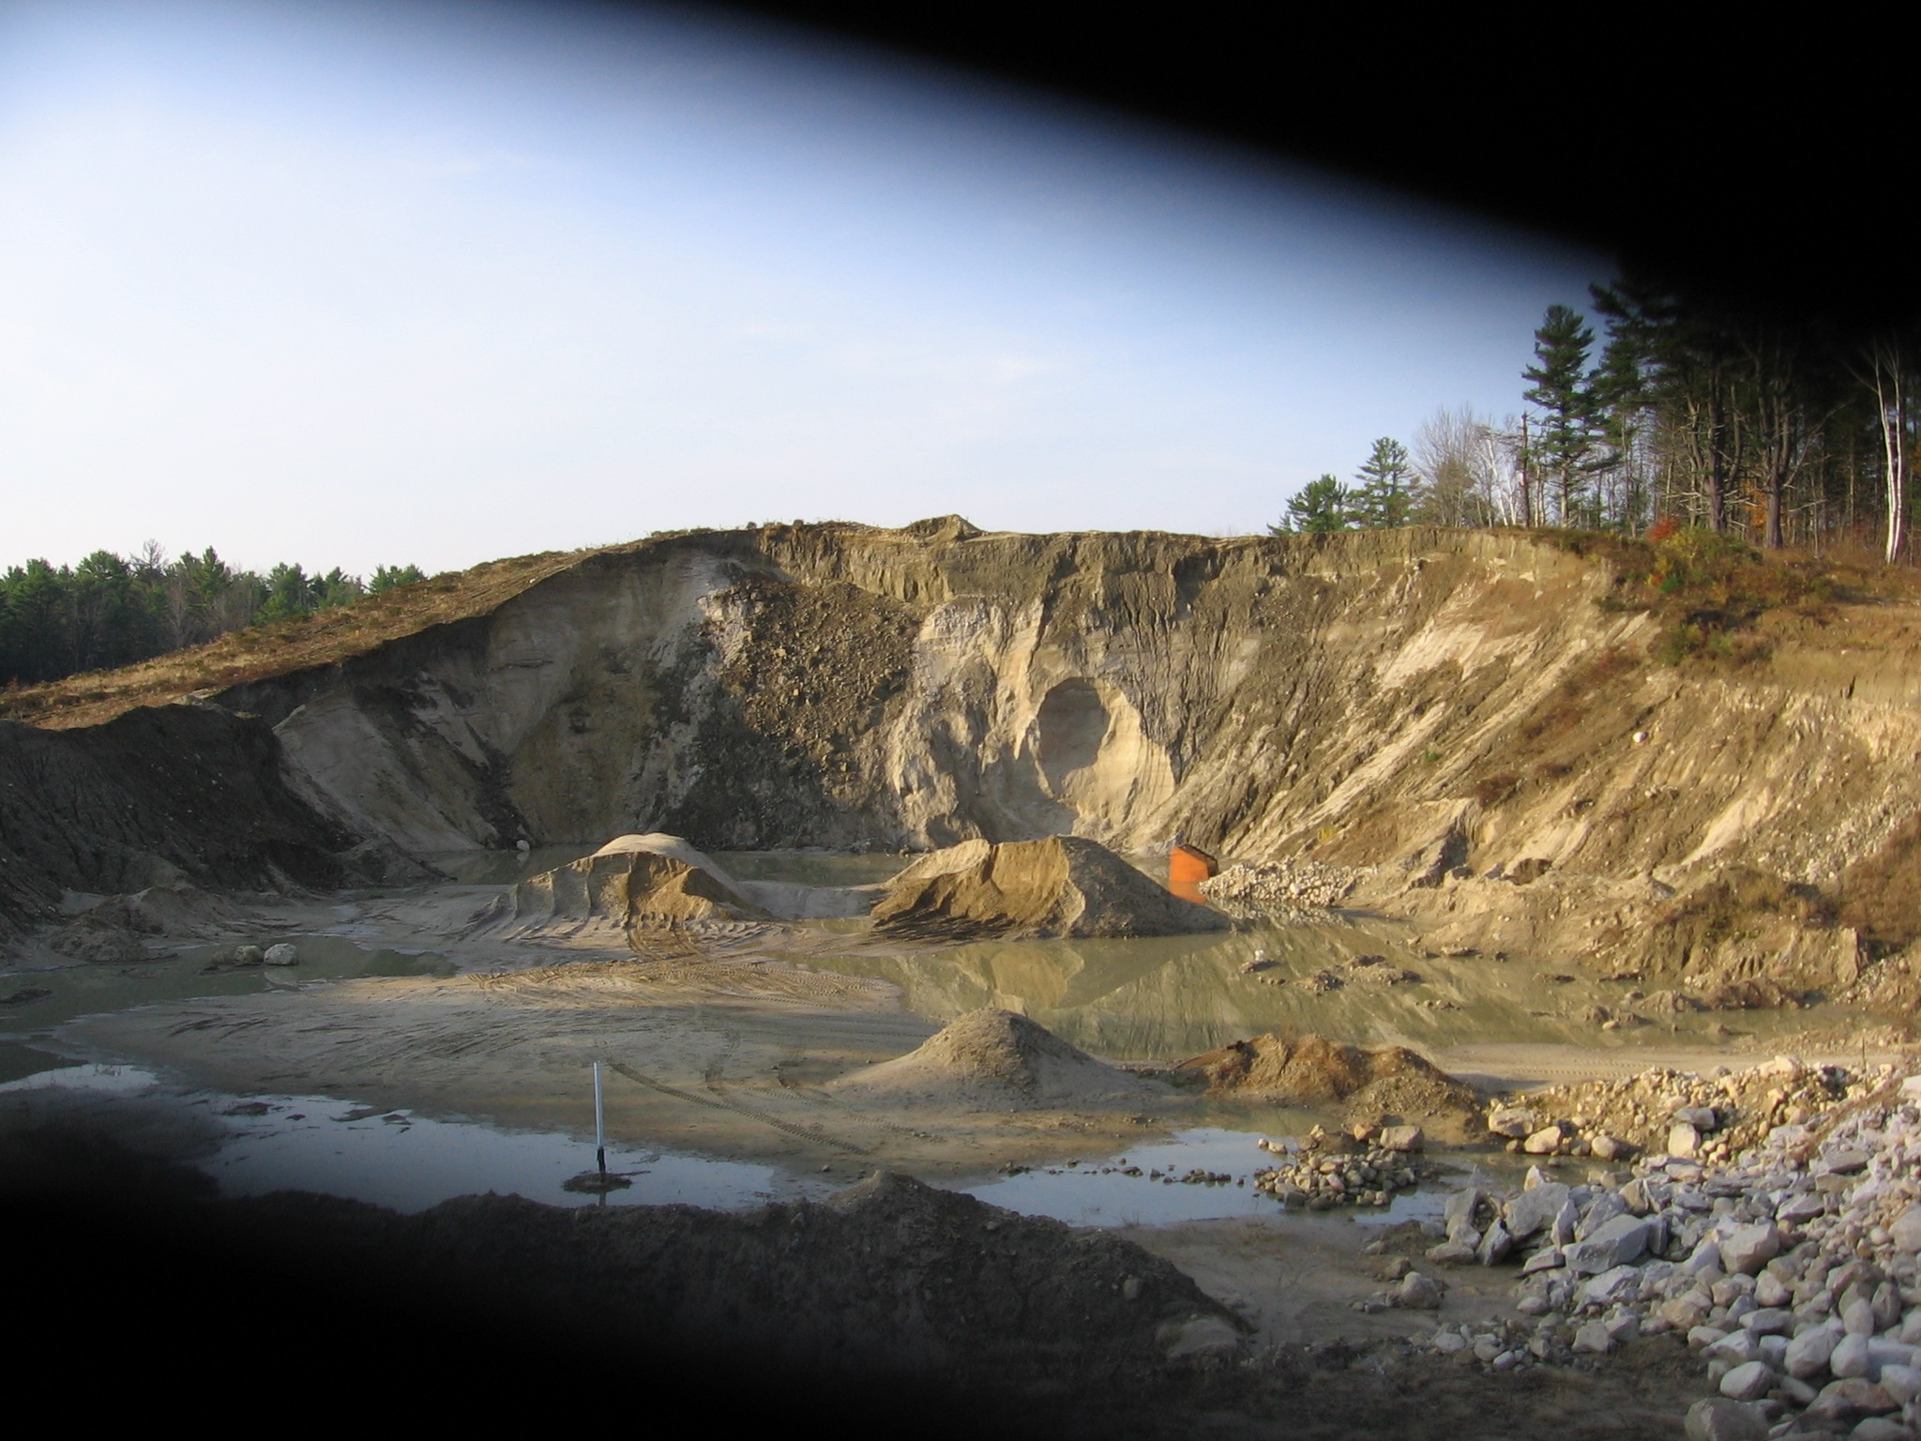
Drumlin Deposits
MAINE DEPARTMENT OF ENVIRONMENTAL PROTECTION www.maine.gov/dep

Slide 23
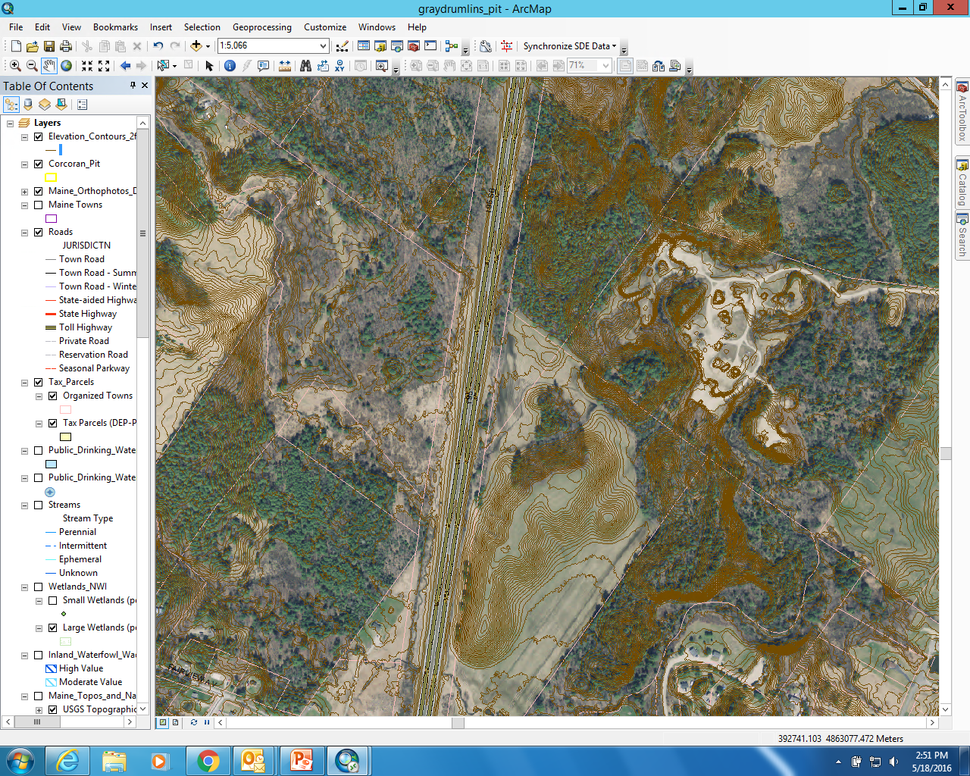
Drumlin Deposits
MAINE DEPARTMENT OF ENVIRONMENTAL PROTECTION www.maine.gov/dep

Slide 24
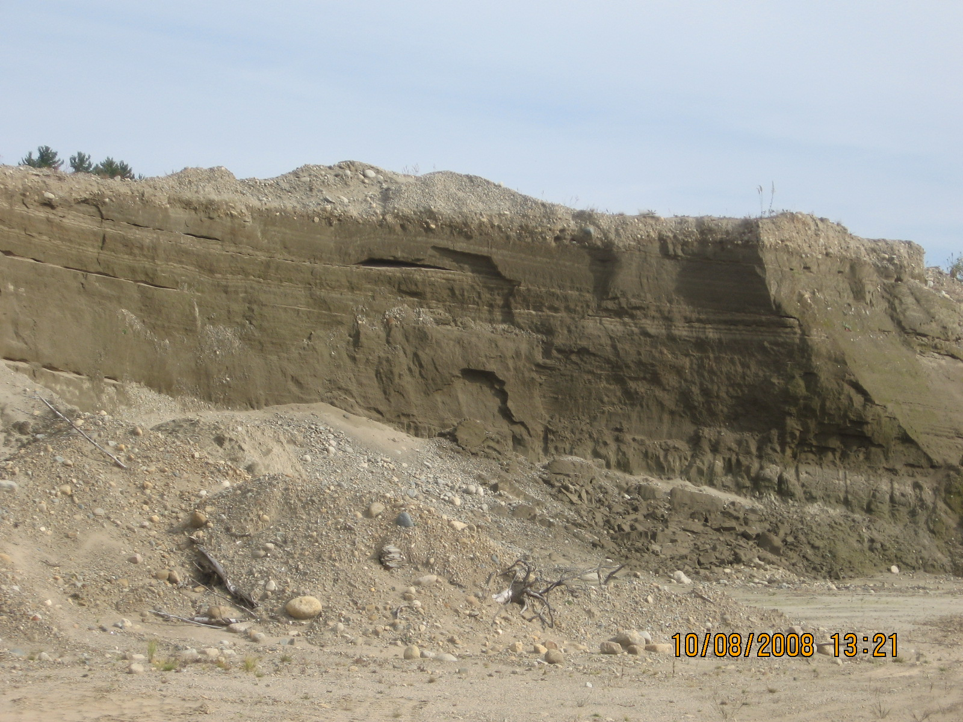
Lacustrine (Lake)
MAINE DEPARTMENT OF ENVIRONMENTAL PROTECTION www.maine.gov/dep

Slide 25
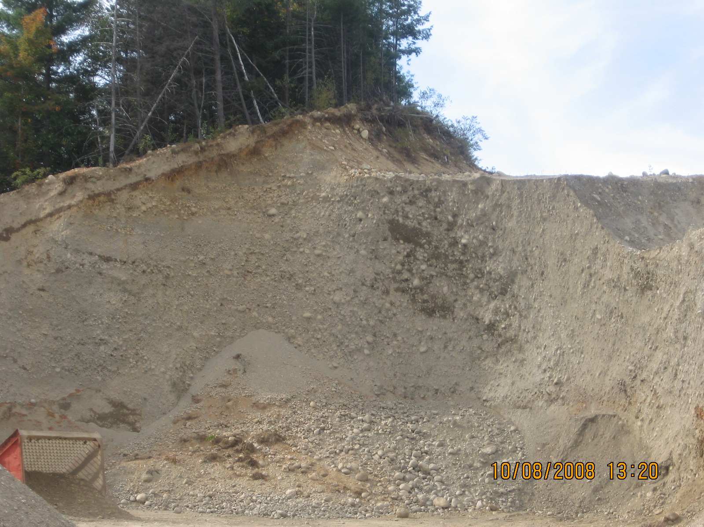
Eskers
MAINE DEPARTMENT OF ENVIRONMENTAL PROTECTION www.maine.gov/dep

Slide 26
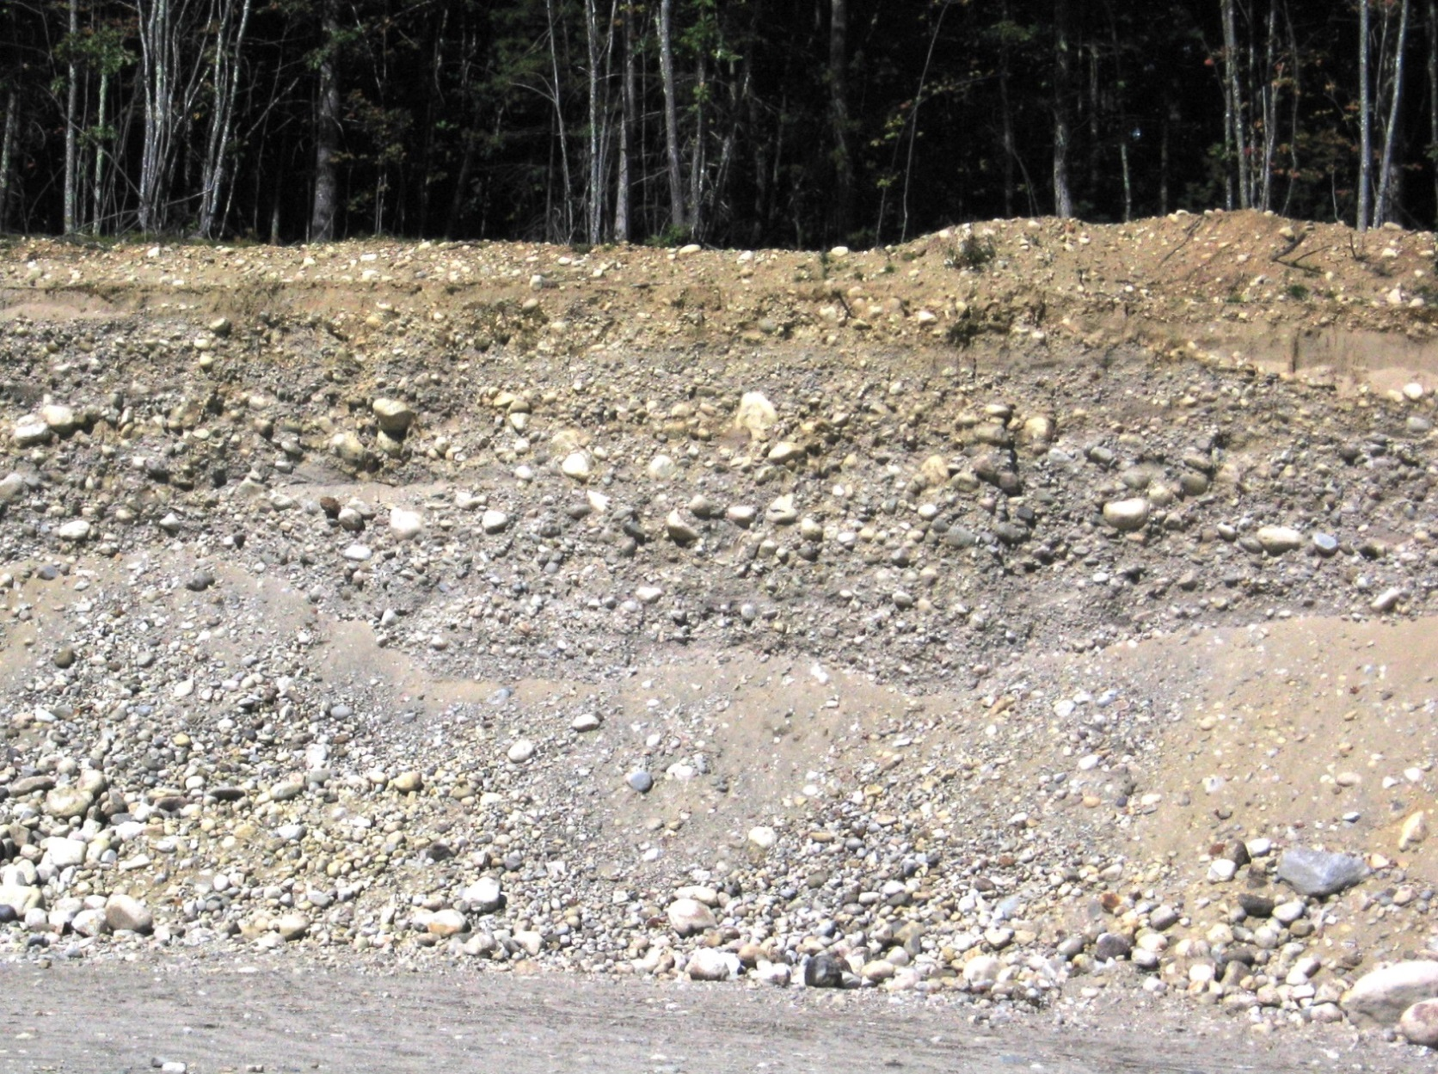
Outwash Deltas
MAINE DEPARTMENT OF ENVIRONMENTAL PROTECTION www.maine.gov/dep

Slide 27
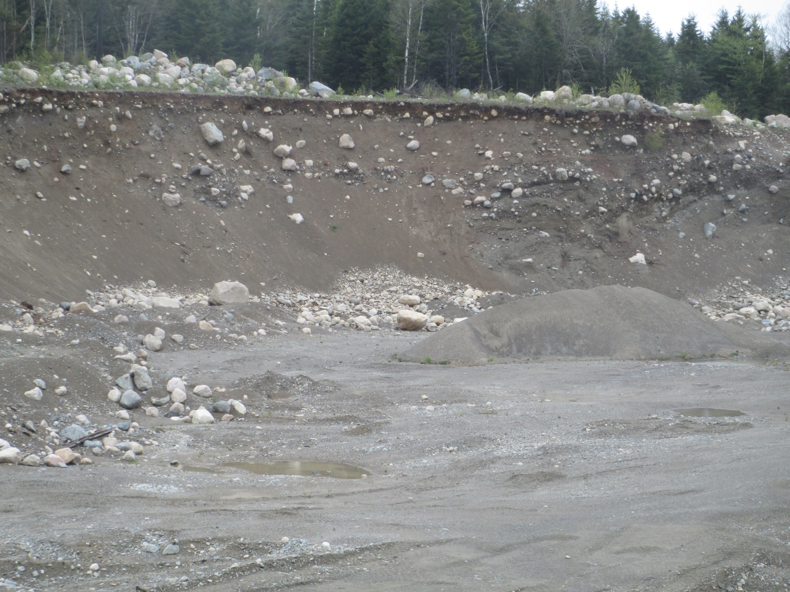
Moraine
MAINE DEPARTMENT OF ENVIRONMENTAL PROTECTION www.maine.gov/dep

Slide 28
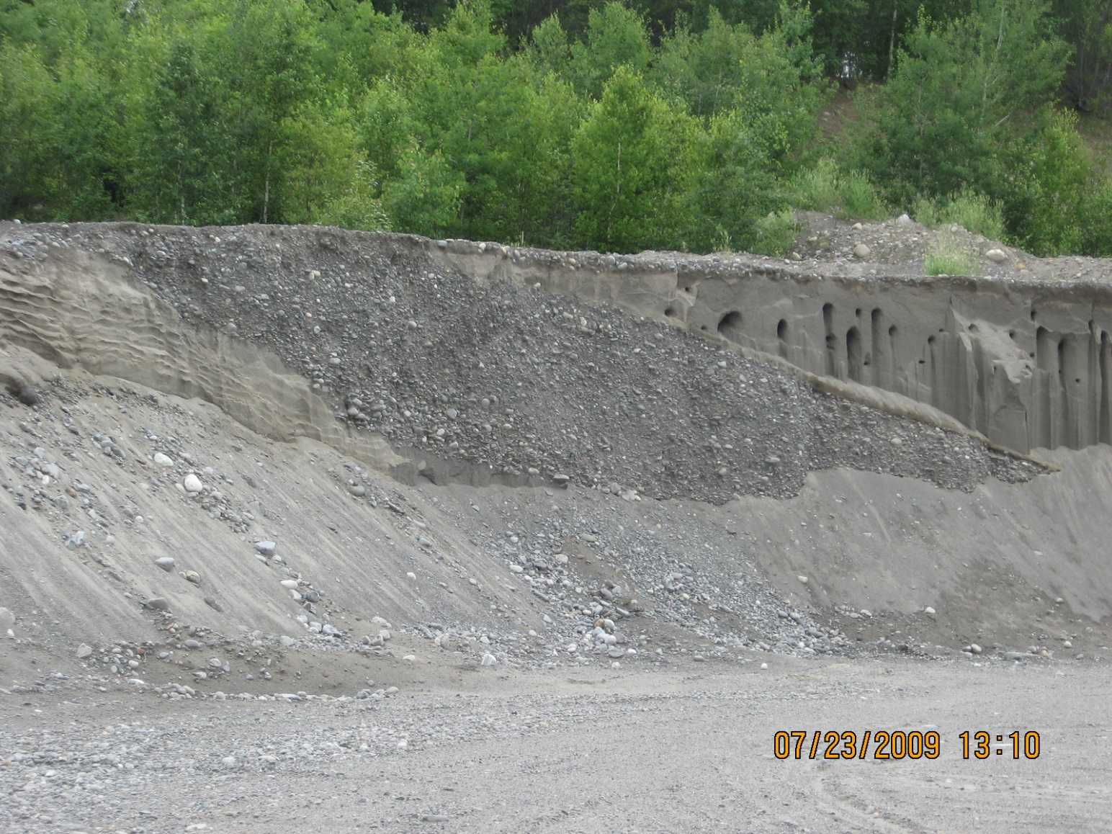
Mixture of Different Materials
MAINE DEPARTMENT OF ENVIRONMENTAL PROTECTION www.maine.gov/dep

Slide 29
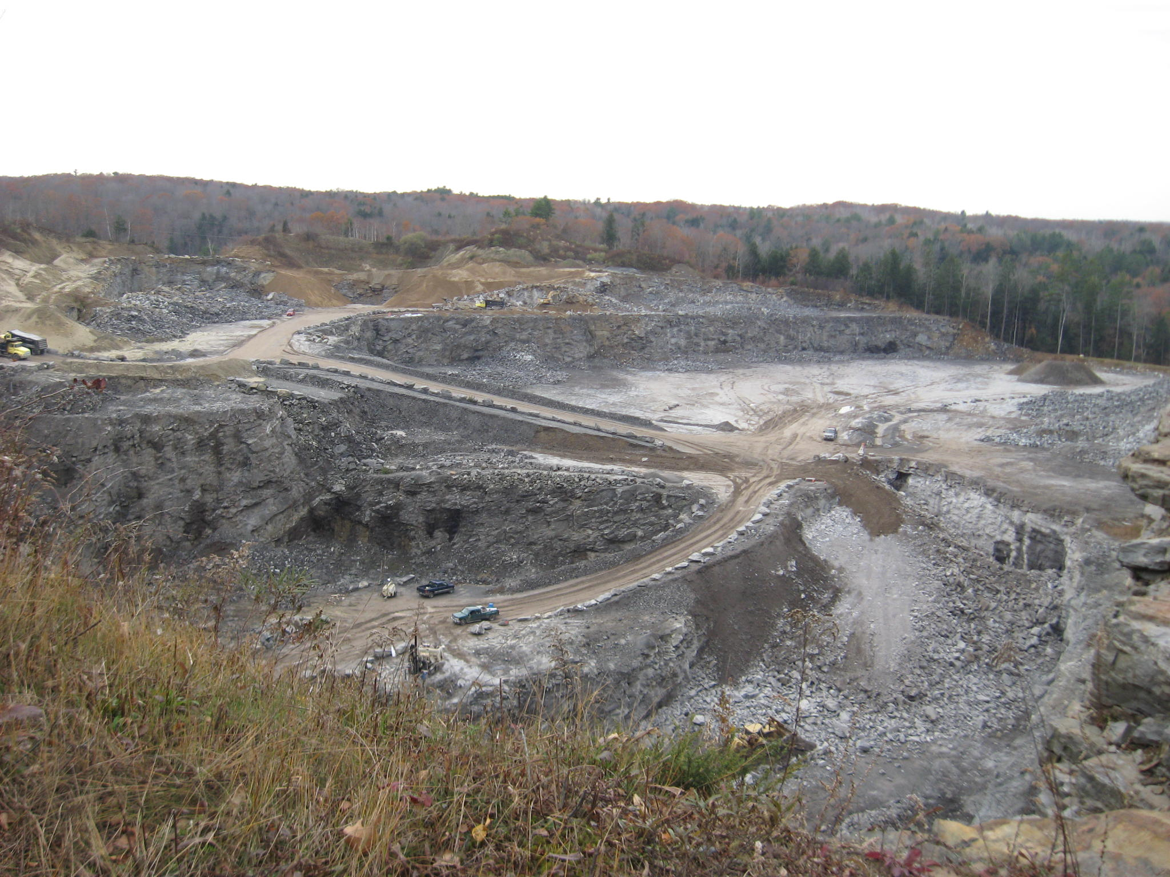
Quarry
MAINE DEPARTMENT OF ENVIRONMENTAL PROTECTION www.maine.gov/dep

Slide 30
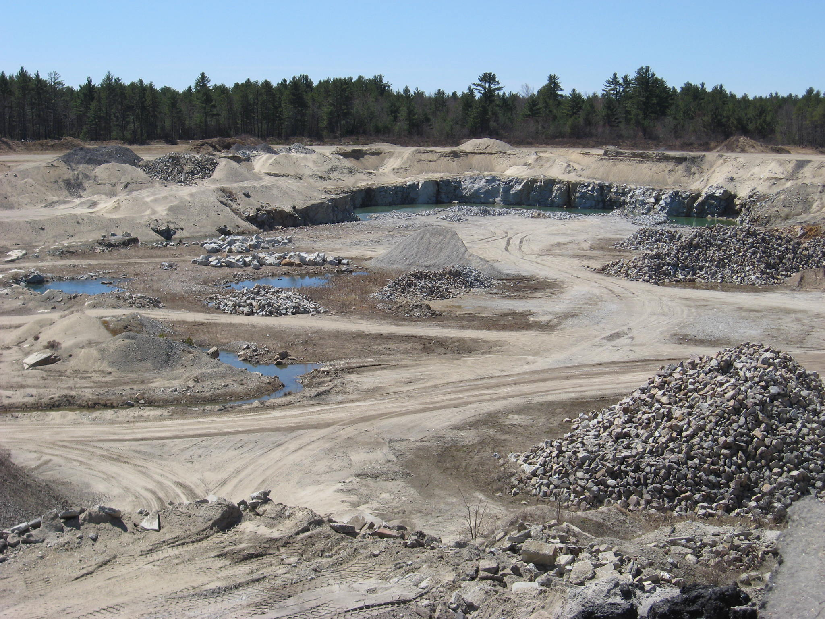
Combination of Quarry & Gravel Pit
MAINE DEPARTMENT OF ENVIRONMENTAL PROTECTION www.maine.gov/dep
Notes:
Some mine sites may contain both sand and rock and are mined at the some time. In this case, the sand/gravel is the overburden layer.

Slide 31
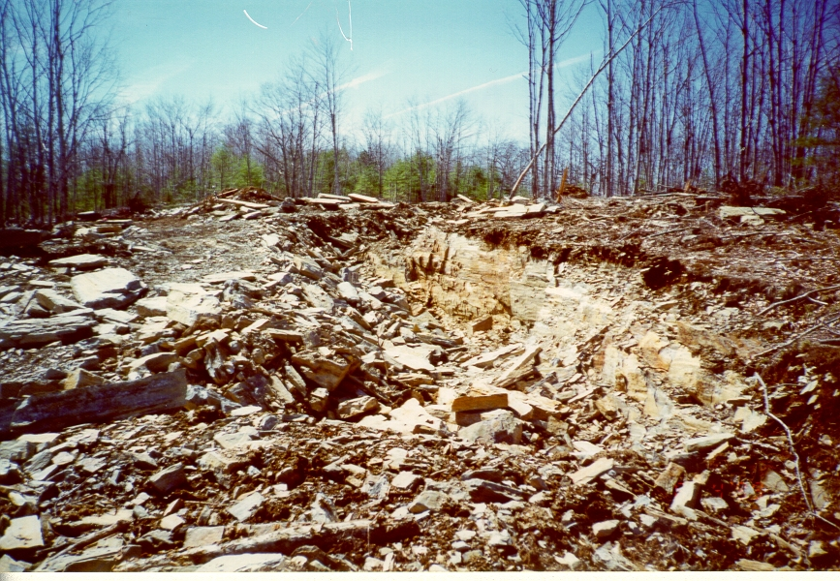
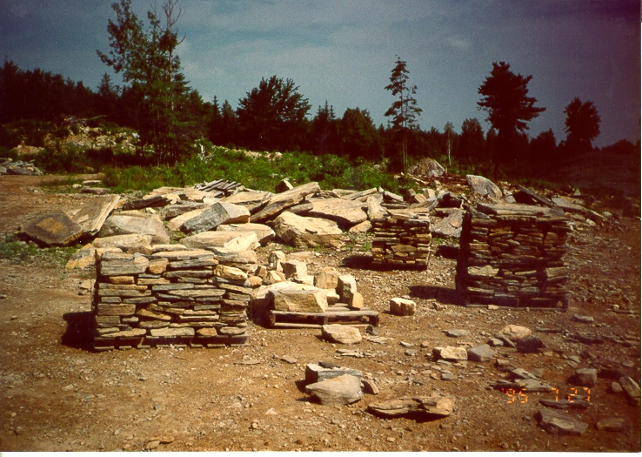
Flat Rock Mine
MAINE DEPARTMENT OF ENVIRONMENTAL PROTECTION www.maine.gov/dep

Slide 32
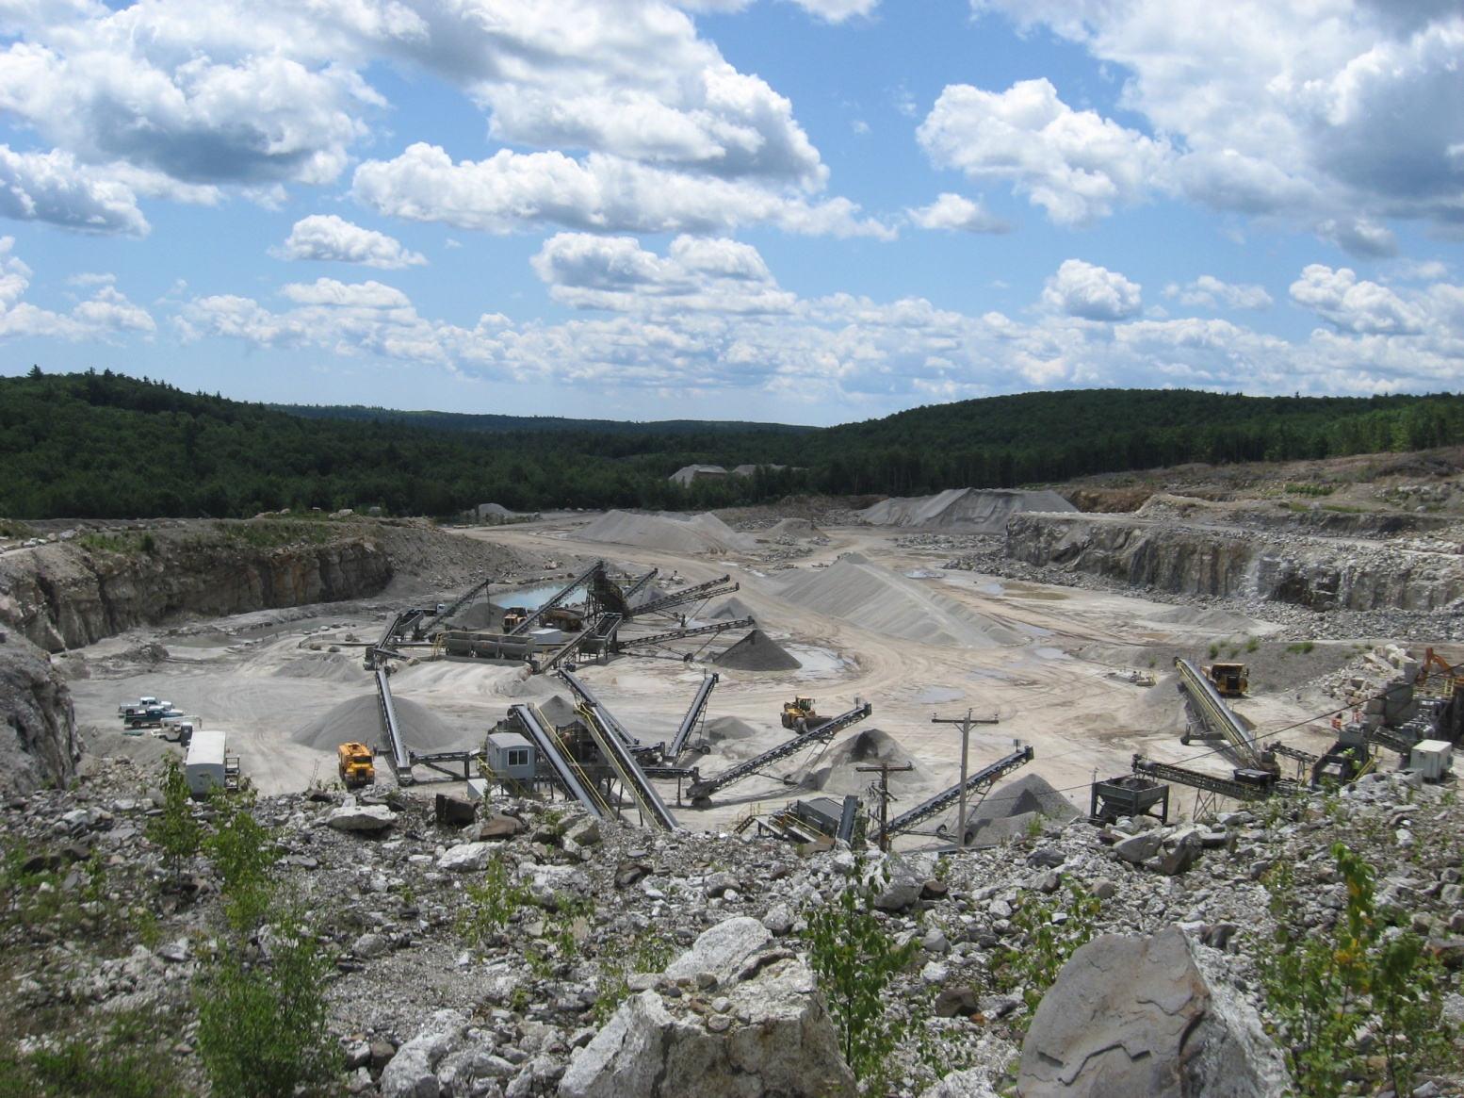
Quarry Facility
MAINE DEPARTMENT OF ENVIRONMENTAL PROTECTION www.maine.gov/dep

Slide 33
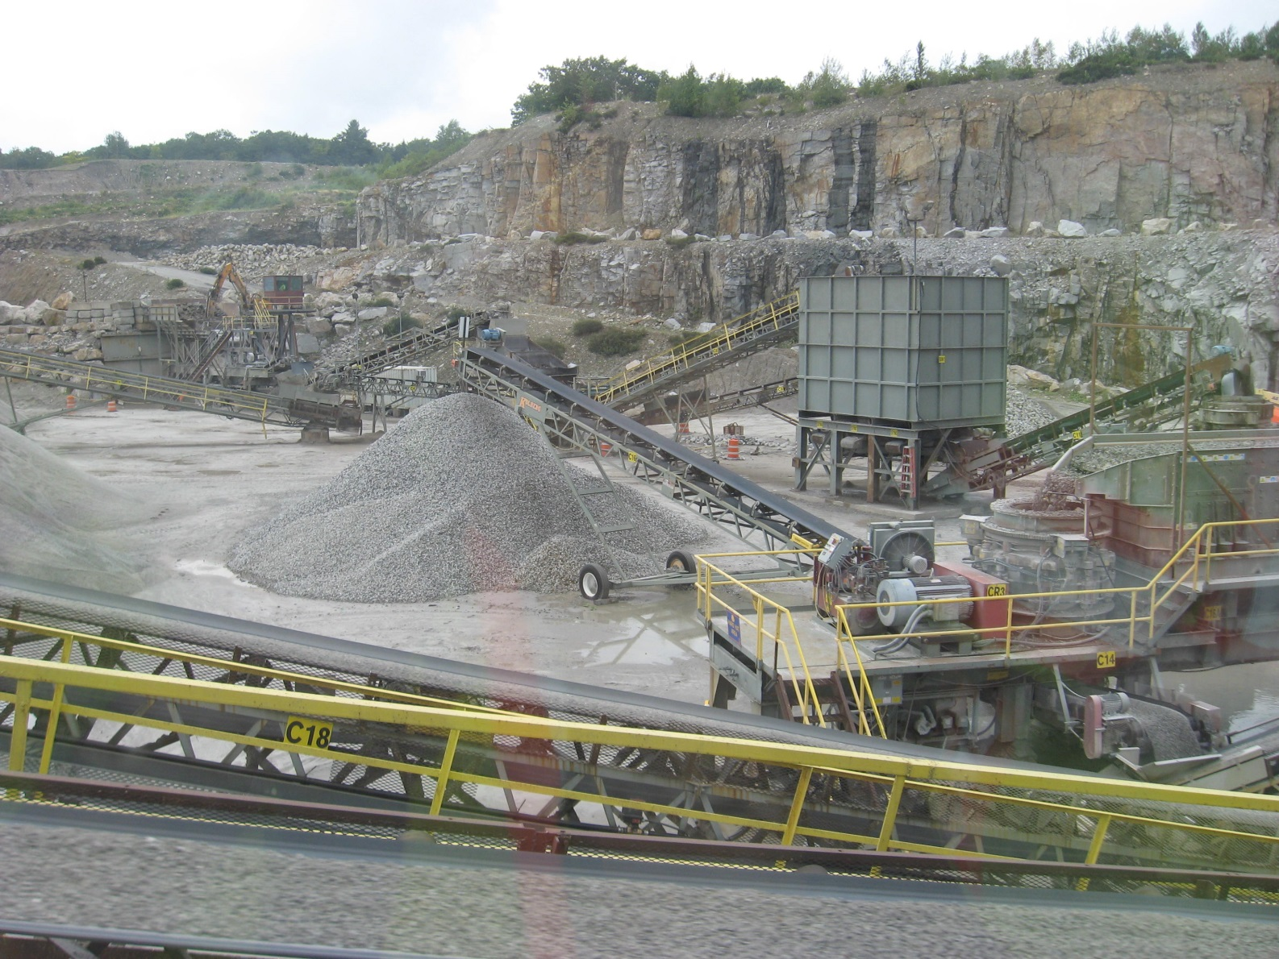
Crushing Plants
MAINE DEPARTMENT OF ENVIRONMENTAL PROTECTION www.maine.gov/dep

Slide 34
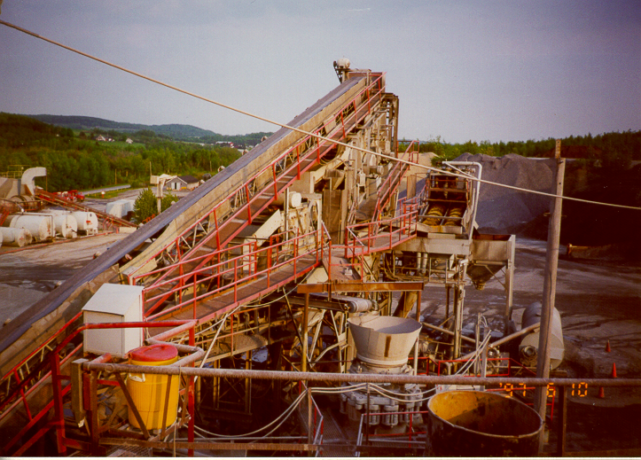
Crushing plants
MAINE DEPARTMENT OF ENVIRONMENTAL PROTECTION www.maine.gov/dep

Slide 35
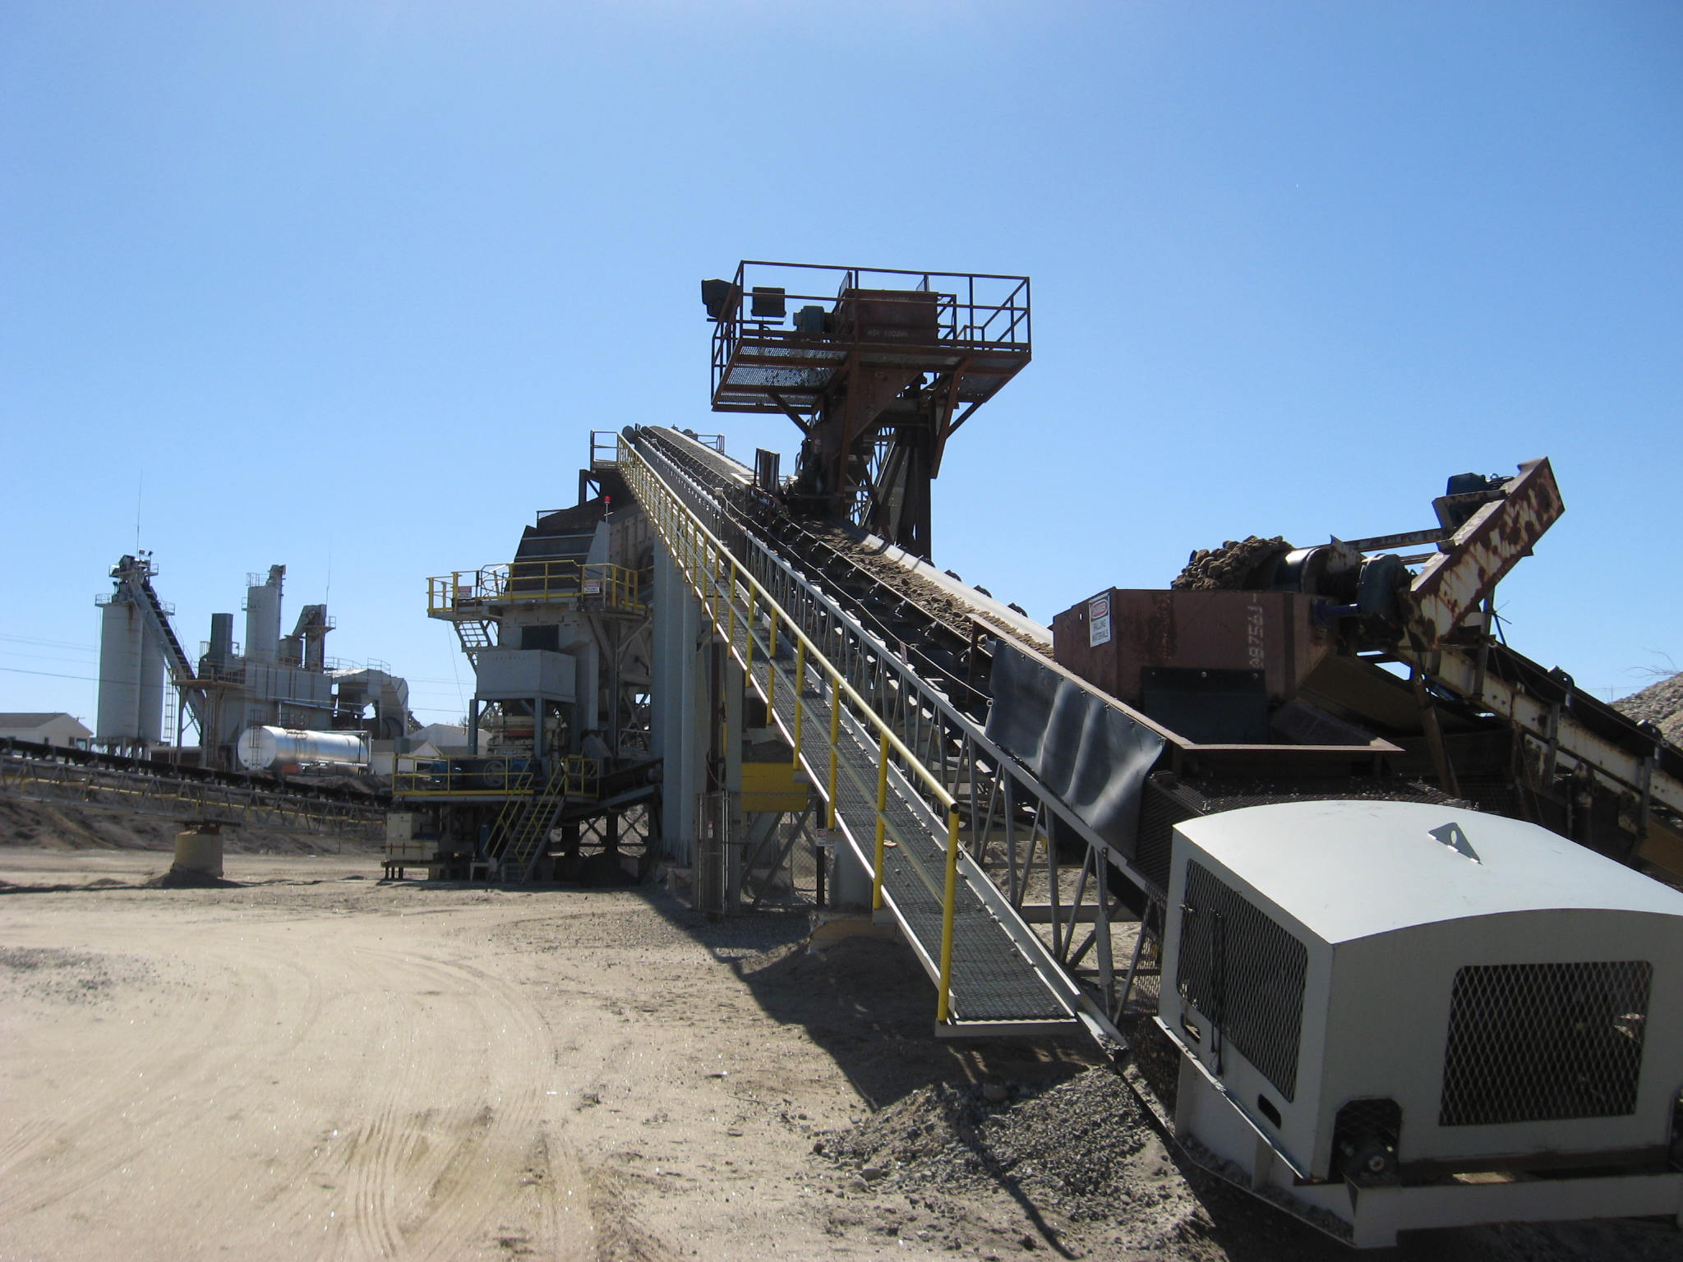
Permanent Crushers
MAINE DEPARTMENT OF ENVIRONMENTAL PROTECTION www.maine.gov/dep

Slide 36
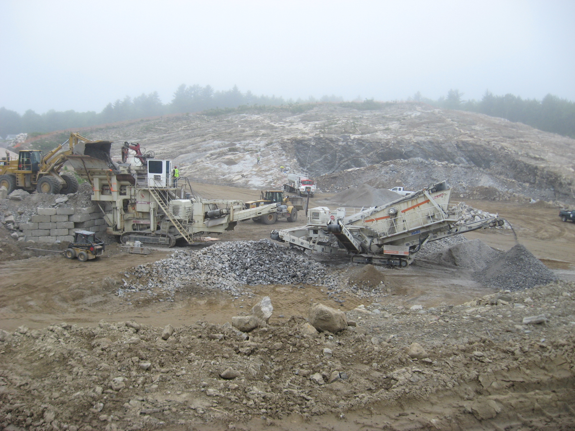
Mobile Track Crushers
MAINE DEPARTMENT OF ENVIRONMENTAL PROTECTION www.maine.gov/dep
Notes:
Track crushers are very portable and can be moved from site to site with less cost than a traditional portable crushing plant. Requires less set-up time.

Slide 37
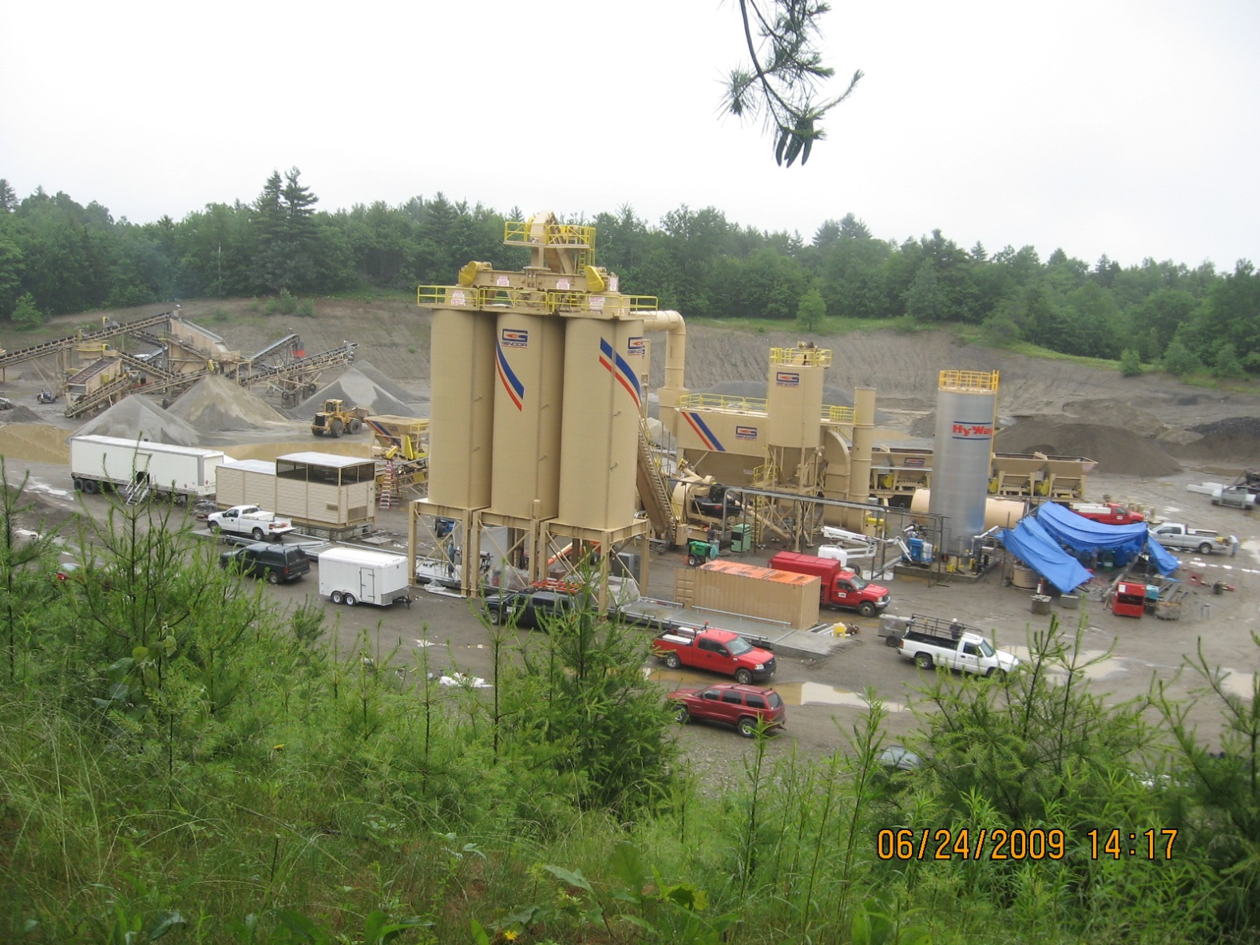
Asphalt Plants
MAINE DEPARTMENT OF ENVIRONMENTAL PROTECTION www.maine.gov/dep
Notes:
Most operators are placing asphalt plants in close proximity to their local markets. Mobile plants are used to cover projects located away from their normal markets

Slide 38
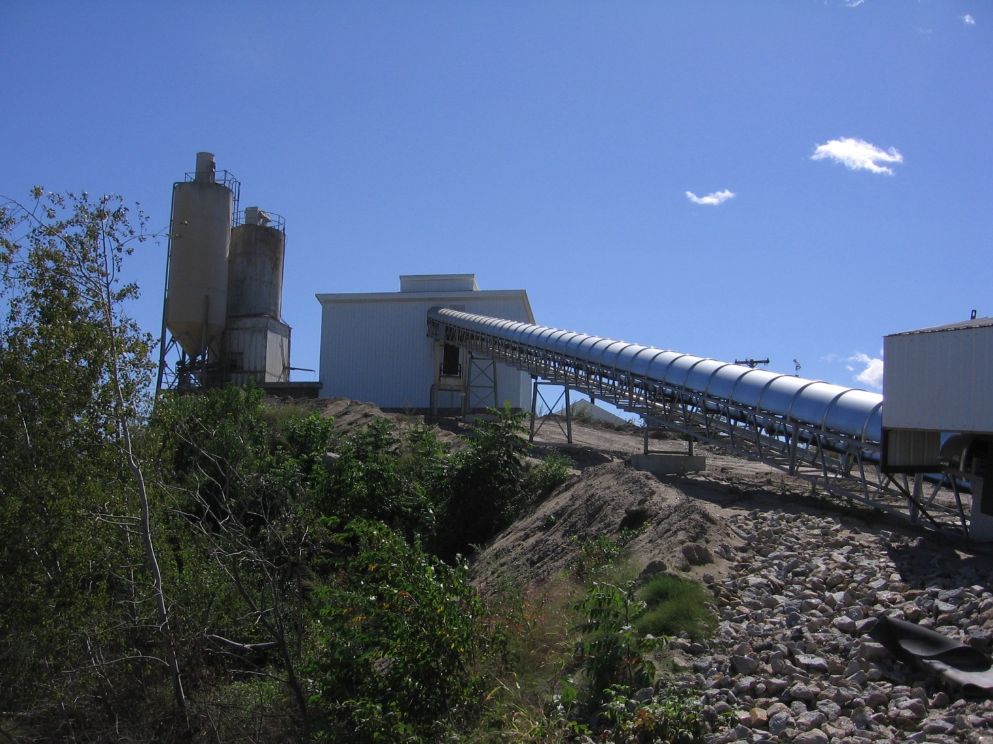
Concrete Plants
MAINE DEPARTMENT OF ENVIRONMENTAL PROTECTION www.maine.gov/dep

Slide 39
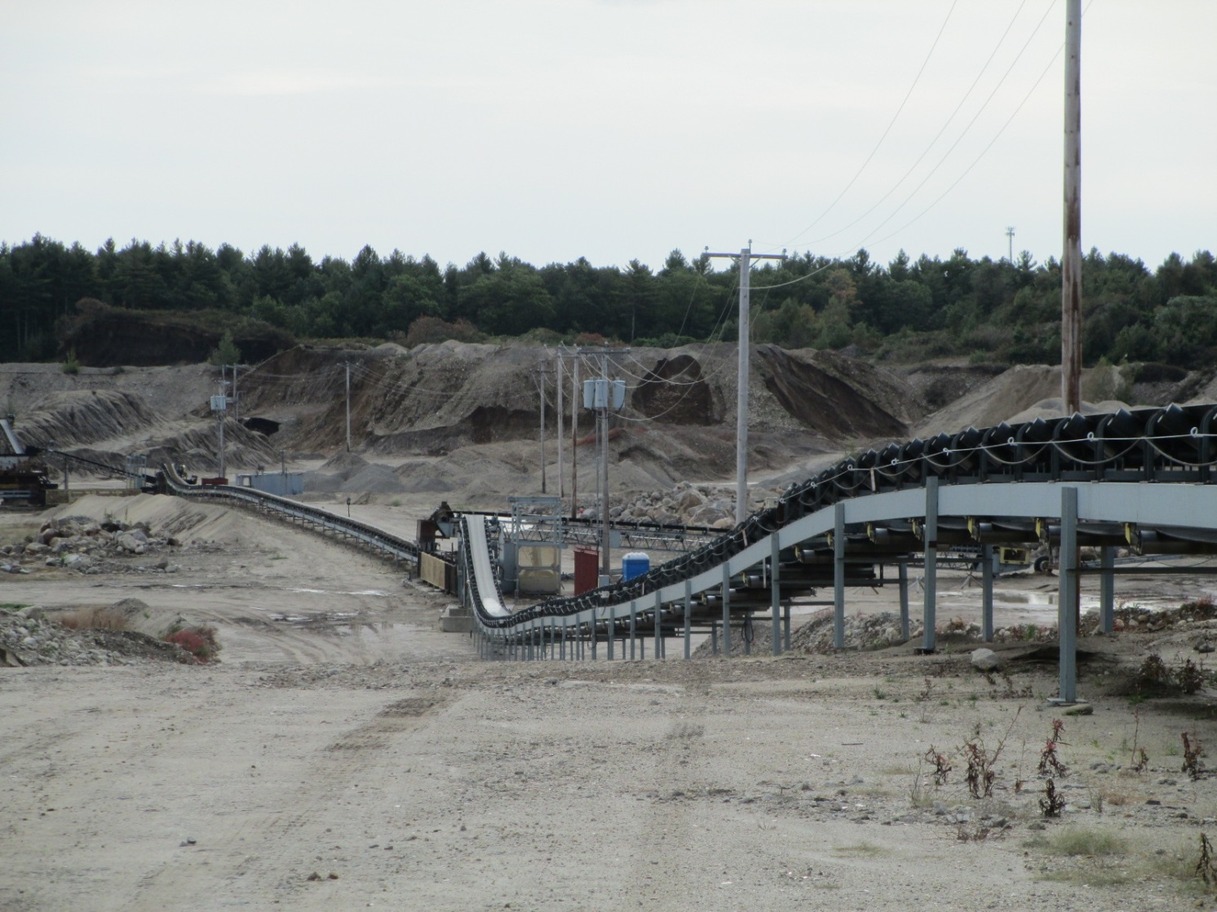
Overland Conveyers
MAINE DEPARTMENT OF ENVIRONMENTAL PROTECTION www.maine.gov/dep
Notes:
Some operators are eliminating onsite transportation cost by employing overland conveyors. Significant cost savings are achieved especially when the price of diesel fuel rises.

Slide 40
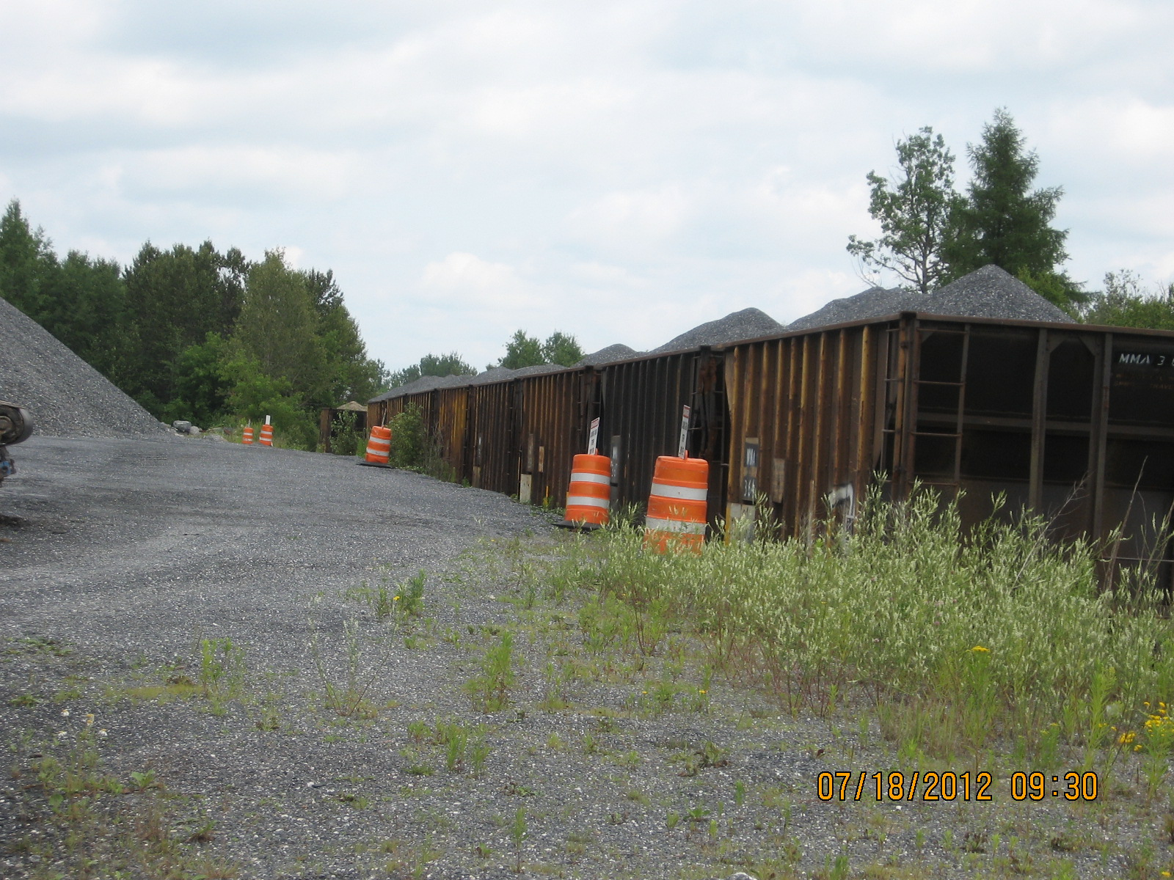
Side Rail Facility
MAINE DEPARTMENT OF ENVIRONMENTAL PROTECTION www.maine.gov/dep
Notes:
99.9 % of the aggregate produce in the State is transported by truck. A few operators may use side rails, but you are at the mercy of the railroad owner for delivery.
In the Midwest, a lot of material is transported by barge.

Slide 41
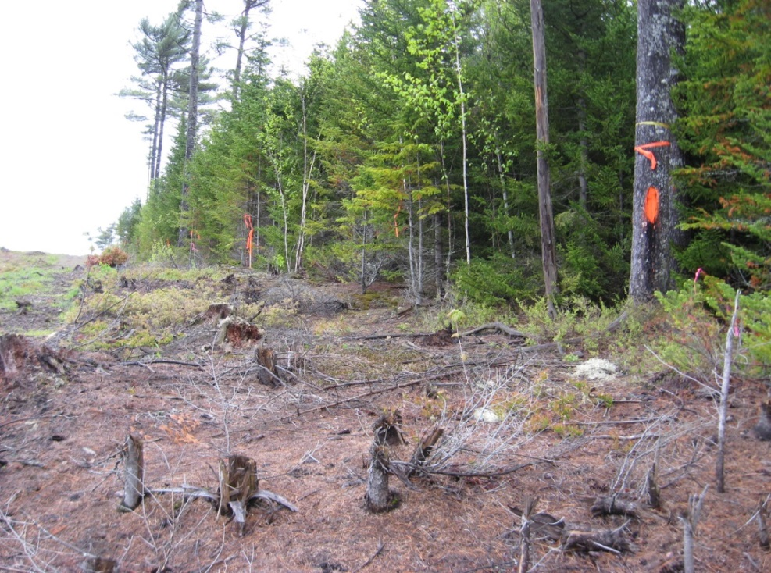
Exclusion Areas-Non Mineable
50 ft. property line buffer
50 ft. property line buffer
Gravel Pit
100 ft. road buffer
75 ft. stream buffer
Be sure you have identified the required buffer line before clearing, grubbing, or excavating in any new area.
MAINE DEPARTMENT OF ENVIRONMENTAL PROTECTION www.maine.gov/dep

Slide 42
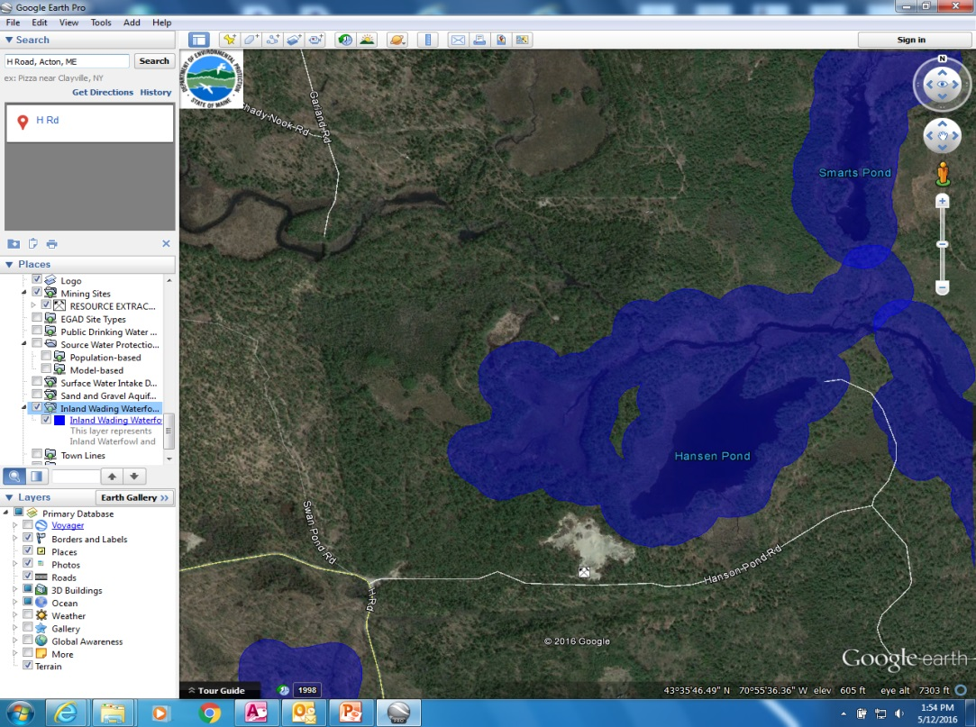
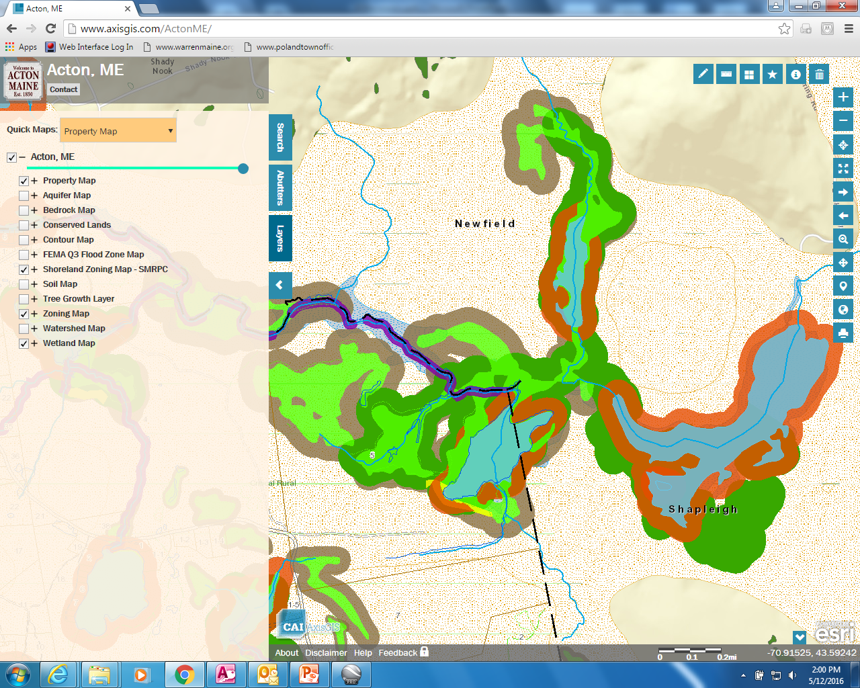
Other Exclusion Areas
Local Zoning Restrictions
Water Table
Setbacks
Source: Town Of Acton Online Maps
MAINE DEPARTMENT OF ENVIRONMENTAL PROTECTION www.maine.gov/dep
Notes:
Buffers must be maintained even when they are distant from the actual active pit. Nothing may be cut in buffers, even for forestry purposes. Permitting requirements may restrict the value of estimated reserves.

Slide 43
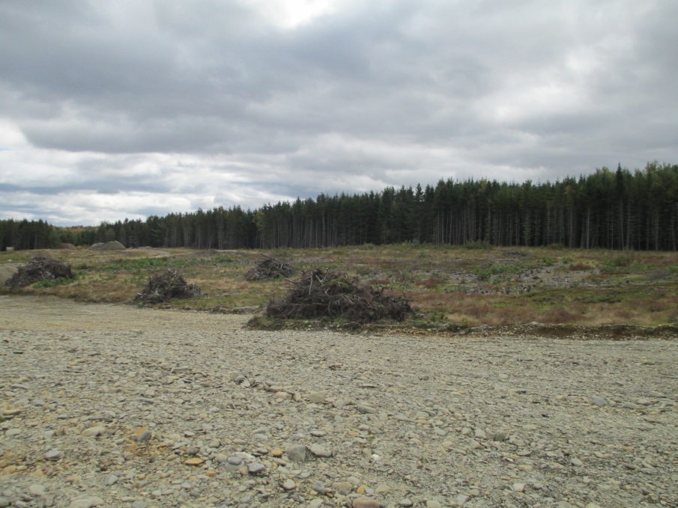
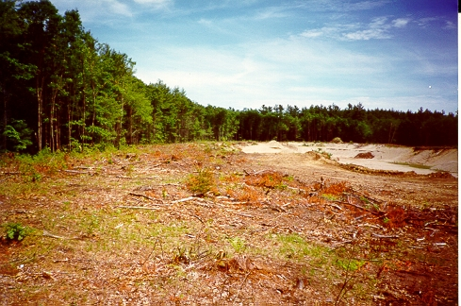
Working Pit Area
What is the working pit?
  Excavation area.
  Includes sideslopes.
  Does not include fixed structures or stockpile areas
MAINE DEPARTMENT OF ENVIRONMENTAL PROTECTION www.maine.gov/dep
Notes:
Working pit is defined by statute under the Performance Standards.

Slide 44


Reclamation Cost
Cost include : Direct Cost: Structure removal, earthmoving (grading & backfilling) , revegetation
Indirect Costs: Mobilization & demobilization, contingencies, cost of 3rd Party
MAINE DEPARTMENT OF ENVIRONMENTAL PROTECTION www.maine.gov/dep
Notes:
Reclamation cost must be incorporated into the operating expense of the operator. At Dep, we use a flat rate of $3500 per acre, assuming that topsoil has been salvaged at the site. If not, the cost of reclamation substantially increases. DEP doe not use full cost bonding approaching . You can use Means Cost Data to estimate construction cost.

Slide 45


Reclamation
Sideslopes 2.5 H : 1 V
90% ground cover
Remove all structures
Mandatory topsoil salvage
MAINE DEPARTMENT OF ENVIRONMENTAL PROTECTION www.maine.gov/dep
Notes:
The list above includes the reclamation standards required under the performance standards.

Slide 46



Conversion to other land uses
MAINE DEPARTMENT OF ENVIRONMENTAL PROTECTION www.maine.gov/dep
Notes:
Mine sites are a temporary land uses and are ultimately converted to other types of land uses such residential , commercial and agricultural properties.
Examples: Lewiston –Walmart Distribution Center-Former Clay and sand pits
Westbrook –Blue Rock Quarry converted to commercial with large scale retailers.
Poland - Former sand & gravel pit converted into office building which houses SAD 16

Slide 47

Fair Market Value
Valuation Methods:
Asset Based/Cost
  Determine value of all assets
Market Approach
  “Comps”
Income Based
  Discounted cash flow
MAINE DEPARTMENT OF ENVIRONMENTAL PROTECTION www.maine.gov/dep
Notes:
“FMV”is defined as a selling price for an item to which a buyer and seller can agree.
Fair market value can be determined by three approaches used to evaluate mineral properties.
USPAP-Uniform Standards of Professional Appraisers Practice.

Slide 48
Valuation Methods-Market
“Sales Comp”
Commonly used in selling houses, offices, commercial buildings
Mine sites are unique:
  Sales infrequent
  Sale price confidential
  All mine sites are uniquely different. (apples & oranges)
MAINE DEPARTMENT OF ENVIRONMENTAL PROTECTION www.maine.gov/dep

Slide 49
Valuation Methods
Asset Based/Cost
What would it cost to recreate the business.
Method used for valuing non-performing assets.
Value of all assets:
  Sum of all assets
  Non performing assets are included (excess equipment)
  Usually not used in valuing mine properties.
MAINE DEPARTMENT OF ENVIRONMENTAL PROTECTION www.maine.gov/dep

Slide 50
Valuation Methods-Income
Use Discounted Cash flow analysis
Most accurate methods to establish value for mines.
  Maybe harder to use this method for small mines
Information needs:
  Long term mine plan
  Sales, Cost & Capital
  Forecast future demand
  Mine life (25 years)
  Deposit quality
  Mine design: annual production data
MAINE DEPARTMENT OF ENVIRONMENTAL PROTECTION www.maine.gov/dep
Notes:
Income approach: All income is discounted year by year at a specific rate.
Type of material extracted, geology, market conditions:, assets owned, reclamation cost, permitting cost… Remember transportation cost. Usually markets are within 35 miles. Trucking is one of the most expensive cost for sand, gravel and rock.
Royalty based approach w DCF
If you need assistance seek the help of an appraiser certified in appraising mineral properties.

Slide 51

Capital Investments
MAINE DEPARTMENT OF ENVIRONMENTAL PROTECTION www.maine.gov/dep
Notes:
To increase production rates (tonnage) requires capital investments on equipment. This is a scale model of a $12 million crushing facility located in Southern Maine. Obviously, a strong market demand for aggregate is required to justify the expenditure.

Slide 52
Pit and Quarry Depletions
Name | Cubic yards
Pit A | 124,000
B | 1,498
C | 0
D | 9,324
E | 0
F | 0
G | 14,710
H | 0
I | 0
J | 19,364
Name | Cubic Yards
A | 3,000
B | 5,000
C | 7,000
D | 6,000
E | 1,000
F | 500
G | 10,000
H | 500
Name | Cubic Yards
A | O
B | O
C | O
D | 338,031
E | 28,163
F | 261,608
G | 0
H | 0
I | 55,490
J | 0
K | 0
O
MAINE DEPARTMENT OF ENVIRONMENTAL PROTECTION www.maine.gov/dep
Notes:
This slide depicts the amount of material removed annual y from some licensed pits in Maine. Its important to note that some sand & gravel operations may be inactive for many years with no material removed. These pits become active only when a nearby project needs aggregate material.
Most of the large scale operators in the State have a processing facility, such as an asphalt plant or concrete plant that requires a large amount of aggregate to produce the final product.

Slide 53

Pit & Quarry Depletions
Annual fee for DEP
  30% operators remove <2,500 cubic yards
  70 % operators remove >2,500 cubic yards
MAINE DEPARTMENT OF ENVIRONMENTAL PROTECTION www.maine.gov/dep
Notes:
30% value represents roughly 260 small sand & gravel operators licensed by DEP.

Slide 54

What is the Fair Market Value?
Asset Based
  Determine value of all assets
Market Approach
  “Comps”
Income Based
  Discounted cash flow
How this process makes me feel!
MAINE DEPARTMENT OF ENVIRONMENTAL PROTECTION www.maine.gov/dep
Notes:
All valuation methods require assumptions. All assumptions must reflect reality. In other words the data/ assumptions must be justifiable and defensible.
Review Court cases:

Slide 55
Summary
Variety of mineral commodities have been mined in Maine.
In 1993, MDEP moved to a performance –based regulatory process.
Several different methods are used to establish fair market value for mine sites. Each method has advantages and disadvantages.
Mine sites are uniquely different. (Geology & Market).
How do you assess the value of a depleting resource?
MAINE DEPARTMENT OF ENVIRONMENTAL PROTECTION www.maine.gov/dep

Slide 56

Questions? Call Us?
Mark Stebbins – 822-6367
mark.n.stebbins@maine.gov
Erich Kluck – 899-6879
erich.kluck@maine.gov
MAINE DEPARTMENT OF ENVIRONMENTAL PROTECTION www.maine.gov/dep

Slide 57
www.maine.gov/dep

