Slide 1
Incident Management Team
Workshop 2023
Team-Based Incident Command System Training
Wyman Briggs
USCG Sector Northern New England

Slide 2
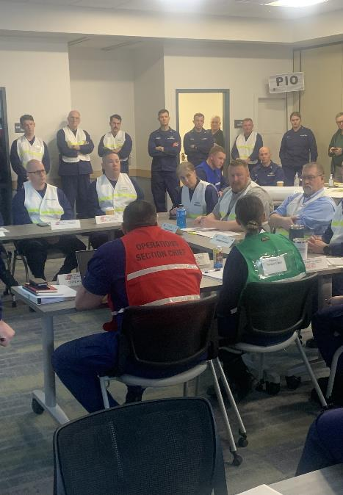
Background
Coast Guard’s ICS 300 training now conducted online
Position-based ICS training conducted virtually
Need for hands-on ICS training for Coast Guard and Agency Partners

Slide 3
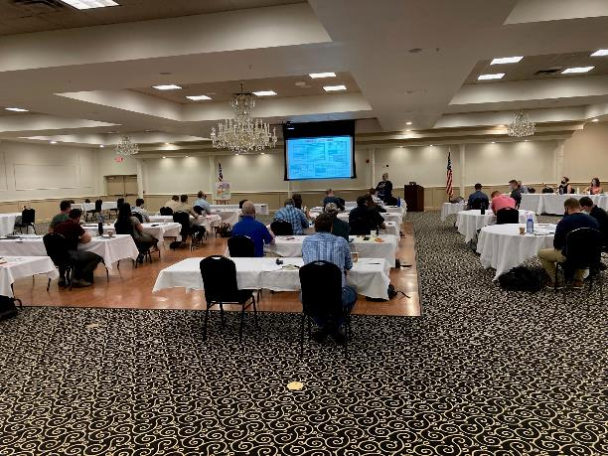
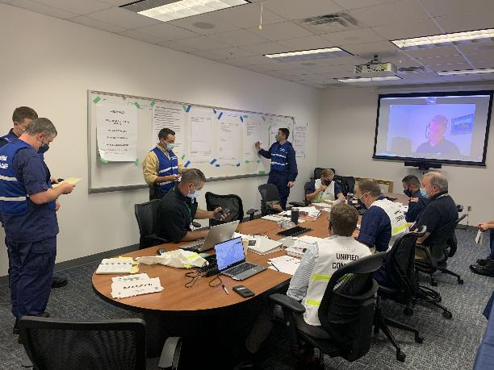
IMT Workshop 2021
SNNE first held a locally sponsored IMT Workshop in September 2021
Prepared responders for Penobscot Bay Full Scale Exercise

Slide 4
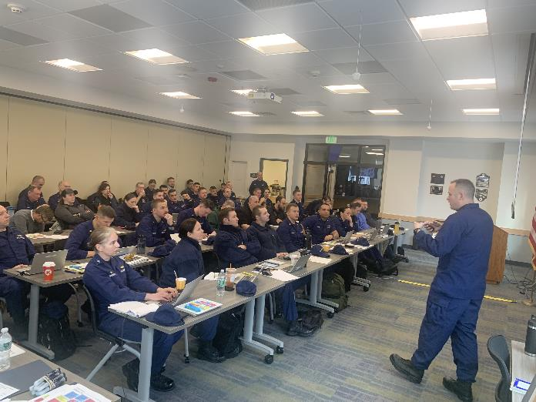
IMT Workshop 2023 Overview
Held on Feb 8-9, 2023 at Scarborough Public Safety Building
ICS Training for 40 SNNE IMT members and seven agencies
Instructors from SNNE, SEC Boston, D1 and USCG Academy

Slide 5
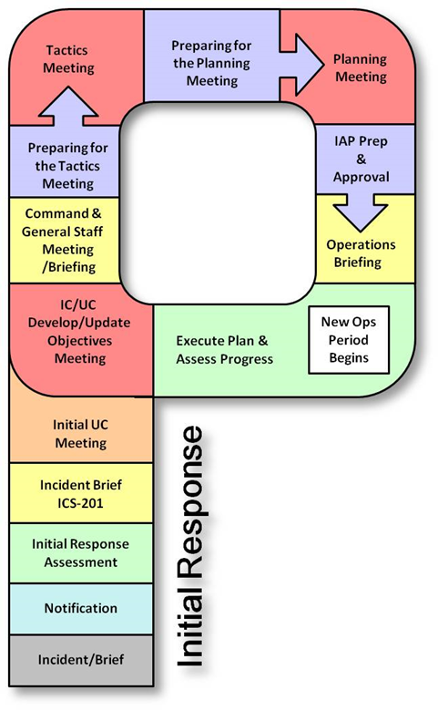
IMT Workshop Agenda
Basic ICS Principles
ICS Forms
Incident Information
Resource Management
ICS 201 Brief
Initial IC/UC Meeting
Command and General Staff Meeting
Safety and Tactics
Planning Meeting
Operations Brief/ IAP

Slide 6
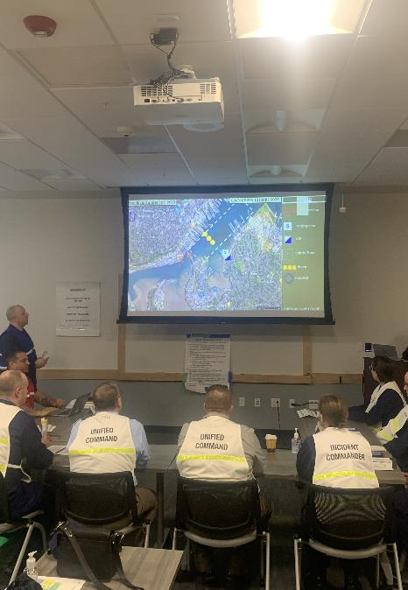
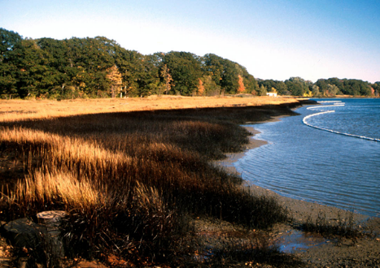
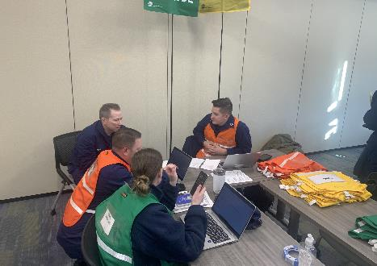
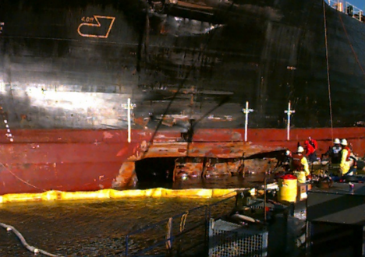
Scenario-Based Role Playing

Slide 7
Workshop Lessons Learned
Positives
Participants highlighted value of combined formal ICS 300 refresher and hands-on role playing ICS meetings
Agency representatives appreciated opportunity to participate in Workshop
Breakouts with coaches for specific training
New MS TEAMS based IMT application showed promise including resource tracking
Deltas
Need to develop means to better share TEAMS platform across agencies
Need to develop more complete digital situation displays and Common Operational Picture
Classroom a bit tight for 53 participants

Slide 8
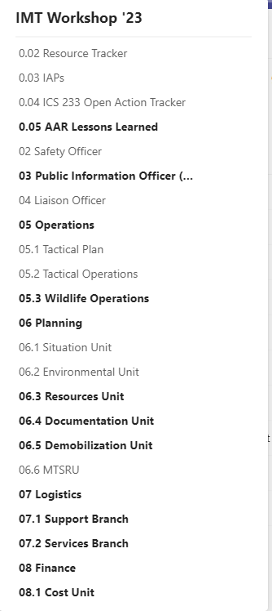
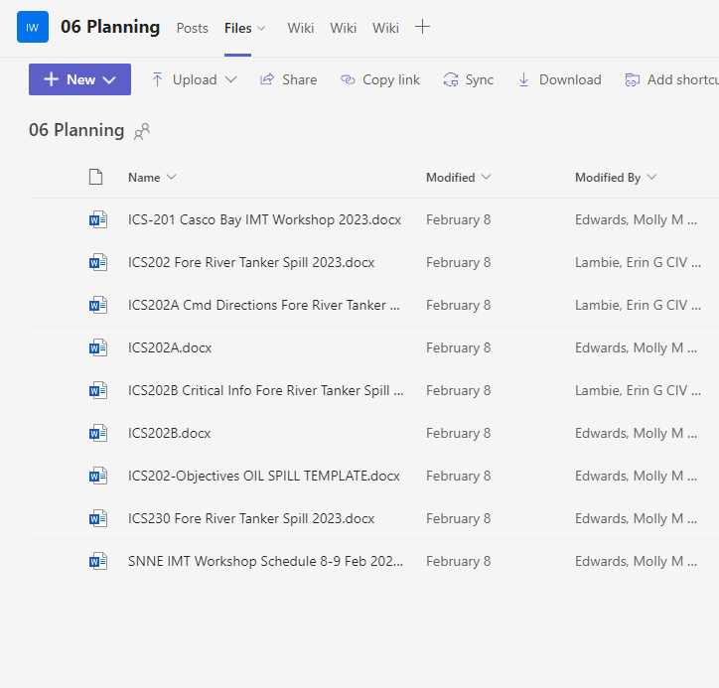
TEAMS for IMT

