Slide 1

Maine Department of Environmental Protection
Response Services
AFFF and PFAS emerging awareness of impacts to the Aquatic environment
MAINE DEPARTMENT OF ENVIRONMENTAL PROTECTION
Protecting Maine’s Air, Land and Water

Slide 2
Recent Responses with AFFF discharges to water
Madawaska fire Department AFFF discharge to St. John River September 21, 2022
The Division of Response Services was notified of a release of PHOS fire fighting foam to two storm drains. Approximately 10 gallons was released from a firetruck. Response Services was able to pump the foam / water mixture from the collection point in the storm drain to a salvage drum.
Division of Response Services labeled the drum and ensured transport to the public works facility for storage in the garage until disposed.
MAINE DEPARTMENT OF ENVIRONMENTAL PROTECTION www.maine.gov/dep
MAINE DEPARTMENT OF ENVIRONMENTAL PROTECTION www.maine.gov/dep

Slide 3
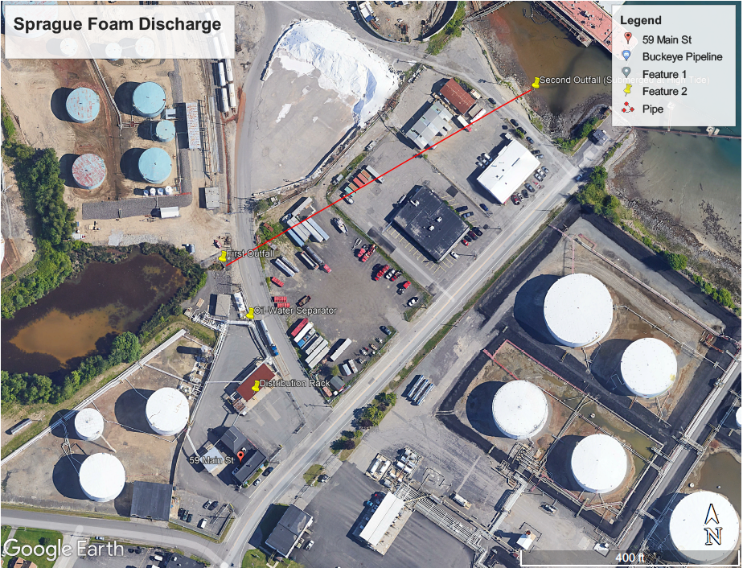
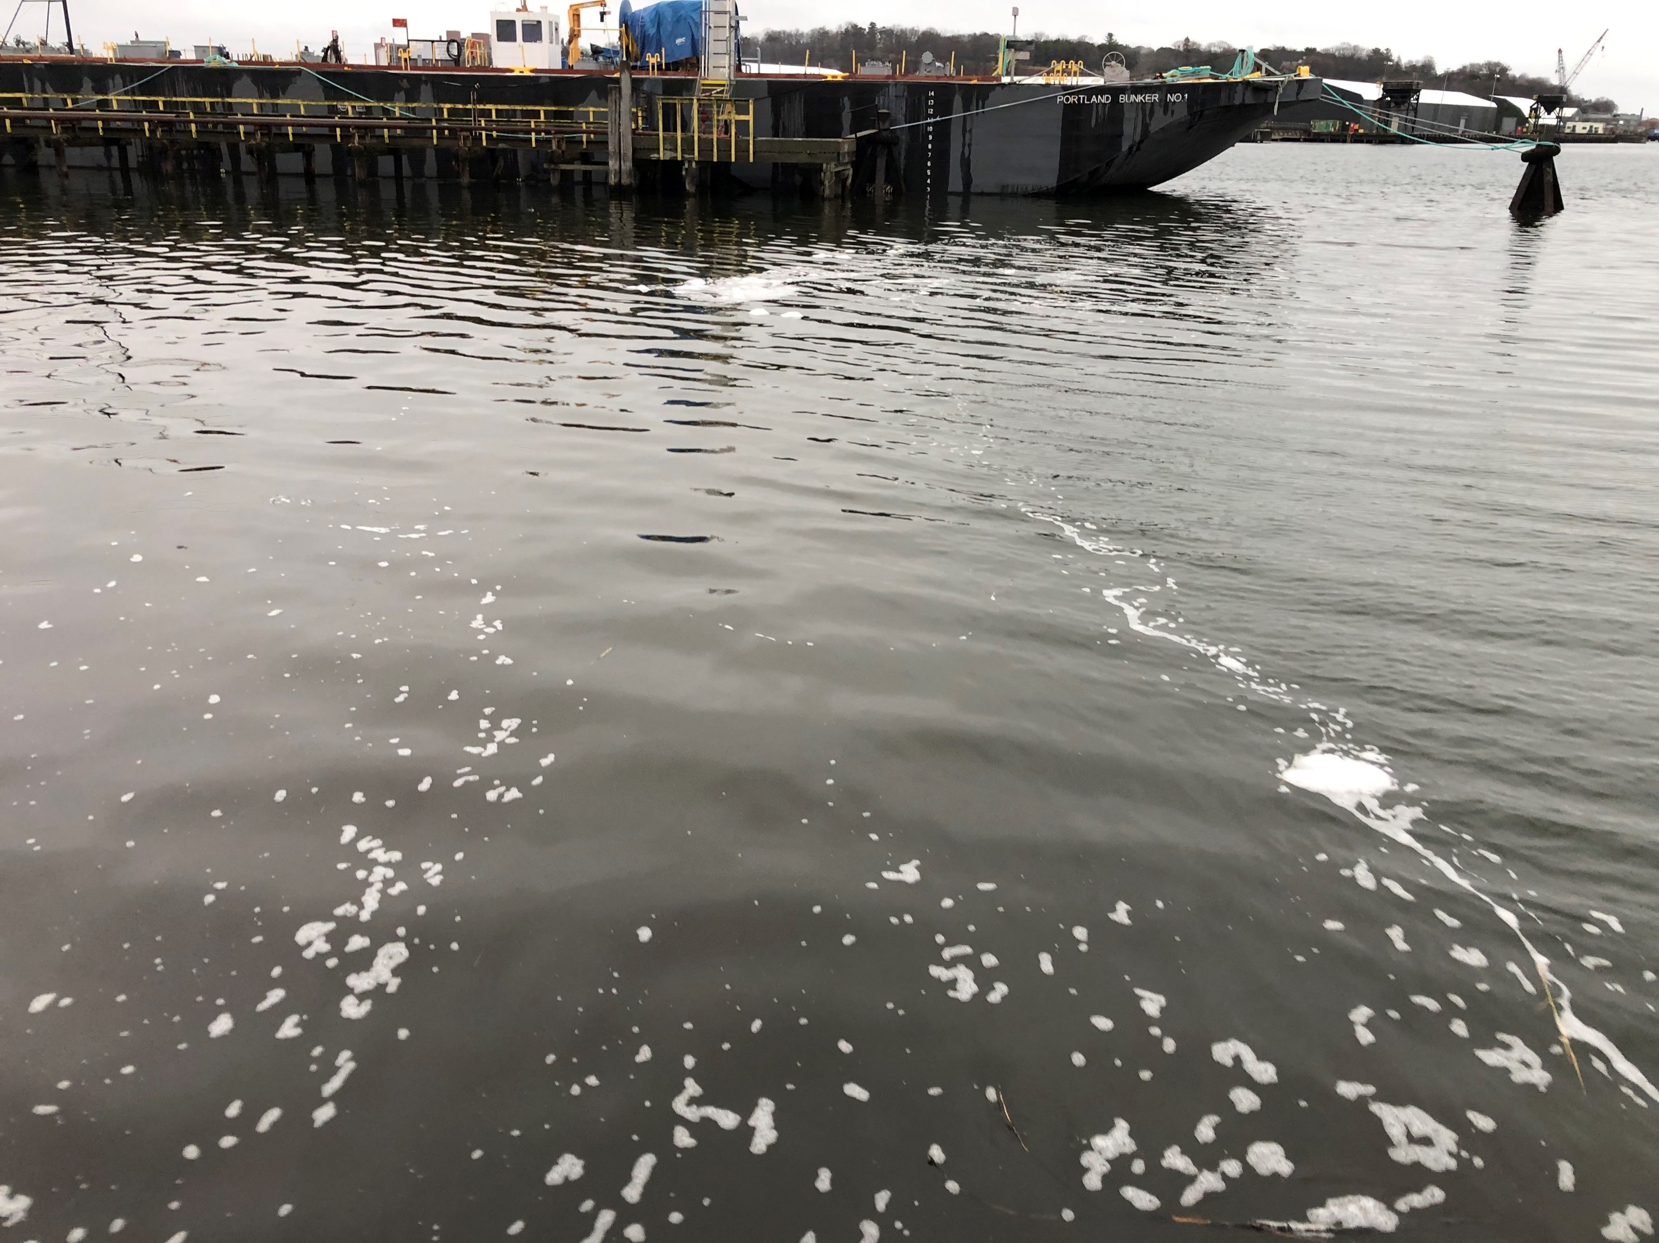
Recent Responses with AFFF discharges to water
Sprague Terminal AFFF discharge to Fore River January 5, 2023
MAINE DEPARTMENT OF ENVIRONMENTAL PROTECTION www.maine.gov/dep
MAINE DEPARTMENT OF ENVIRONMENTAL PROTECTION www.maine.gov/dep

Slide 4
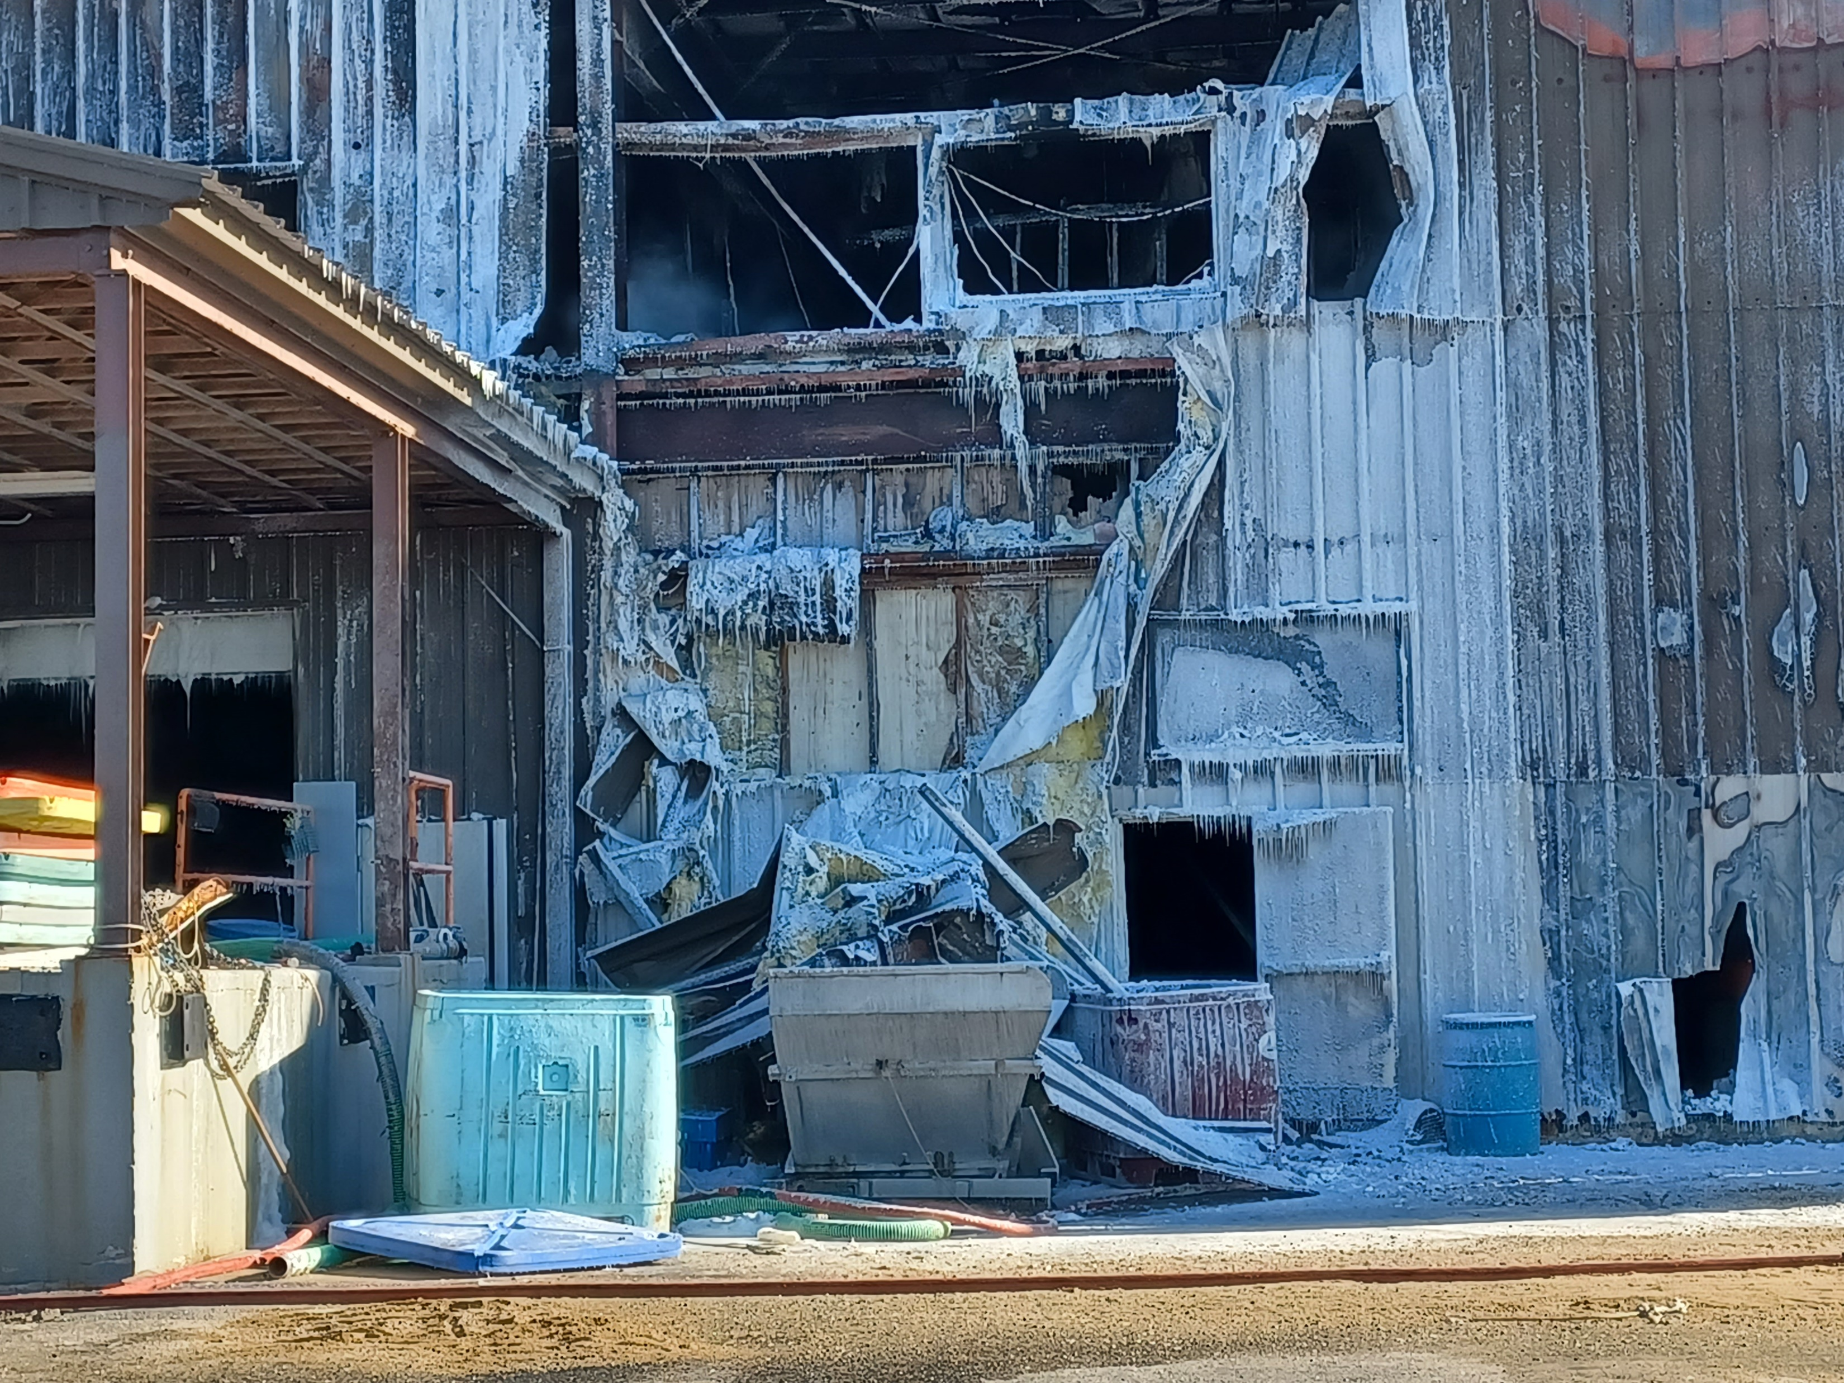
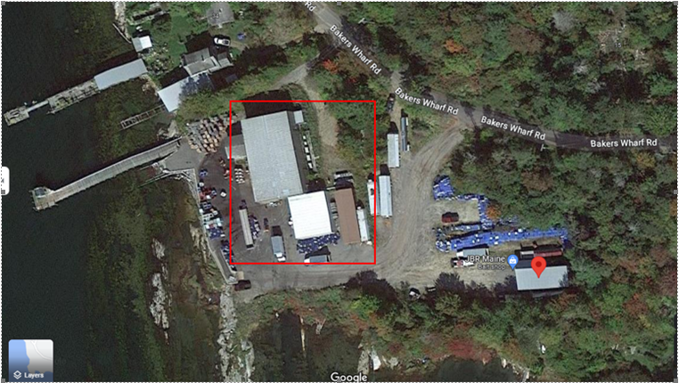
Recent Responses with AFFF discharges to water
Phippsburg Fire Department AFFF discharge to Sebasco Harbor February 3, 2022
MAINE DEPARTMENT OF ENVIRONMENTAL PROTECTION www.maine.gov/dep
MAINE DEPARTMENT OF ENVIRONMENTAL PROTECTION www.maine.gov/dep

Slide 5
38 MRSA §424-C. Perfluoroalkyl and polyfluoroalkyl substances in firefighting or fire-suppressing foam
2. Discharge prohibited. Beginning January 1, 2022, a person may not discharge or cause to be discharged for testing or training purposes a firefighting or fire-suppressing foam to which PFAS have been intentionally added unless the foam is entirely collected by the person for proper disposal.
Nothing in this subsection prohibits a person from discharging or causing to be discharged in an emergency situation to protect life or property a firefighting or fire-suppressing foam to which PFAS have been intentionally added.
[PL 2021, c. 449, §1 (NEW).]
3. Discharge reporting. A person that discharges or causes to be discharged firefighting or fire-suppressing foam to which PFAS have been intentionally added into or upon any coastal waters, estuary, tidal flat, beach or land adjoining the seacoast of the State or into or upon any lake, pond, river, stream, sewer, surface water drainage, groundwater or other waters of the State or any public or private water supply or onto land adjacent to, on or over such waters of the State shall report the discharge to the department as soon as practicable, but no later than 24 hours after the discharge occurs.
MAINE DEPARTMENT OF ENVIRONMENTAL PROTECTION www.maine.gov/dep
MAINE DEPARTMENT OF ENVIRONMENTAL PROTECTION www.maine.gov/dep
Notes:
1. Definitions. As used in this section, unless the context otherwise indicates, the following terms have the following meanings.
A. "Discharge" means a release by any means, including, but not limited to, spilling, leaking, pumping, pouring, spraying, emitting, disposing, escaping, emptying or dumping, whether intentional or unintentional. [PL 2021, c. 449, §1 (NEW).]
B. "Perfluoroalkyl and polyfluoroalkyl substances" or "PFAS" has the same meaning as in Title 32, section 1732, subsection 5‑A. [PL 2021, c. 449, §1 (NEW).]
C. "Person" means a natural person, firm, association, partnership, corporation or trust; the State or any agency of the State; a governmental entity or quasi-governmental entity; the United States or any agency of the United States; or any other legal entity. [PL 2021, c. 449, §1 (NEW).]

Slide 6
AFFF Overview
Class A Foam: Used to extinguish Class A materials, such as wood, paper, and brush (wildland), is widely used by many fire departments for structural firefighting using compressed air foam systems.
Class B Foam (also called AFFF): Used to extinguish Class B materials, which include gasoline, oil, and jet fuel.
What we know and don't know about fluorine-free AFFF
Three main information gaps need to be filled to characterize fluorine-free foams in order to promote them as safer alternatives to fluorinated foams:
  Current performance data is uncertain and/or lacking.
  The makeup of foams is incomplete as many ingredients are protected as confidential business information. Many researchers and those in the firefighting foam industries have raised a concern about whether foams are truly fluorine-free or not.
  The ecotoxicity and impacts on human health of most fluorine-free foams and their ingredients have not been characterized or assessed.
  Maine DEP’s current view is that no AFFF is completely PFAS free
MAINE DEPARTMENT OF ENVIRONMENTAL PROTECTION www.maine.gov/dep
MAINE DEPARTMENT OF ENVIRONMENTAL PROTECTION www.maine.gov/dep

Slide 7
Breakdown of PFAS terms
Per- and polyfluoroalkyl substances (PFAS) are a large family of man-made chemical compounds found in a wide range of consumer products such as nonstick products, polishes, waxes, paints and cleaning products.
Two PFAS compounds: perfluorooctane acid (PFOA) and perfluorooctanesulfonic acid (PFOS), may be present in firefighting aqueous film forming foam (AFFF) solutions.
Human effects: PFAS can accumulate and stay in the human body for long periods of time. Long-term exposure to PFAS/PFOA/PFOS, in high concentrations, causes a buildup in the body. This buildup may have negative health effects like a risk of thyroid disease and several types of cancer.
MAINE DEPARTMENT OF ENVIRONMENTAL PROTECTION www.maine.gov/dep
MAINE DEPARTMENT OF ENVIRONMENTAL PROTECTION www.maine.gov/dep

Slide 8
Tidbits to consider from research on the effects to marine life
Tracing the flow of "forever chemicals" into waterways and wildlife
In Maine, PFAS compounds in surface water and groundwater have reached the sea, and are turning up in marine life
PUBLISHED JANUARY 25, 2023 7:45AM (EST) - By MARINA SCHAUFFLER
Key points:
PFAS is highly mobile and more water soluble than traditional pollutants,
compounds distribute mainly through rivers and groundwater
Bigelow Laboratory for Ocean Sciences in East Boothbay testing blue mussels for 30 different PFAS compounds concluded that PFASs are taken up by quite a lot of marine organisms, bottom-dwelling ones and those in the water column.
MAINE DEPARTMENT OF ENVIRONMENTAL PROTECTION www.maine.gov/dep
MAINE DEPARTMENT OF ENVIRONMENTAL PROTECTION www.maine.gov/dep

Slide 9
Tidbits to consider from research on the effects to marine life (continued)
Organisms at the bottom end of the marine food web, like shellfish and plankton, appear to have lower accumulations, but the species that feed on those organisms have significantly more PFAS
Testing of ribbed muscles have detected PFOS presence near the head of a tidal cove of Casco bay closest to the former Brunswick Naval Air Base where a brook from the former brook empties into the bay. In a 2020 sampling the PFOS levels were higher in the mussels closest to the base than those further out in the bay that were sampled in 2014 & 2016.
A recent analysis done for NOAA's National Centers for Coastal Ocean Science assessed mussels throughout the Gulf of Maine, The study tested for 12 PFASs at 40 sites and found three compounds: PFOA and PFOS, both at less than 3 percent of sample sites, and PFOSA, a less well studied breakdown product, at 40 percent of sites
MAINE DEPARTMENT OF ENVIRONMENTAL PROTECTION www.maine.gov/dep
MAINE DEPARTMENT OF ENVIRONMENTAL PROTECTION www.maine.gov/dep

Slide 10
Tidbits to consider from research on the effects to marine life (continued)
Contamination of Australian Defence Force facilities and other Commonwealth, state and territory sites in Australia May 2003
Toxicity tests are generally conducted on a variety of organisms that represent key links in the food chain. In aquatic environments such tests are conducted on algae, protozoa, crustacea, and fish. The toxicity effects of fire fighting foams to aquatic organisms are usually due to the surfactants they contain, depleting the ability of water to carry oxygen for aquatic organisms (McDonald et al. 1996; Poulton n.d.). Although many of the test organisms, such as aquatic invertebrates, are considered to be of low economical and recreational importance, they are critical to the function of the food chain that supports higher trophic levels such as birds and fish, and eventually humans.
AFFF foams decompose in the environment to a certain extent, however, the surfactants used in AFFF always leave behind a residue of fluorosurfactants (fluorinated carbon chains) (Moody & Field 2000). These fluorosurfactants have been found to persist in soil and in ground water around sites where AFFF has been used on grass or soil surfaces, with the possibility of these substances transporting/leaching to areas surrounding the contaminated sites
MAINE DEPARTMENT OF ENVIRONMENTAL PROTECTION www.maine.gov/dep
MAINE DEPARTMENT OF ENVIRONMENTAL PROTECTION www.maine.gov/dep

Slide 11
QUESTIONS

