Slide 1

Maine Marine Oil Spill Contingency Plan
30th Anniversary and Appendix I Refresh
Jason L. Weigle, Ph.D.
Response Support Specialist
jason.weigle@maine.gov

Slide 2

Legislative History of the Maine Marine Oil Spill Contingency Plan
1985
  Chapter 496, An Act to Amend Certain Provisions of the Oil Discharge Prevention and Pollution Control Act and to Establish a New Act Relating to Underground Oil Storage Facilities, expands previous 1970s UST/LUST and oil response legislation to define importance of and include coastal areas with respect to oil and chemical pollution control and response, establishes the Main Coastal and Inland Surface Oil Clean-up Fund
1989
  March 24 – Exxon Valdez
  Chapter 546, An Act to Amend Certain Laws Affecting the Department of Environmental Protection, expanded the Department’s ability to develop and enforce plans to respond to and address oil and petroleum pollution, updated definitions
  Chapter 868, An Act to Enhance the Ability of the State to Respond to Oil Spills, established the Commission to Study Maine’s Oil Spill Cleanup Preparedness to assess the state’s ability to respond to coastal oil spills
1990 – Oil Pollution Act
1991
  Chapter 454, An Act to Improve Marine Oil Spill Prevention, Planning, and Response, established current framework for marine response and planning
    MRS Title 38, §546-A State Marine Oil Spill Contingency Plan
    MRS Title 38, §546-B Sensitive Area Identification and Protection
    MRS Title 38, §546-C Wildlife Rehabilitation Plan
  Chapter 530, An Act Assuring Clean Waters in Maine, extended the Commission and charged it with 13 tasks to support the implementation of Chapter 454 and OPA 90
  Chapter 698, An Act to Amend the State’s Oil Spill Prevention and Response Provisions, further refined legislative intent and created an Oil Spill Advisory Committee to oversee the implementation of Chapters 454, 530, and 698
  Preliminary plan deadline – December 31, 1991
2015
  Chapter 319, An Act To Stabilize and Streamline the Department of Environmental Protection’s Ground Water Oil Clean-up Fund and Maine Coastal and Inland Surface Oil Clean-up Fund, removed the Oil Spill Advisory Committee from statute, changed language in 1989 and 1991 Chapters

Slide 3
Maine Marine Oil Spill Contingency Plan
Contingency Plan
Appendices
  Equipment and Support Services Directory
  Wildlife Response Plan
  Marine Site Safety Plan (Generic)
  Scenarios
  Gasoline and Ethanol Spill Response
  In-situ Burning: Checklist, Decision Tree, and Memorandum of Understanding
  Dispersant Preauthorization Plan (DRAFT)
  Comment Response and Change Log (added 2022)
Components updated on (somewhat) regular basis

Slide 4
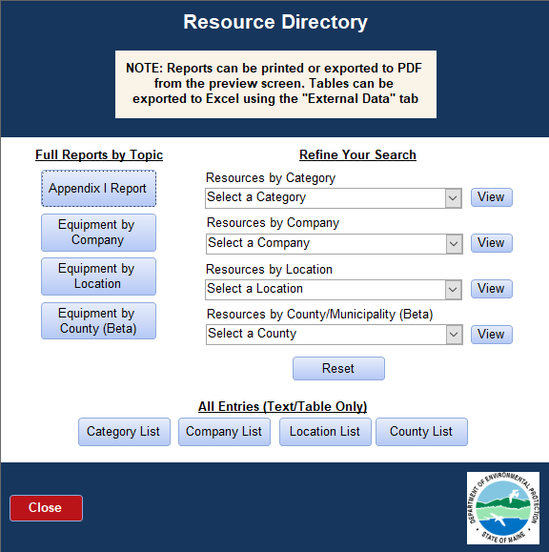
2022 Appendix I Refresh
Commission’s Nov 1990 and Nov 1991 reports laid groundwork for Appendix I
Last significant update – 2009 (software)
Line by line review of categories and equipment
Rebuilt categories, reports, and MS Access Database
Created list of future refinements; potential online and app alternatives

Slide 5
2022 Category Updates
Old Categories
New Category(ies)
Boats, Support
Sorbents
Wildlife Rehabilitation
Boats, Less than 16ft
Boats, 16ft to 35ft
Boats, Greater than 35ft
Sorbents, Adsorbents
Sorbents, Booms
Sorbents, Other (e.g. loose dry)
Sorbents, Pads
Wildlife Response

Slide 6
“The 30th Anniversary Refresh” or A Lot Has Changed in 30 Years
Much of the logic underlying the directory contents has been lost
Building Clarity for the Future
  Comprehensiveness & criteria for inclusion
  All of Maine vs. Coastal Maine vs. Maine/NH region
  Audience
  Consistency
Leveraging Technology
  Cellular and high-speed internet
  Analog vs. Digital vs. Hybrid
  “Google it”
Internal working group and external advisory team
Documentation of decision points and public input

Slide 7
ME GRS/Historic Site Conflict Avoidance Project
Cooperative Effort of Maine DEP and the Maine Historic Preservation Commission

Slide 8
Project Background
GRS/archaeological conflict was identified during the PenBay exercise
Engaged MHPC in a proactive effort to look at conflicts and how we might avoid them
Goals
  Identify “map-based” vs. “field-based” conflicts
  Identify data gaps, need for refined map products, and need for field investigations
  Identify opportunities for GRS changes or institutional controls to help protect historic resources as much as practicable while maintaining safety and effectiveness
  Do this outside of an exercise or spill event
  Document decisions

Slide 9
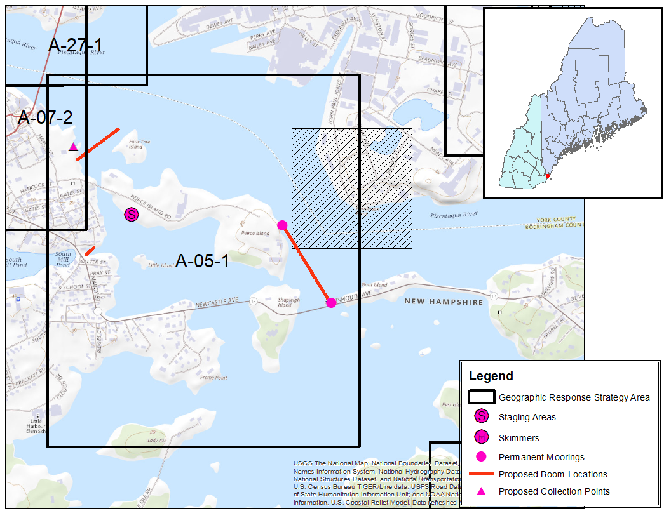
A-05-1 Prescott Park, Peirce
Is., Goat Is., So. Mill Pond
Portsmouth, NH
https://www.maine.gov/dep/spills/emergspillresp/grp_web/regiona-documents/A-05-1.pdf
SITENUMBER | NATLREGS | sitetype
ME 226-227 |  | domestic
Potential Conflict(s):
Likely none?

Slide 10
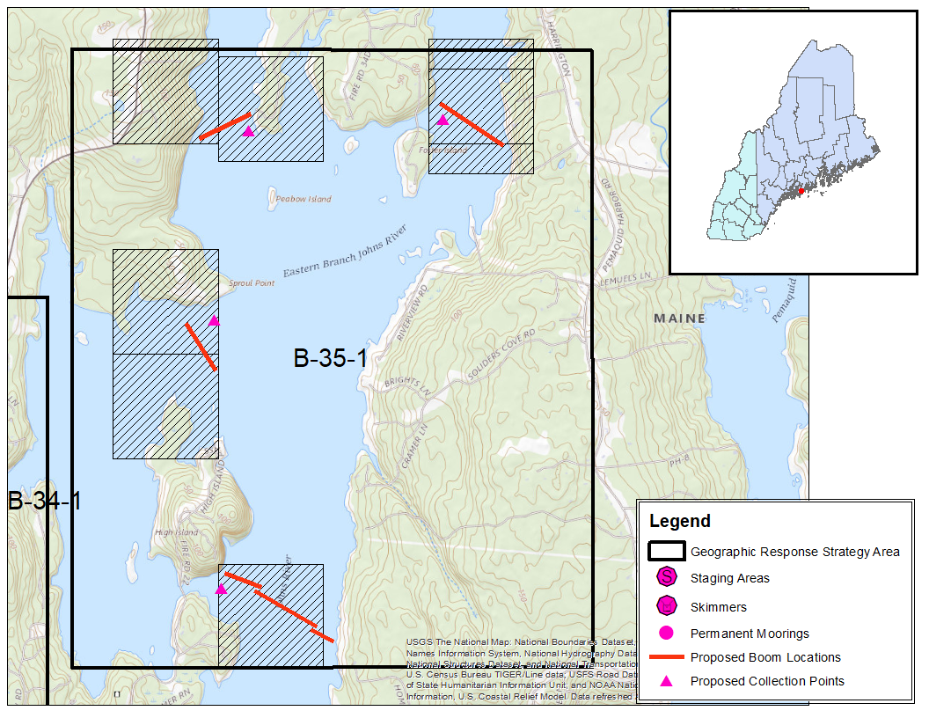
016.156-
016.157-
016.158-
B-35-1 South Bristol / Bristol
https://www.maine.gov/dep/spills/emergspillresp/grp_web/regionb-documents/B-35-1.pdf
016.078-
016.155-
016.095-
016.006-
016.091-
016.205-
016.206-
SITENUMBER | NATLREGS | sitetype
016.006- | PL | Native American site
016.078- | NS | Native American site
016.091- | NS | Native American site
016.095- | NS | Native American site
016.113- | NS | Native American site
016.155- | IN | Native American site
016.156- | IN | Native American site
016.157- | NS | Native American site
016.158- | NS | Native American site
016.179- | NS | Native American site
016.205- | IN | Native American site
016.206- | PL | Native American site
016.113-
Potential Conflict(s):
Anchors used on boom
Shoreside connections
Collection points traffic
016.179-

Slide 11
DEP/MHPC Conflict Avoidance Project
181 GRSs in ME and NH
  97 conflicts identified based on MHPC and DEP mapping
  Of these, 58 GRSs were identified as having real conflicts, potential conflicts, or as locations where more field data and/or refined maps are needed
  15 of the 58 have been field tested, rest are ‘paper exercises’
Team currently in early stages of reviewing MHPC information and developing options
  David Cherry – SMRO (GRS Regions A and B)
  Brandon Wright – CMRO (GRS Regions B and C)
  Tiffany LaClair – EMRO (GRS Regions C and D)
Expand to New Hampshire coastal GRSs(?)

Slide 12
Questions?
Jason L. Weigle, Ph.D.
Response Support Specialist
jason.weigle@maine.gov

Slide 13
2022 Appendix I Directory Snapshot
Of the 1023 entries in the directory
  432 entries are from 5 OSROs (42%)
  381 are from 31 government agencies (37%)
  113 are from 12 large construction, salvage, and marine companies (11%)
  97 are from 47 other sources (10%)
  43% of resources are in Augusta, Bangor, Portsmouth, Portland, and South Portland (57% if greater areas around these cities included)*
  15% are located outside of Maine and New Hampshire (11% in Massachusetts, 4% remainder of US and Canada)
*Note: Some companies list their equipment at their base of operations, regardless of where their equipment might be located. If the equipment is at a forward location the presented numbers would be lower. This is an issue to be fixed in the 2023 update.

