Slide 1
SoPo/Po VOC Project Update for BAQ Annual Air Monitoring Planning Meeting
March 2, 2022
Andrew Johnson, Director
Division of Air Quality Assessment
MAINE DEPARTMENT OF ENVIRONMENTAL PROTECTION
Protecting Maine’s Air, Land and Water

Slide 2

Timeline of Significant Events for 2021
Feb. 9: Received SoPo/CAAC Recommended Site Relocations Request
Feb. 24: SoPo/Po Stakeholders Meeting
Mar. 17 / 23: SPCR ends / SPMS begins
Apr. 19: Sent Reply to SoPo City Manager Responding to Site Relocations Request
May – Dec.: Deployment of some RainWise Units at Sites Proposed for Relocation Delayed
MAINE DEPARTMENT OF ENVIRONMENTAL PROTECTION www.maine.gov/dep

Slide 3
Timeline of Significant Events for 2021
(continued)
Spring – Fall: Deployment of the PSP at 6 Different Residential Locations
Spring – Fall: PurpleAir PM Sensors in Use at SPMS (Apr.) & SPCC (Sep.)
Nov. 1: Completed 2nd 12-month period of sampling
Winter: PSP Deployed at Cash Corner Fire Station
Ongoing: Configuration & Testing of GC Analytical System for PAHs
MAINE DEPARTMENT OF ENVIRONMENTAL PROTECTION www.maine.gov/dep

Slide 4
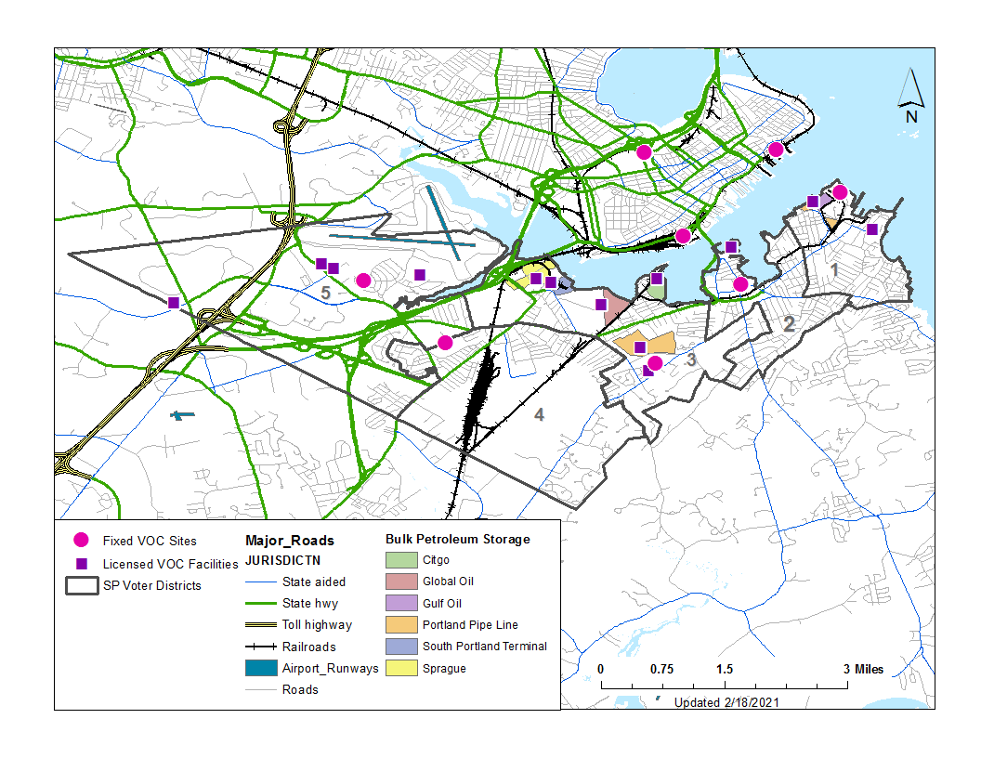
Map of 24-hour Sampling Site Locations

Slide 5
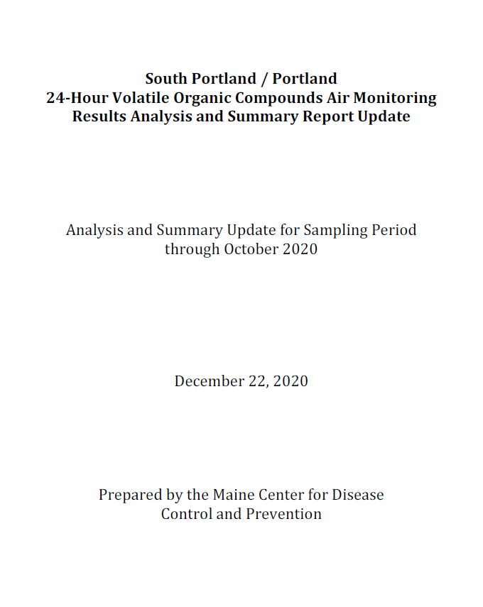
Collaborating with Our Maine CDC Colleagues
January 2021 VOC analytical data was delivered to Maine CDC on February 22, 2021

Slide 6
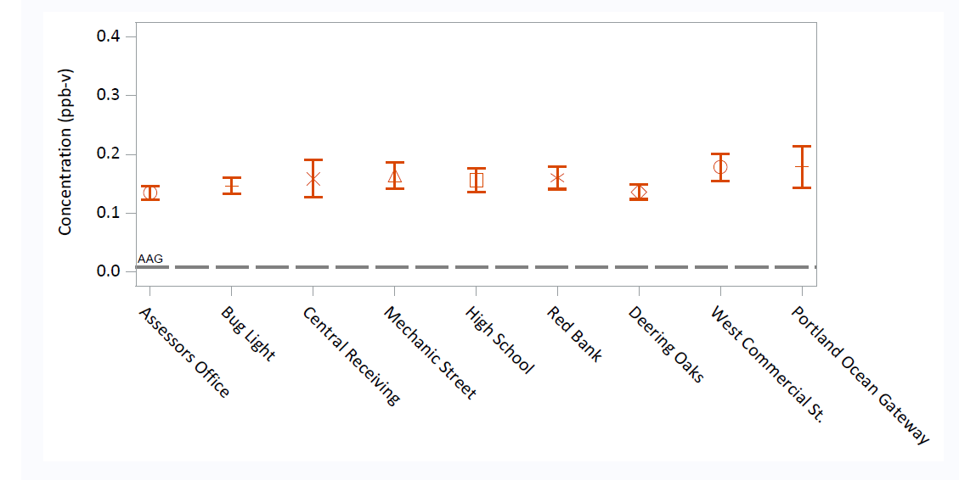
Acrolein - Average 24-hour sampling results with 95% confidence interval by station (Dec 2021)

Slide 7
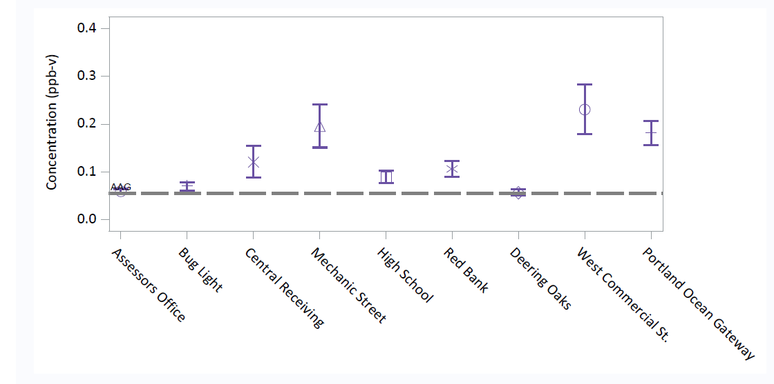
Naphthalene - Average 24-hour sampling results with 95% confidence interval by station (Dec 2021)

Slide 8
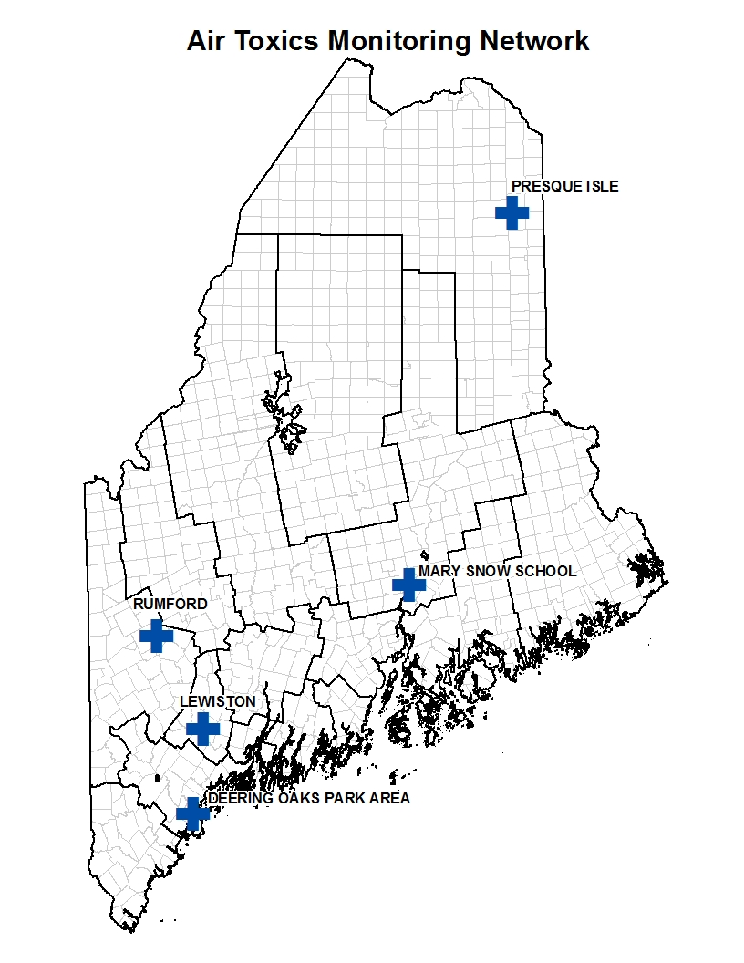
Quantifying the Effort to Date
(as of December 31, 2021)
The 7 new VOC air monitoring sites in South Portland/Portland exceed the number of other VOC sites (5) operating across the State
9 canister sampling systems = ~$20,000
  Includes “portable” and backup/spare systems
48 canisters = ~$31,200
9 meteorological sensors units = ~$18,000
Analytical costs = ~$685,290
Total to date ~$754,490
Stakeholders’ contributions $30,000
In-kind staff time to plan and implement project – “priceless”!

Slide 9
Next Steps: Air Monitoring
Continue to install and operate meteorological sensors units at all 24-hour canister sampling sites
Deploy portable sampling system to confirm “interesting” results and/or locations (i.e. “hot spots”), and explore other project objectives as needed
Consider and respond to SoPo’s proposed changes to some fixed sites
Explore other pollutant categories to measure (e.g. hydrogen sulfides, particulate matter, PAHs)
Re-establish canister sampling at Two Lights State Park
Continue to share findings and provide periodic updates and reports to the City, and upon request.
Continue to do further assessments of all sample data and work with Maine CDC on interpreting findings
Apply for future federal air toxics monitoring grant funding
Pursue further collaboration with Colby College Chemistry Department

Slide 10
Next Steps: DEP-BAQ
Continue monitoring local air quality in South Portland and Portland to assess impact of odor controls on ambient air quality
Propose revisions to Department’s Chapter 111 Petroleum Liquid Storage Vapor Control rule to require monthly leak detection and repair using FLIR camera.
Propose revisions to Department’s Chapter 112 Bulk Terminal Petroleum Liquid Transfer Requirements rule to prohibit switch loading
Evaluate effectiveness of mist eliminators and carbon adsorption odor control equipment in reducing VOC emissions. If technology is proven effective, require as Best Practical Treatment to control VOC emissions from heated petroleum storage tanks.
Investigate elevated levels of acrolein and naphthalene at other sites in Maine, including Presque Isle
Implement other terminal initiatives through the air licensing process

Slide 11
Andrew Johnson
Andy.Johnson@maine.gov
(207) 480-0906

