Slide 1
NADP & Aeroallergens Updates for BAQ Annual Air Monitoring Planning Meeting
March 2, 2022
Andrew Johnson, Director
Division of Air Quality Assessment
MAINE DEPARTMENT OF ENVIRONMENTAL PROTECTION
Protecting Maine’s Air, Land and Water

Slide 2
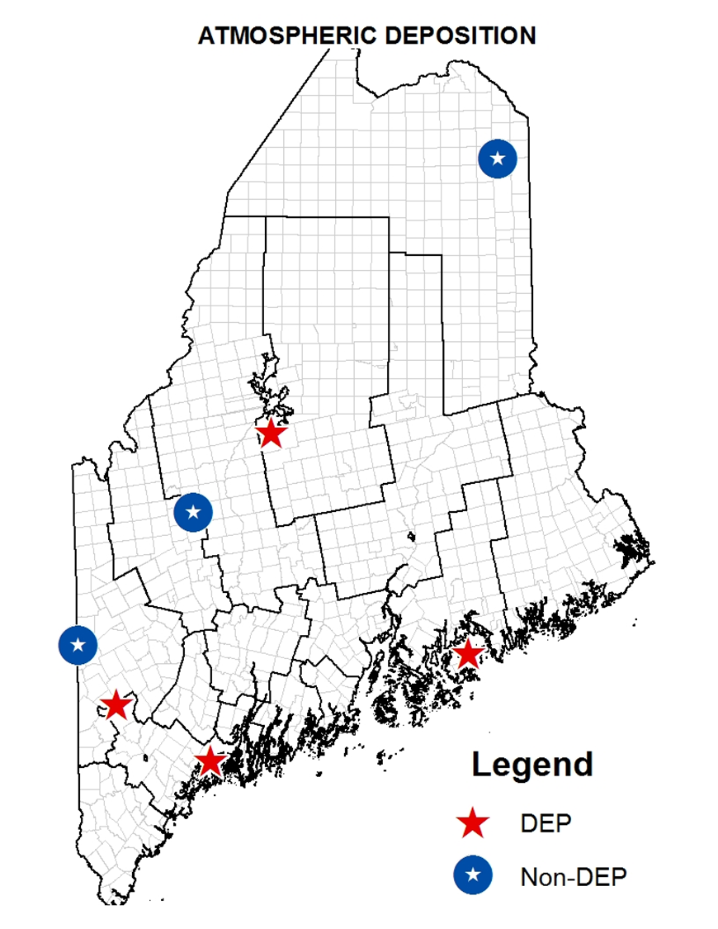

National Atmospheric Deposition Network
(NADP)
6 Mercury Deposition Network (MDN) Sites - elemental Hg
Caribou ME00 – 2007
Bridgton ME02 – 1997
Carrabassett Valley ME04 – 2009
Greenville ME09* - 1996
Freeport ME96 – 1998
Bar Harbor ME98 – 1996
$ 52,118
8 National Trends Network (NTN) Sites - (precipitation chemistry)
Caribou ME00 – 1980
Bridgton ME02 – 1980
Carrabassett Valley ME04 – 2002
Gilead ME08 – 1999
Greenville ME09* - 1979
Indian Township ME94 – 2013
Freeport ME96 – 1998
Bar Harbor ME98 – 1981
$ 21,784
* Collectors relocated to airport location
1 Ammonia Monitoring Network (AMoN) Site - ammonia
Ashland ME93 – 2015
FFY21 $73,902
MAINE DEPARTMENT OF ENVIRONMENTAL PROTECTION www.maine.gov/dep

Slide 3
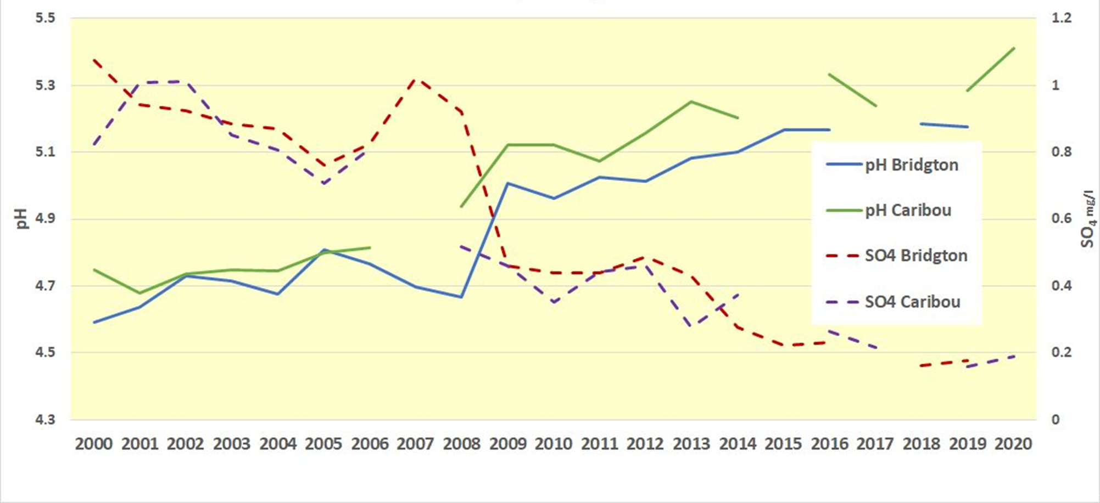
Average Annual pH/SO₄ Trends in Northern & Southern Maine
MAINE DEPARTMENT OF ENVIRONMENTAL PROTECTION www.maine.gov/dep

Slide 4
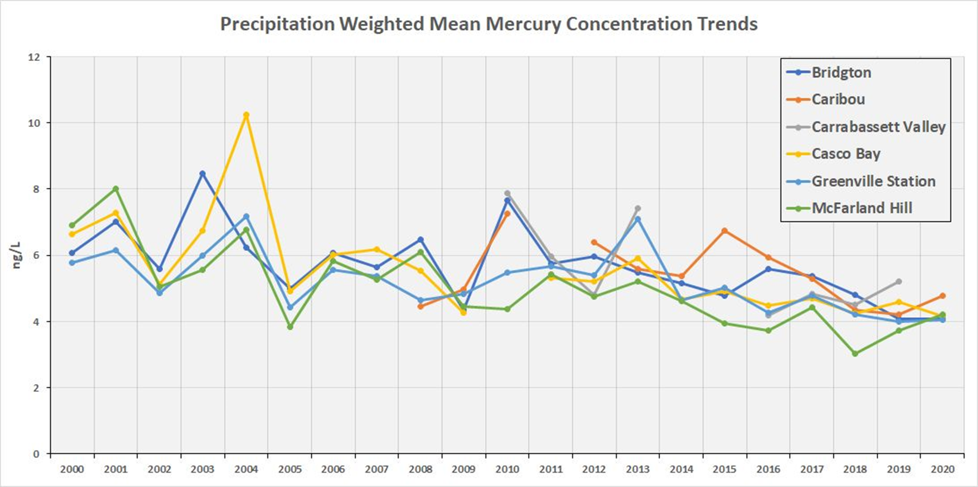
Precipitation-Weighted Mean Mercury Concentration Trends
MAINE DEPARTMENT OF ENVIRONMENTAL PROTECTION www.maine.gov/dep

Slide 5
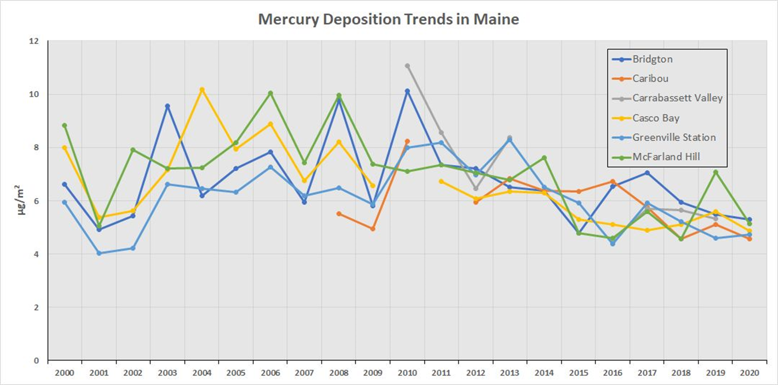
Mercury Deposition Trends
MAINE DEPARTMENT OF ENVIRONMENTAL PROTECTION www.maine.gov/dep

Slide 6
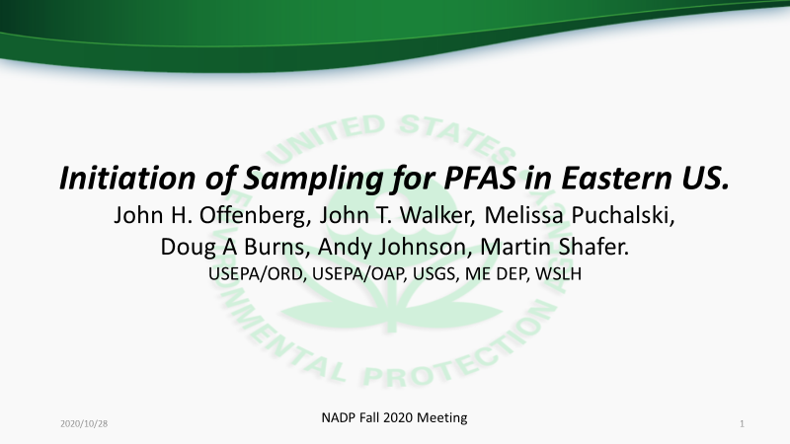
PFAS in Wet Deposition Study in the Eastern US
MAINE DEPARTMENT OF ENVIRONMENTAL PROTECTION www.maine.gov/dep

Slide 7
PFAS Air Research Needs
How important are ‘Air Pathways’ in PFAS Contamination?
  Does such importance vary with Exposure Pathway?
Can sources be reduced, or eliminated, to decrease the impact of air pathways?
Can we measure: source emissions, ambient distributions, chemical transformations, phase transfers, transport, deposition, & relative roles of each? Can we understand & quantify how well we measure each?
Can we model: (CTM) that which is observed? Can we predict environmental behavior that agrees with observations? Can we quantify how well we model?

Slide 8
PFAS Wet Deposition – Ongoing planning/coordination
Collection at existing NADP sites
  Coordination w/ Site Sponsors & Site Operators
  Limit impact on existing NAPD NTN sample protocols
    Coordination with NADP Central Analytical Lab
    Addition: PFAS bucket rinse (MeOH) & in-laboratory processing
Chemical Analysis by WSLH after NTN processing
  Modified ISO non-potable water Method by WSLH
    39 PFAS compounds by LC/MS
    No neutral PFAS compounds (e.g. FTOHs by GC)
    No mono-chloro-polyfluoro-polyether carboxylates
        (Washington et al. 2020, Science)
    Developing future interest in adding Non-Targeted Analysis (NTA),
        dependent on analyst & instrument availability

Slide 9
PFAS Wet Deposition – Outline of Plans
Casco Bay-Wolf’s Neck Farm, Freeport, ME (ME96)
    2 years of wet deposition for targeted PFAS
      Site Sponsor: ME DEP
Whiteface Mountain, NY (NY98)
    2 years of wet deposition for targeted PFAS
      Site Sponsor: USGS sponsors
Washington’s Crossing, NJ (NJ99)
    2 years of wet deposition for targeted PFAS
      Site Sponsor EPA/OAP/CAMD
Duke Forest, NC (NC30)
    3 years of wet deposition - single sampler - for targeted PFAS
    Including, 1 year of co-located PFAS wet deposition
        Triplicate samplers (both NTN & PFAS analysis)
    Plus, 1 year of PFAS throughfall under hardwood & pine canopies.

Slide 10
PFAS Wet Deposition – Sampling Started September 2020
Targeted PFAS
2 yrs @ 4 sites
ME-96
NY-98
NJ-99
NC-30 - more detail
Working towards collaboration with other state efforts.

Slide 11
Aeroallergens:
Timeline of Significant Events - 1
Pollen Summit meetings hosted by CSTE & CDC: 2015 – 2019
CSTE Position Paper approved & released: 2016
Aeroallergen Monitoring Science Committee (AMSC) approved by NADP Executive Committee (EC), provisionally for 1 year: 2016
AMSC approved for full 4 years by NADP EC: 2017
Maine Climate Council report calls for pollen monitoring in all 16 Maine counties: 2020
AMSC designed & implemented a pollen monitoring methods comparison study: 2020-21
AMSC approved for another 4 years by NADP EC: 2021
MAINE DEPARTMENT OF ENVIRONMENTAL PROTECTION www.maine.gov/dep

Slide 12
Aeroallergens:
Timeline of Significant Events - 2
Maine CDC is successful in getting $9,830 in funding for pollen monitoring activities in their BRACE* Climate & Health grant: 2021
Building Resilience Against Climate Effects
Planning underway with Maine CDC to convene a series of meetings of a stakeholders group: 2022
Presentation to WSLH Board on aeroallergens: March 15, 2022
MAINE DEPARTMENT OF ENVIRONMENTAL PROTECTION www.maine.gov/dep

Slide 13
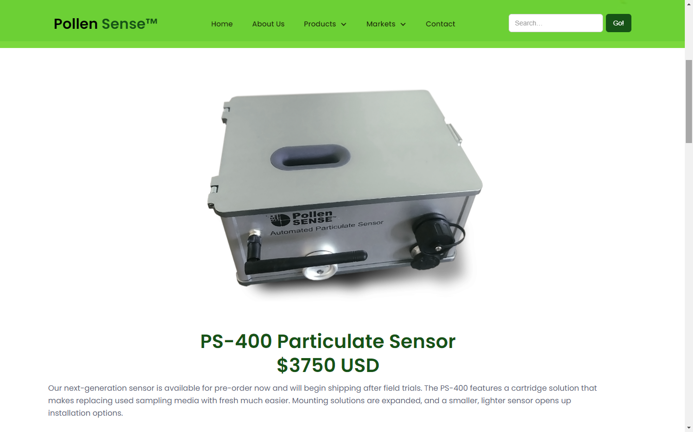
Pollen Sense Sensor
MAINE DEPARTMENT OF ENVIRONMENTAL PROTECTION www.maine.gov/dep

Slide 14
Andrew Johnson
Andy.Johnson@maine.gov
(207) 480-0906

